Slide 1
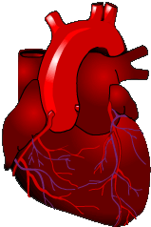
Rhythm & 12 Lead ECG Review
DONE BY: Safaa Hammad

Slide 2
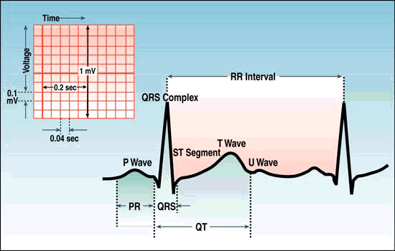
Components of the Rhythm Strip
ECG Paper
Wave forms
Wave complexes
Wave segments
Wave intervals

Slide 3
POSITIONING CHEST ELECTRODES
V₁: Fourth intercostal space at the right border of the sternum
V₂: Fourth intercostal space at the left border of the sternum
V₃: Halfway between V₂ and V₄
V₄: Fifth intercostal space at the left midclavicular line
V₅: In the horizontal plane of V₄ at the left anterior axillary line (or halfway between V₄ and V₆, if the anterior axillary line is ambiguous)
V₆: In the horizontal plane of V₄ at the left midaxillary line

Slide 4
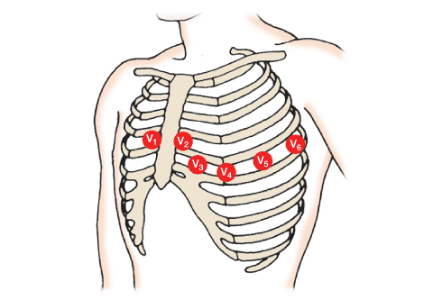
Make sure to “feel” for intercostal space – don’t just use your eyes

Slide 5
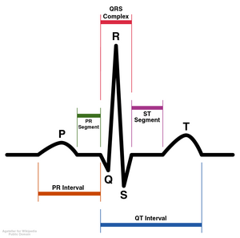
Wave Forms, Complexes, Segments & Intervals
P wave – atrial depolarization
QRS – Ventricular depolarization
T wave – Ventricular repolarization
Notes:
Depolarization does not guarantee that a contraction occurred. Contractions must be evaluated by feeling for a pulse and measuring the blood pressure. Depolarization is an electrical response and contractions are a mechanical response.

Slide 6
Intervals and Complexes
PR interval :-
- Includes atrial depolarization & delay in the AV node (PR segment)
QRS complex
  Corresponds to the patient’s palpated pulse
  Large in size due to reflection of ventricular activity

Slide 7
The Electrical Conduction System
AV Node
Bundle of HIS
Left Bundle Branch
SA Node
Right Bundle Branch
Purkinje Fibers
Notes:
SA node is heart’s dominant pacemaker site with an inherent rate of 60-100 beats per minute. As you move down the conduction system, the pacemaker site becomes slower and is less reliable.
Inherent rates:
SA node 60-100
AV node 40-60
Ventricles 20-40

Slide 8
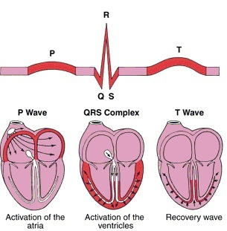
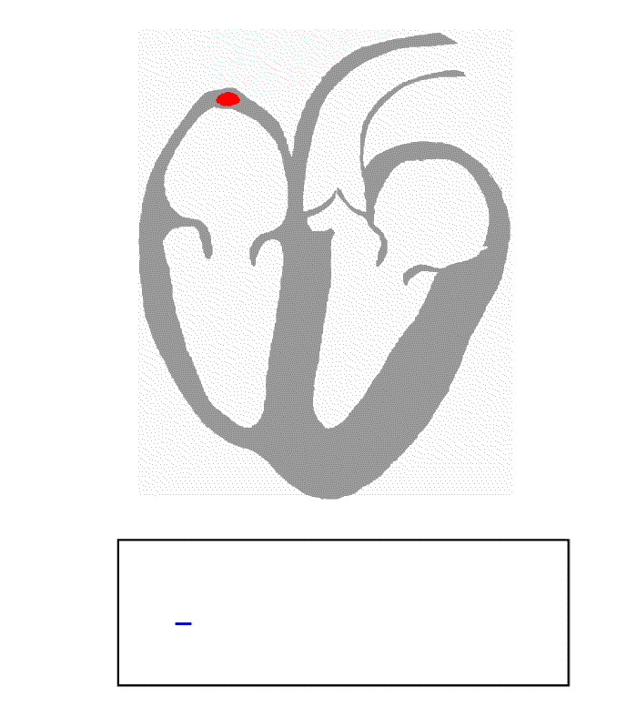
Correlation of ECG Wave Forms

Slide 9
Sinus Rhythms
Originate in the SA node
  Normal sinus rhythm (NSR)
  Sinus bradycardia (SB)
  Sinus tachycardia (ST)

Slide 10
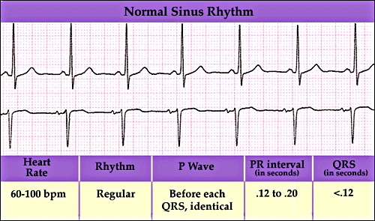
Sinus Rhythm

Slide 11
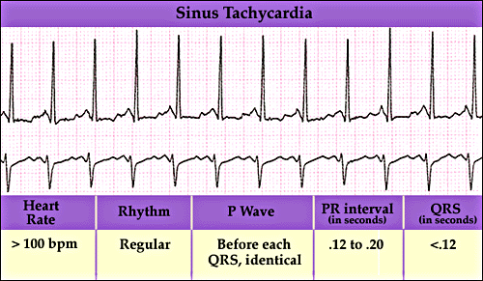
Sinus Tachycardia

Slide 12
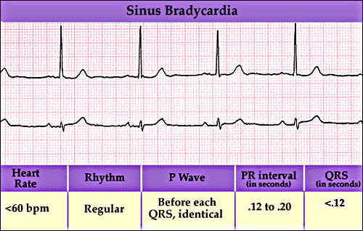
Sinus Bradycardia

Slide 13
Equipment
Bath blanket, sheet or disposable drape
Disposable pregelled electrodes
ECG machine with recording paper and leadwires
Facility-approved disinfectant⁸
Gloves
Optional: alcohol pad, disposable-head hair clippers, gauze pads, indelible marker, single-patient-use scissors, soap and water, washcloths

Slide 14
Verify the order.
Gather and prepare the equipment and supplies.
Perform hand hygiene.
Confirm the patient's identity.
Provide privacy.
Explain the procedure.
Raise the examination table or stretcher to waist level.
Position the patient supine.
Cover the patient, leaving the arms, legs, and chest exposed.
Perform hand hygiene.
Put on gloves as needed.

Slide 15
Select the electrode sites.
If needed, clip hair at the electrode sites.
If needed, wash the electrode sites with soap and water; wipe them with a dry washcloth or gauze pad.
Apply disposable pregelled electrodes to the patient's limbs and chest.
Connect the leadwires to the electrodes.
Ensure that the paper speed is set to the standard 25 mm/second and that the machine is set to full voltage.
If any part of the waveform height extends beyond the paper when you record the ECG tracing, adjust the normal standardization to half-standardization.
Instruct the patient to relax and breathe normally.
Record and observe the ECG tracing.

Slide 16
When finished, remove the electrodes and clean the patient's skin.
Disconnect the leadwires and discard the electrodes as indicated.
Return the examination table or stretcher to the lowest position.
Remove and discard your gloves, if worn.
Perform hand hygiene.
Put on gloves.
Clean and disinfect reusable equipment.
Remove and discard your gloves.
Perform hand hygiene.
Provide the ECG tracing to the ordering practitioner.
Document the procedure.

Slide 17
Special Considerations
Record the ECG tracing with the patient in the same position each time because different positions may cause differences in the tracings. If the patient's condition requires another position, document that position on the tracing and in the patient's medical record

Slide 18
Complications associated with 12-lead ECG may include:
mild rash
skin irritation
allergic reaction to the gel
poor ECG tracing due to artifact caused by shivering, body movement, hiccups, or nearby electrical devices

Slide 19
Documentation
date and time that you obtained the ECG tracing
practitioner who reviewed the tracing
patient's response to the procedure
data noted on the ECG tracing (which is placed in the patient's medical record)
  date and time
  patient's name and assigned identification number
  appropriate clinical information

