Slide 1
Mechanical Ventilation

Slide 2
Mechanical Ventilation is ventilation of the lungs by artificial means usually by a ventilator.
A ventilator delivers gas to the lungs with either negative or positive pressure.

Slide 3
Purposes:
To maintain or improve ventilation, & tissue oxygenation.
To decrease the work of breathing & improve patient’s comfort.

Slide 4
Indications:
1- Acute respiratory failure due to:
Mechanical failure, includes neuromuscular diseases as Myasthenia Gravis, Guillain-Barré Syndrome, and Poliomyelitis (failure of the normal respiratory neuromuscular system)
Musculoskeletal abnormalities, such as chest wall trauma (flail chest)
Infectious diseases of the lung such as pneumonia, tuberculosis.

Slide 5
2- Abnormalities of pulmonary gas exchange
as in:
Obstructive lung disease in the form of asthma, chronic bronchitis or emphysema.
Conditions such as pulmonary edema, atelectasis, pulmonary fibrosis.
Patients who has received general anesthesia as well as post cardiac arrest patients often require ventilatory support until they have recovered from the effects of the anesthesia or the insult of an arrest.

Slide 6
Criteria for institution of ventilatory support:
Normal range | Ventilation indicated | Parameters
10-20 5-7 65-75 75-100 | > 35 < 5 < 15 <-20 | A- Pulmonary function studies: Respiratory rate (breaths/min). Tidal volume (ml/kg body wt) Vital capacity (ml/kg body wt) Maximum Inspiratory Force (cm HO₂)

Slide 7
Criteria for institution of ventilatory support:
Normal range | Ventilation indicated | Parameters
7.35-7.45 75-100 35-45 | < 7.25 < 60 > 50 | B- Arterial blood Gases PH PaO₂ (mmHg) PaCO₂ (mmHg)

Slide 8
Types of Mechanical ventilators:
Negative-pressure ventilators
Positive-pressure ventilators.

Slide 9
Negative-Pressure Ventilators
Early negative-pressure ventilators were known as “iron lungs.”
The patient’s body was encased in an iron cylinder and negative pressure was generated .
The iron lung are still occasionally used today.

Slide 10
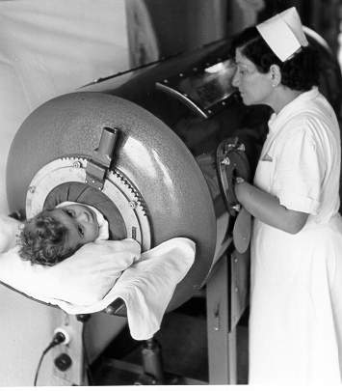

Slide 11
Positive-pressure ventilators
Positive-pressure ventilators deliver gas to the patient under positive-pressure, during the inspiratory phase.

Slide 12
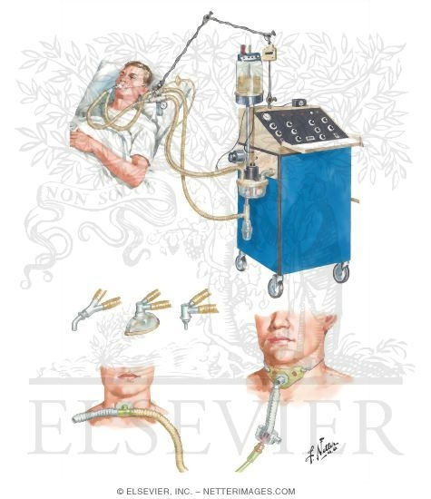

Slide 13
Types of Positive-Pressure Ventilators
1- Volume Ventilators.
2- Pressure Ventilators

Slide 14
1- Volume Ventilators
The volume ventilator is commonly used in critical care settings.
The basic principle of this ventilator is that a designated volume of air is delivered with each breath.
The amount of pressure required to deliver the set volume depends on :-
- Patient’s lung compliance
- Patient–ventilator resistance factors.

Slide 15
Therefore, peak inspiratory pressure (PIP ) must be monitored in volume modes because it varies from breath to breath.
With this mode of ventilation, a respiratory rate, inspiratory time, and tidal volume are selected for the mechanical breaths.

Slide 16
2- Pressure Ventilators
The use of pressure ventilators is increasing in critical care units.
A typical pressure mode delivers a selected gas pressure to the patient early in inspiration, and sustains the pressure throughout the inspiratory phase.
By meeting the patient’s inspiratory flow demand throughout inspiration, patient effort is reduced and comfort increased.

Slide 17
Although pressure is consistent with these modes, volume is not.
Volume will change with changes in resistance or compliance,
Therefore, exhaled tidal volume is the variable to monitor closely.
With pressure modes, the pressure level to be delivered is selected, and with some mode options (i.e., pressure controlled [PC], described later), rate and inspiratory time are preset as well.

Slide 18
Ventilator mode
The way the machine ventilates the patient
How much the patient will participate in his own ventilatory pattern.
Each mode is different in determining how much work of breathing the patient has to do.

Slide 19
Modes of Mechanical Ventilation
A- Volume Modes
B- Pressure Modes

Slide 20
A- Volume Modes
1- Assist-control (A/C)
2- Synchronized intermittent
mandatory ventilation (SIMV)

Slide 21
1- Assist Control Mode A/C
The ventilator provides the patient with a pre-set tidal volume at a pre-set rate .
The patient may initiate a breath on his own, but the ventilator assists by delivering a specified tidal volume to the patient. Client can initiate breaths that are delivered at the preset tidal volume.
Client can breathe at a higher rate than the preset number of breaths/minute

Slide 22
The total respiratory rate is determined by the number of spontaneous inspiration initiated by the patient plus the number of breaths set on the ventilator.
In A/C mode, a mandatory (or “control”) rate is selected.
If the patient wishes to breathe faster, he or she can trigger the ventilator and receive a full-volume breath.

Slide 23
Often used as initial mode of ventilation
When the patient is too weak to perform the work of breathing (e.g., when emerging from anesthesia).
Disadvantages:
Hyperventilation,

Slide 24
2- Synchronized Intermittent
Mandatory Ventilation (SIMV)
The ventilator provides the patient with a pre-set number of breaths/minute at a specified tidal volume and FiO₂.
In between the ventilator-delivered breaths, the patient is able to breathe spontaneously at his own tidal volume and rate with no assistance from the ventilator.
However, unlike the A/C mode, any breaths taken above the set rate are spontaneous breaths taken through the ventilator circuit.

Slide 25
The tidal volume of these breaths can vary drastically from the tidal volume set on the ventilator, because the tidal volume is determined by the patient’s spontaneous effort.
Adding pressure support during spontaneous breaths can minimize the risk of increased work of breathing.
Ventilators breaths are synchronized with the patient spontaneous breathe.
( no fighting)

Slide 26
Used to wean the patient from the mechanical ventilator.
Weaning is accomplished by gradually lowering the set rate and allowing the patient to assume more work

Slide 27
B- Pressure Modes
1- Pressure-controlled ventilation (PCV)
2- Pressure-support ventilation (PSV)
3- Continuous positive airway pressure
(CPAP)
4- Positive end expiratory pressure (PEEP)
5- Noninvasive bilevel positive airway pressure ventilation (BiPAP)

Slide 28
3- Continuous Positive Airway
Pressure (CPAP)
Constant positive airway pressure during spontaneous breathing
CPAP allows the nurse to observe the ability of the patient to breathe spontaneously while still on the ventilator.
CPAP can be used for intubated and nonintubated patients.
It may be used as a weaning mode and for nocturnal ventilation (nasal or mask CPAP)

Slide 29
4- Positive end expiratory pressure (PEEP)
Positive pressure applied at the end of expiration during mandatory \ ventilator breath
positive end-expiratory pressure with positive-pressure (machine) breaths.

Slide 30
Uses of CPAP & PEEP
Prevent atelactasis or collapse of alveoli
Treat atelactasis or collapse of alveoli
Improve gas exchange & oxygenation
Treat hypoxemia refractory to oxygen therapy.(prevent oxygen toxicity
Treat pulmonary edema ( pressure help expulsion of fluids from alveoli

Slide 31
5- Noninvasive Bilateral Positive
Airway Pressure Ventilation (BiPAP)
BiPAP is a noninvasive form of mechanical ventilation provided by means of a nasal mask or nasal prongs, or a full-face mask.
The system allows the clinician to select two levels of positive-pressure support:
An inspiratory pressure support level (referred to as IPAP)
An expiratory pressure called EPAP (PEEP/CPAP level).

Slide 32
Common Ventilator Settings parameters/ controls
Fraction of inspired oxygen (FIO₂)
Tidal Volume (VT)
Peak Flow/ Flow Rate
Respiratory Rate/ Breath Rate / Frequency ( F)
Minute Volume (VE)
I:E Ratio (Inspiration to Expiration Ratio)
Sigh

Slide 33
● Fraction of inspired oxygen (FIO₂)
The percent of oxygen concentration that the patient is receiving from the ventilator. (Between 21% & 100%)
(room air has 21% oxygen content).
Initially a patient is placed on a high level of FIO₂ (60% or higher).
Subsequent changes in FIO₂ are based on ABGs and the SaO₂.

Slide 34
In adult patients the initial FiO₂ may be set at 100% until arterial blood gases can document adequate oxygenation.
An FiO₂ of 100% for an extended period of time can be dangerous ( oxygen toxicity) but it can protect against hypoxemia
Usually the FIO₂ is adjusted to maintain an SaO₂ of greater than 90% (roughly equivalent to a PaO₂ >60 mm Hg).
Oxygen toxicity is a concern when an FIO₂ of greater than 60% is required for more than 25 hours

Slide 35
Signs and symptoms of oxygen toxicity :-
1- Flushed face
2- Dry cough
3- Dyspnea
4- Chest pain
5- Tightness of chest
6- Sore throat

Slide 36
● Tidal Volume (VT)
The volume of air delivered to a patient during a ventilator breath.
The amount of air inspired and expired with each breath.
Usual volume selected is between 5 to 15 ml/ kg body weight)

Slide 37
In the volume ventilator, Tidal volumes of 10 to 15 mL/kg of body weight were traditionally used.
the large tidal volumes may lead to (volutrauma) aggravate the damage inflicted on the lungs
For this reason, lower tidal volume targets (6 to 8 mL/kg) are now recommended.

Slide 38
● Peak Flow/ Flow Rate
The speed of delivering air per unit of time, and is expressed in liters per minute.
The higher the flow rate, the faster peak airway pressure is reached and the shorter the inspiration;
The lower the flow rate, the longer the inspiration.

Slide 39
● Respiratory Rate/ Breath
Rate / Frequency ( F)
The number of breaths the ventilator will deliver/minute (10-16 b/m).
Total respiratory rate equals patient rate plus ventilator rate.
The nurse double-checks the functioning of the ventilator by observing the patient’s respiratory rate.

Slide 40
● I:E Ratio (Inspiration to
Expiration Ratio):-
The ratio of inspiratory time to expiratory time during a breath
(Usually = 1:2)

Slide 41
Ensuring humidification and thermoregulation
All air delivered by the ventilator passes through the water in the humidifier, where it is warmed and saturated.
Humidifier temperatures should be kept close to body temperature 35 ºC- 37ºC.
In some rare instances (severe hypothermia), the air temperatures can be increased.
The humidifier should be checked for adequate water levels

Slide 42
Ventilator alarms:-
Mechanical ventilators comprise audible and visual alarm systems, which act as immediate warning signals to altered ventilation.
Alarm systems can be categorized according to volume and pressure (high and low).
High-pressure alarms warn of rising pressures.
Low-pressure alarms warn of disconnection of the patient from the ventilator or circuit leaks.

Slide 43
Complications of Mechanical Ventilation:-
I- Airway Complications,
II- Mechanical complications,
III- Physiological Complications,
IV- Artificial Airway Complications.

Slide 44
Nursing care of patients on mechanical ventilation
Assessment:
1- Assess the patient
2- Assess the artificial airway (tracheostomy
or endotracheal tube)
3- Assess the ventilator

Slide 45
Nursing Interventions
1-Maintain airway patency & oxygenation
2- Promote comfort
3- Maintain fluid & electrolytes balance
4- Maintain nutritional state
5- Maintain urinary & bowel elimination
6- Maintain eye , mouth and cleanliness and integrity:-
7- Maintain mobility/ musculoskeletal function:-

Slide 46
Nursing Interventions
8- Maintain safety:-
9- Provide psychological support
10- Facilitate communication
11- Provide psychological support & information to family
12- Responding to ventilator alarms /Troublshooting
ventilator alarms
13- Prevent nosocomial infection
14- Documentation

Slide 47
Good Luck

