Slide 1
Urine culture and intake & output

Slide 2
Intake and output measurement
Monitoring of fluid intake and output is essential in patients who undergo surgery, receive IV therapy or parenteral or enteral feedings, have fluid and electrolyte imbalances, or have nasogastric (NG) tubes connected to drainage
Monitoring is also required in patients with burns, hemorrhage, vomiting, diarrhea, edema, or kidney, liver, or heart disease
Intake and output measurement helps monitor a patient's response to treatment, particularly when a patient is receiving treatment for dehydration or heart failure

Slide 3

Intake and output measurement

Slide 4
Fluid intake
includes oral fluids;
IV fluids,
medications,
blood products,
and flushes; tube feedings and flushes; liquid medications; and other fluid instillations or irrigations, such as bladder irrigations⁴

Slide 5
. Fluid output
includes urine,
liquid stool,
vomitus,
blood, and drainage from tubes (such as chest, nephrostomy, or nasogastric tubes),
ileostomies, suction devices, and wound and surgical drains.¹²³
About 100 mL of fluid or less is lost through the GI tract per day under normal conditions. Fluid is also lost through the skin and lungs, but these losses are considered insensible (unmeasurable).

Slide 6
Intake and output should be measured in milliliters and recorded on a 24-hour intake and output record.¹ Measurement and recording of intake and output can occur hourly or at the end of each shift, depending on the patient's condition and the practitioner's order.

Slide 7
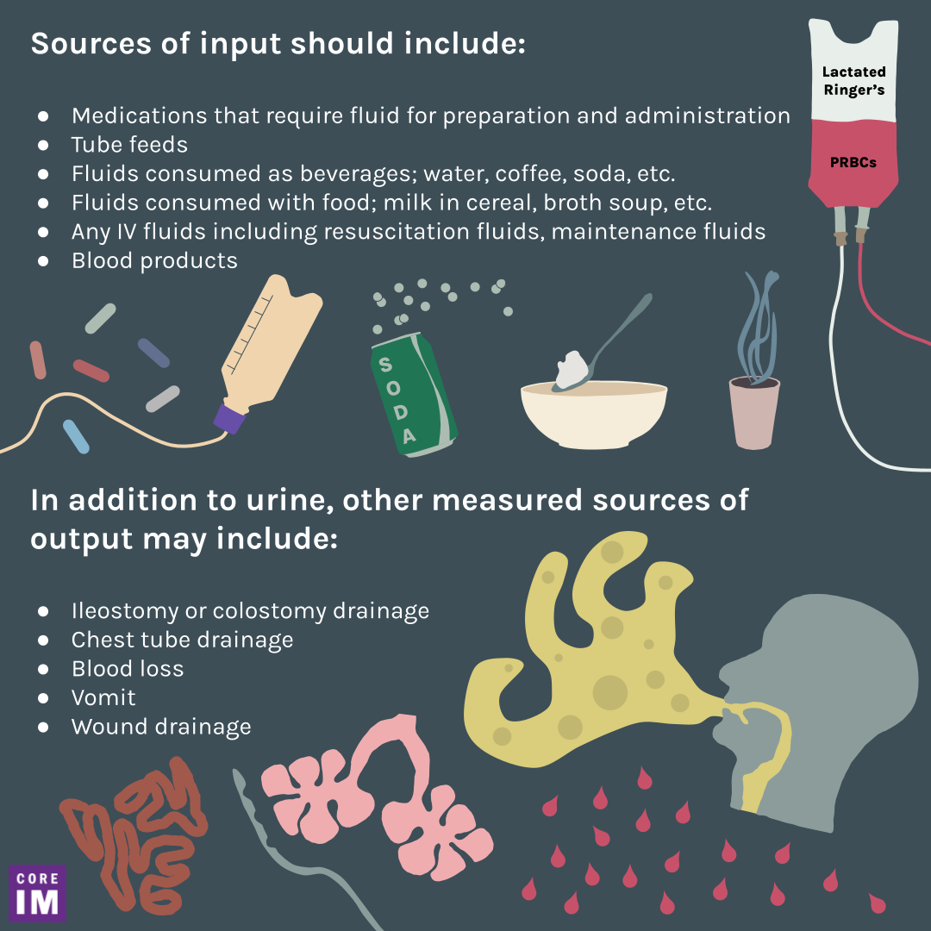

Slide 8
Implementation
Gather and prepare the necessary equipment and supplies.
Perform hand hygiene.
Confirm the patient's identity using at least two patient identifiers.
Provide privacy.
Inform the patient and family (if appropriate) that you'll be measuring the patient's intake and output. Explain the procedure according to their individual communication and learning needs to increase their understanding, allay their fears, and enhance cooperation.
For a nonambulatory patient, provide a urinal, bedpan, or both, as necessary.
For an ambulatory patient, place a urine collection hat under the toilet seat or bedside commode seat to collect urine for measurement.
Provide an emesis basin for a patient with nausea and vomiting. Instruct the patient to notify the nurse of any output so the nurse can measure any vomitus.
Alert the staff of the need to measure and record the patient's intake and output using the process identified in your facility.

Slide 9
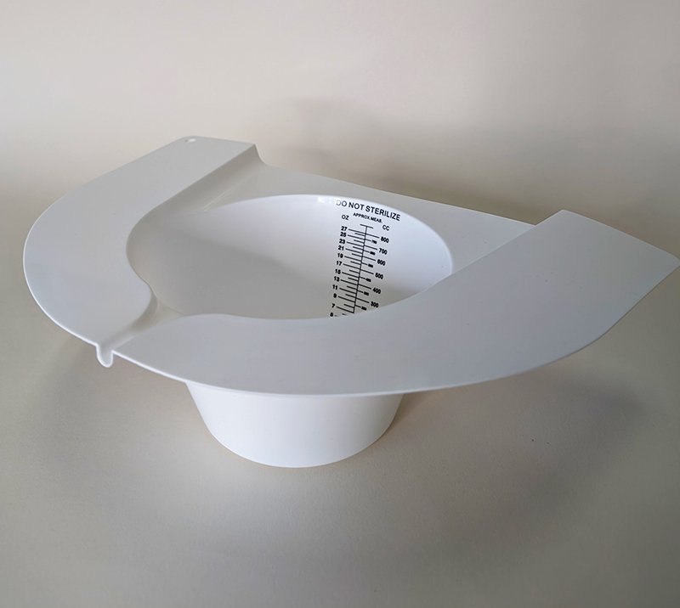
urine collection hat

Slide 10
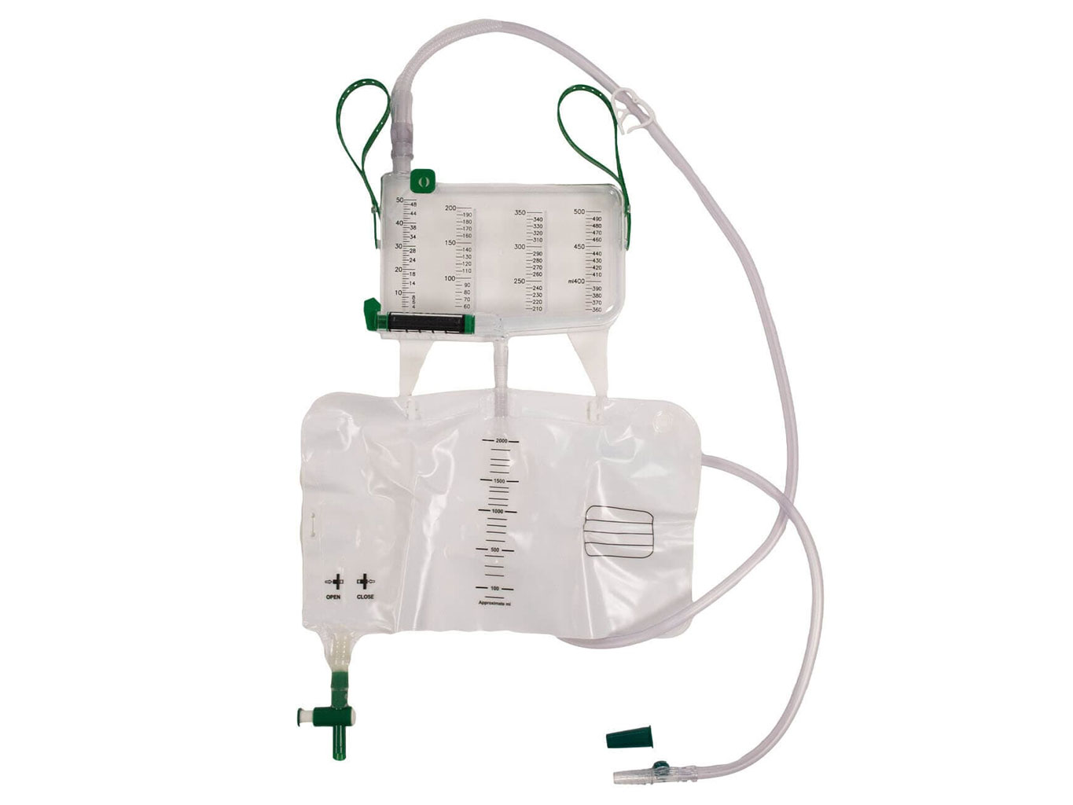
Uri meter

Slide 11
Measuring intake
• Record the type and volume of IV fluid you infused, as appropriate to your role.
• Record the volume of oral fluids ingested. Include food that's a fluid at room temperature, such as sherbet, ice cream, ice chips, and gelatin.
• If the patient requires enteral feedings, record the type and volume of the feedings and flush solution, as appropriate to your role.
• Measure and record the type and volume of instillations and their method of administration, such as bladder and NG tube irrigations, as appropriate to your role.
• Include the volume of medications in fluid or elixir form that are administered orally, as appropriate to your role.
• Measure and record the volume of medication you gave by the IV route, including preservative-free normal saline solution flushes, as appropriate to your role.
• Measure and record the volume of medications you gave through an enteral tube, including flushes, as appropriate to your role.

Slide 12
Measuring output
• Perform hand hygiene.
• Put on gloves and, as needed, other personal protective equipment to comply with standard precautions.
• As you measure output, note its characteristics. Document your findings in the appropriate section of the patient's medical record.
• If the patient uses a bedpan or urine collection hat, pour urine from the device into a graduated measuring container and record the volume in the intake and output record, as appropriate to your role.
• If the patient uses a urinal, measure the volume of urine using the markings on the side of the urinal and record the volume in the intake and output record, as appropriate to your role.
• If the patient has a urinary drainage bag, open the clamp and allow the urine to empty into a calibrated measuring container. A measuring container allows for a more-accurate reading of urinary output than using the markings on the side of the drainage bag. Don't touch the drainage tube to the sides of the container to reduce the risk of introducing microorganisms into the urinary drainage bag.
Close and secure the clamp after draining the urine.
Record the urinary output in the intake and output record, as appropriate to your role.

Slide 13
• Measure and record the volume of liquid stool and vomitus in the intake and output record, as appropriate to your role.
• Empty drains into a calibrated measuring container and record the volume in the appropriate space in the intake and output record, as appropriate to your role. Label each drain, and record the volume from each separately to identify the source of a change in volume. Use a medication cup or syringe for accurate measurement of volumes less than 30 mL.
• For systems that don't get emptied, such as an NG suction container or chest tube drainage system, mark the drainage height on the container, along with the date, the time, and your initials, at the beginning of the shift. Record hourly or shift totals, as indicated, in the appropriate location in the intake and output record, as appropriate to your role.
• Remove and discard your gloves and, if worn, other personal protective equipment.
• Perform hand hygiene.
• Document the procedure

Slide 14
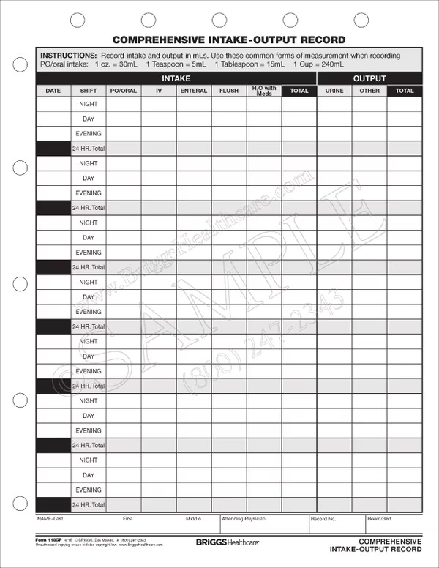

Slide 15

Urine culture
• Evaluates urinary tract infection (UTI), usually bladder infection
• Most commonly used to detect bacterial infections of the upper and lower urinary tract
• May involve a quick urine screen to determine whether urine contains high bacteria or white blood cell (WBC) counts; only urine with bacteria or WBCs is processed for culture
• Preferred method of obtaining a urine specimen is clean-voided midstream collection, rather than suprapubic aspiration or catheterization

Slide 16
Diagnostic Procedure
Key Steps
• Perform hand hygiene.
• Put on gloves.
• Confirm the patient's identity using at least two patient identifiers.
• Collect an early-morning specimen (preferred because bacterial counts are highest during this time).
• Collect a clean-voided urine specimen of 3 to 5 mL of urine into a sterile container. Alternatively, collect a specimen using catheterization or aspiration from a suprapubic or indwelling catheter.
• Record the suspected diagnosis, the collection time and method, current antimicrobial therapy, and fluid- or drug-induced diuresis on the laboratory request form.
• Seal the cup with a sterile lid; label the specimen appropriately, including current use of antimicrobial drugs; and immediately send the specimen to the laboratory.

Slide 17
Urine specimen collection from an indwelling urinary catheter (Foley)
Introduction
Collection of a urine specimen from an indwelling urinary catheter—obtained by aspiration with a syringe—requires maintaining a closed urinary drainage system and using sterile collection technique. Aspiration occurs through a disinfected sampling port to prevent catheter-associated urinary tract infection (CAUTI).

Slide 18
introduction
Processing urine specimens for culture testing should occur as soon as possible, preferably within 2 hours.
If urine specimens can't undergo processing within 30 minutes of collection, they should be refrigerated.
Refrigerated specimens should be cultured within 24 hours.
If adhering to this guideline isn't possible, a culture tube that contains preservative should be used to prevent bacterial growth.

Slide 19
Equipment
• Antiseptic pad
• Gloves
• Laboratory biohazard transport bag
• Specimen label
• Sterile or nonsterile specimen container with lid (depending on the ordered test) or urine collection tube (with preservative)
• Syringe (3- to 30-mL, depending on the volume of urine required for the ordered test) or luer-lock access device
• Optional: ice, laboratory request form

Slide 20
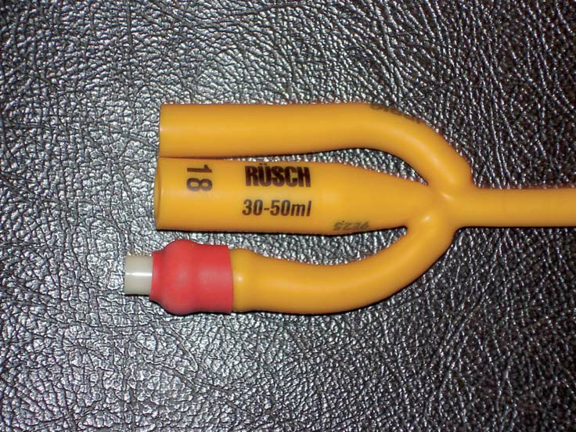

Slide 21
Implementation
• Verify the practitioner's order.
• Gather and prepare the necessary equipment and supplies.
• Perform hand hygiene.
• Confirm the patient's identity using at least two patient identifiers
• Provide privacy.
• Explain the procedure to the patient and family (if appropriate) according to their individual communication and learning needs to increase their understanding, allay their fears, and enhance cooperation.
• Perform hand hygiene.
• Put on gloves to comply with standard precautions.
• Drain urine from the drainage tube into a collection bag.
• Disinfect the sampling port with an antiseptic pad and then allow it to dry.

Slide 22
For collection using a syringe
• Attach the syringe to the sampling port.
• When fresh urine appears in the tubing, aspirate the specimen into the syringe.
• Remove the syringe from the sampling port.
• Slowly transfer the specimen to the appropriate container.
• Discard the syringe in an appropriate receptacle.
For collection using a luer-lock access device
• Attach the luer-lock access device to the sampling port.
• When fresh urine appears in the tubing, securely grasp the access device and push the collection tube into the access device.
• Allow the natural vacuum of the tube to draw the specimen into the tube until the vacuum no longer continues to draw, which indicates complete filling.
• Remove the luer-lock access device from the sampling port.
• Discard the luer-lock access device in an appropriate receptacle.

Slide 23
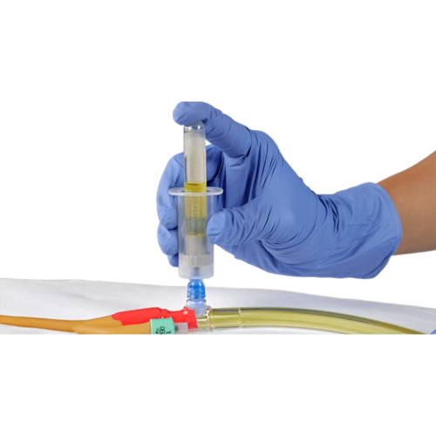
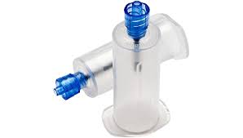
luer-lock access device

Slide 24
Completing the procedure
• Remove and discard your gloves.
• Perform hand hygiene.
• Label the specimen in the presence of the patient to prevent mislabeling.
• Place the specimen in a laboratory biohazard transport bag and send it immediately to the laboratory with the appropriate laboratory request form (if necessary) or refrigerate it if transport may be delayed.19 If a urine culture is to be performed, make sure that you list current antibiotic therapy on the laboratory request form, if required by your facility.
• Perform hand hygiene.
• Document the procedure.

Slide 25


