Slide 1
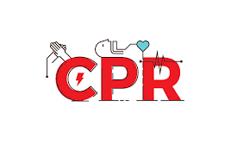
Cardiopulmonary resuscitation (CPR), two-person

Slide 2

Introduction
CPR is a basic life support (BLS) procedure performed for a person in cardiac arrest.
Purpose :to restore and maintain a patient's spontaneous respiration and circulation after the heartbeat and breathing have stopped
ultimate goal is to return the patient to the previous quality of life and functional state
should be performed according to the American Heart Association (AHA) guidelines

Slide 3

Important note
early CPR can improve the patient's likelihood of survival
Performing high-quality CPR is important not only at the onset of resuscitation but also throughout the entire resuscitation process.

Slide 4
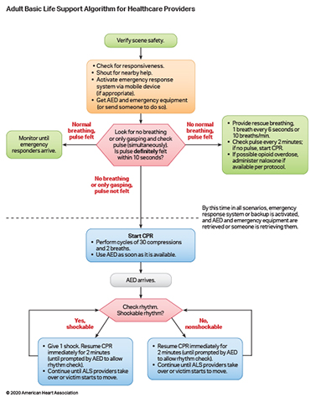
step-by-step guide for CPR as recommended by the AHA

Slide 5
Lippincot procedure
Perform hand hygiene.
Put on personal protective equipment, as needed and available, to comply with standard precaution
Verify the safety of the environment by quickly scanning the patient's location and surroundings for imminent physical threats, such as toxic and electrical hazards.

Slide 6
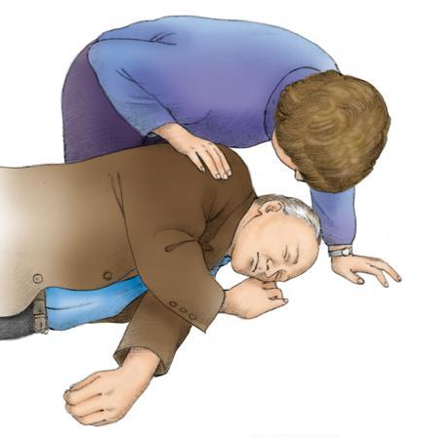
Assess the patient for unresponsiveness by tapping the patient on the shoulder and shouting, "Are you all right?" If the patient is unresponsive,
shout for help and activate the emergency response system via a mobile device (if appropriate).

Slide 7
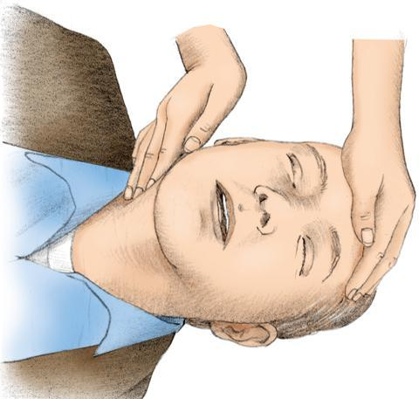
Check to see whether the patient is apneic or only gasping and, if able, simultaneously check for a pulse.(look listen and feel)
check for a pulse, palpate the carotid artery Palpate for no longer than 10 seconds

Slide 8

If the patient is breathing normally and has a pulse, monitor the patient closely until the emergency response team arrives.

Slide 9
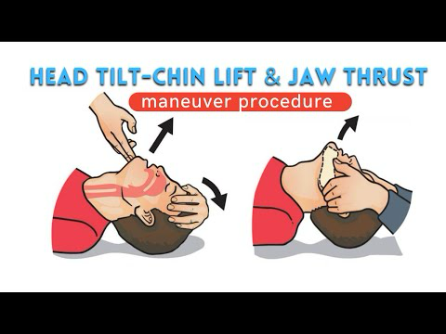
No normal breathing, pulse felt
If breathing is absent or the patient is only gasping and you feel a pulse within 10 seconds, follow these steps:
1-Open the patient's airway
using the head tilt–chin lift maneuver unless you suspect a cervical spine injury. If you suspect a spinal injury, use the jaw-thrust maneuver but don't hyperextend the neck

Slide 10
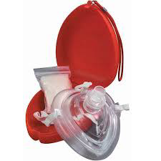
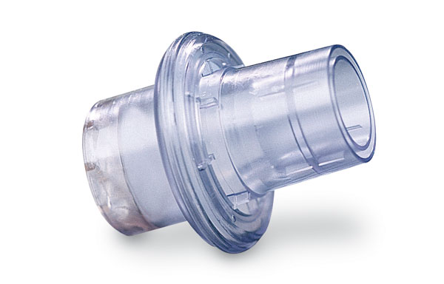
2- Provide rescue breathing by giving the patient 10 breaths/minute (1 breath every 6 seconds). Use a barrier mask with a one-way valve if available.
Avoid excessive ventilation to minimize the impact of positive-pressure ventilation on blood flow.
Check for a pulse every 2 minutes.
If opioid overdose is known or suspected, administer I.M. or intranasal naloxone (if available) according to protocol.

Slide 11
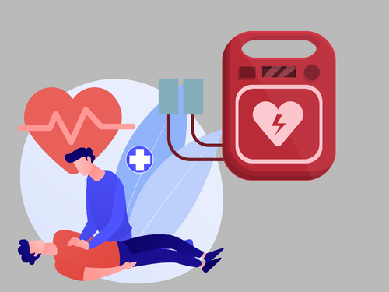
No breathing or only gasping, pulse not felt
follow these steps:
1-Ask a coworker to retrieve an AED or other defibrillator, and alert the emergency response team (if not already done).

Slide 12
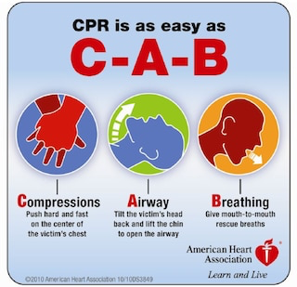

Slide 13
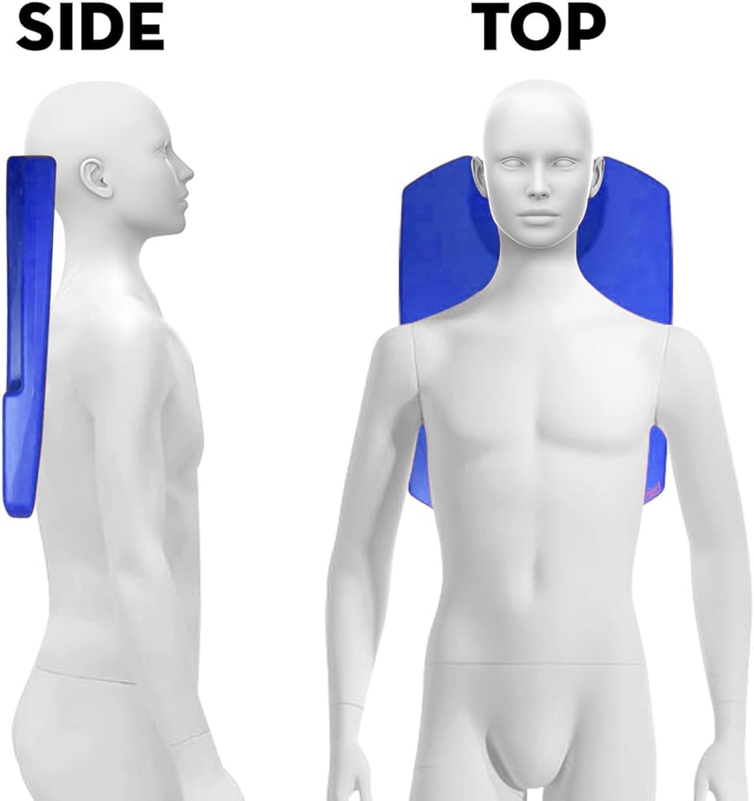
2- Place the patient in the supine position on a firm surface, such as a backboard or the floor. If the patient is on an air-filled mattress, deflate the mattress to maximize the effectiveness of chest compressions.

Slide 14
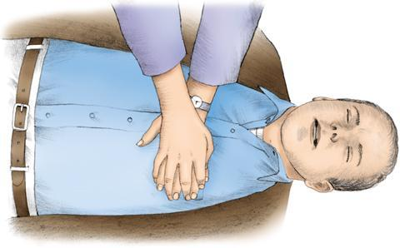
Ensure that your knees or feet are apart to provide a wide base of support.
Place the heel of one hand on the center of the patient's chest (over the lower half of the sternum) and the heel of your other hand on top of the first so that your hands are overlapped and parallel

Slide 15
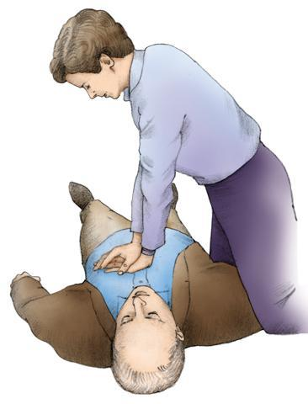
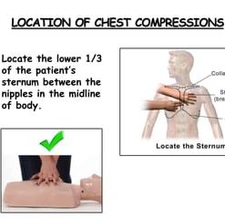
Begin performing chest compressions immediately. Continue until the AED or another defibrillator is ready for use.
Perform chest compressions with your elbows locked, arms straight, and shoulders directly over your hands Using the weight of your upper body, compress the patient's chest at least 2" (5 cm) but no more than 2.4" (6 cm)
keeping chest compression and chest recoil duration equal. Let the patient's chest recoil completely after each chest compression to create a relative negative intrathoracic pressure that promotes venous return and cardiopulmonary blood flow

Slide 16
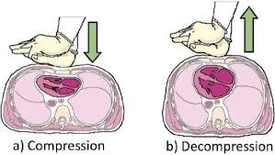

Slide 17
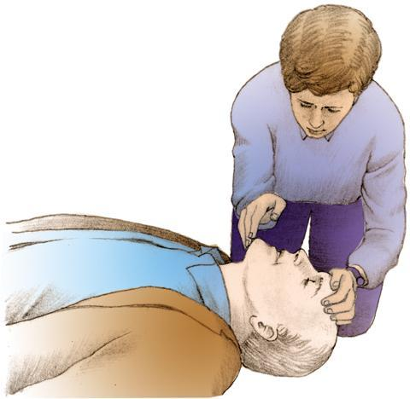
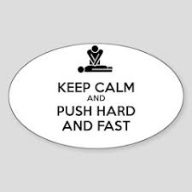
Perform 30 chest compressions at a rate of 100 to 120 compressions/minute, pushing hard and fast.
open the patient's airway and prepare to give two ventilations.

Slide 18
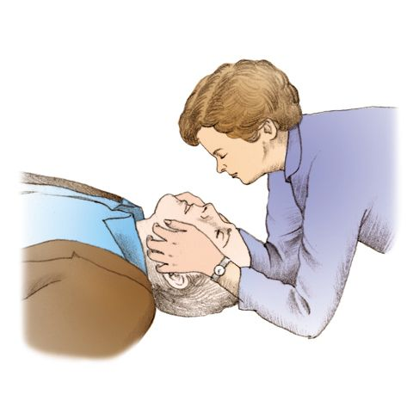
If you suspect a cervical spine injury, use the jaw-thrust maneuver.
To perform this maneuver, kneel at the patient's head with your elbows on the ground. Rest your thumbs on the patient's lower jaw near the corners of the mouth, pointing your thumbs toward the feet. Then place your fingertips around the lower jaw. To open the airway, lift the lower jaw with your fingertips

Slide 19
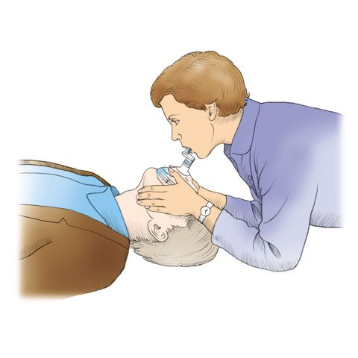
To begin ventilations using a barrier mask with a one-way valve, position the narrow portion of the mask over the patient's nose and the wide portion above the patient's chin. Create a tight seal by covering the patient's nose and mouth with the mask. Take a regular breath and place your mouth on the mouthpiece .
to begin ventilations using mouth-to-mouth rescue breathing, position yourself beside the patient's head and pinch the patient's nostrils shut with the thumb and index finger of the hand you've had on the forehead. Take a regular breath and place your mouth over the patient's mouth, creating a tight seal

Slide 20

Give two regular breaths, each over 1 second, with enough volume to produce a minimal chest rise.
Continue performing chest compressions until the emergency response team arrives or another rescuer arrives with an AED or other defibrillator.
As soon as it's ready, use the AED or other defibrillator to evaluate the patient's rhythm.
If the patient has a shockable rhythm, give one shock and then resume CPR

Slide 21
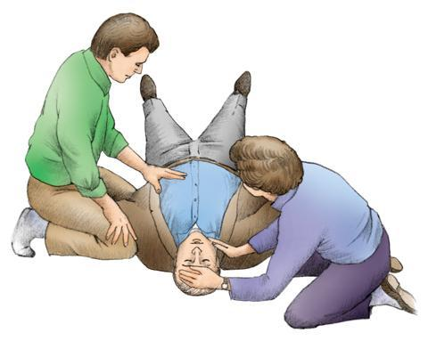
Switch between 2 rescuer
If the second rescuer is another health care professional, the two of you can perform two-person CPR.
After you've finished a cycle of 30 chest compressions and two ventilations, the second rescuer should get into position opposite you and get ready to begin performing chest compressions;
Note : the switch should occur in less than 5 seconds.

Slide 22
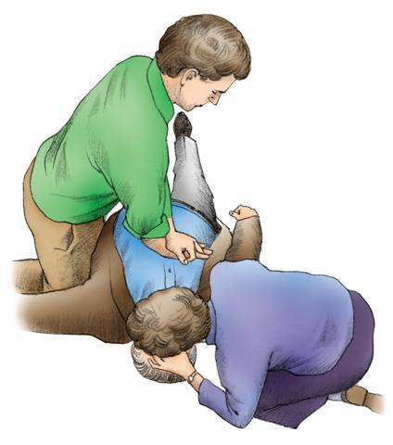
Switch the compressor role after five cycles of chest compressions and ventilations to prevent rescuer fatigue and a resulting decrease in compression quality5 seconds
Don't interrupt chest compressions for more than 10 seconds unless a specific intervention, such as defibrillation or advanced airway placement, is necessary to maximize compression time and improve tissue oxygenation.
Both rescuers should continue performing CPR until ACLS providers take over or until normal breathing and effective circulation return.

Slide 23
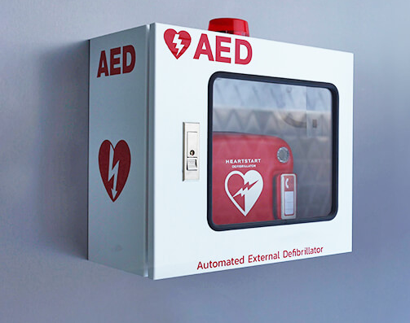
AED

Slide 24
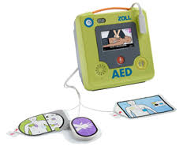
AED (Automated external defibrillation)
AED:is a device equipped with a microcomputer that senses and analyzes a patient's heart rhythm at the push of a button. Then it audibly or visually prompts the user to deliver a shock.

Slide 25
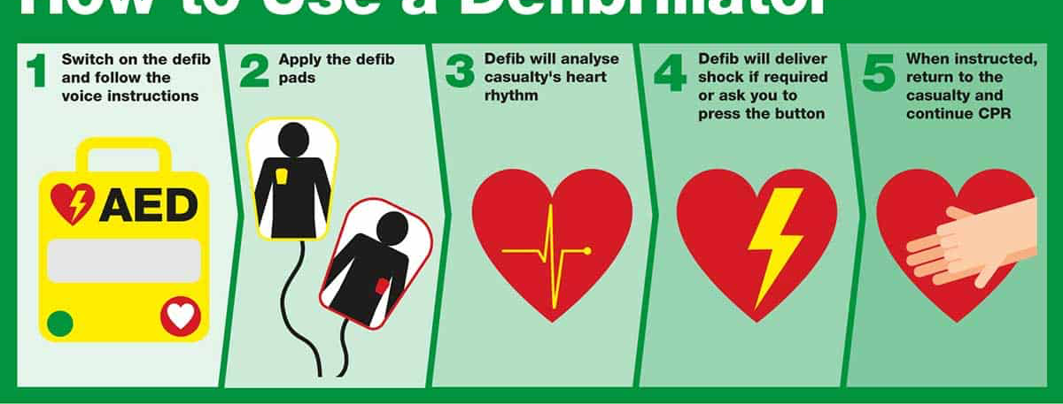
How to use AED
Turn on the AED and follow its visual and audio prompts.
Open the foil packages containing the two AED electrodes.
Expose the patient's chest.
Make sure that the patient is in a dry environment and that the patient's chest is dry because personnel or the patient who comes into contact with water may receive a shock (personnel) or skin burns (patient) during defibrillation. In addition, make sure that the area where you'll apply the AED electrodes is dry because moisture under the electrode pads may decrease the effectiveness of contact with the patient's skin.⁵ If needed, dry the patient's skin with a towel.

Slide 26
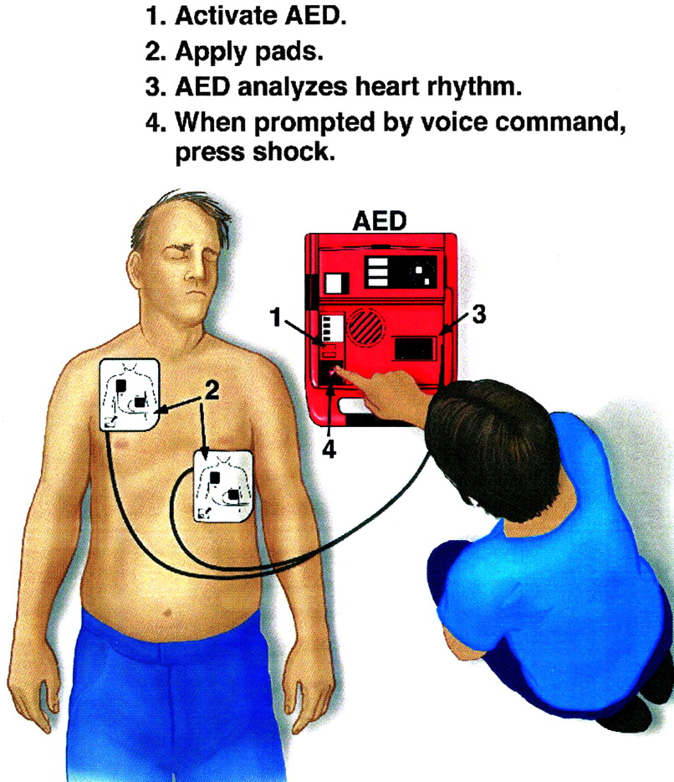
Remove any metal objects that the patient is wearing because metal conducts electricity and may cause burns during defibrillation.
Remove transdermal medication patches from the patient's chest (and back if you'll use anterior-posterior electrode placement) because the medication may interfere with current conduction and produce burns.
Remove the plastic backing film from the two AED electrodes.
Place one AED electrode on the right side of the patient's bare, dry chest just below the clavicle. Place the second electrode on the left side of the patient's bare, dry chest to the left of the heart's apex..

Slide 27
Attach one AED electrode to each electrode cable (if not already attached). Then connect the cable to the AED.
Ask everyone to stand clear. Press the ANALYZEbutton when prompted by the machine.
Wait for the AED to analyze the heart rhythm.
As needed, wait until the fully-charged AED prompts you to deliver a shock. Make sure that no one is touching the patient or bed. Call out “Stand clear.” Then press the SHOCK button on the AED.
Continue CPR immediately for five cycles, beginning with chest compressions for about 2 minutes. After five cycles of CPR, the AED should analyze the heart rhythm and prompt you to deliver another shock, if indicated.

Slide 28

Clinical alert: Don't interrupt CPR for AED electrode placement. Even a few seconds of interruption may decrease coronary blood flow.
Clinical alert: Don't place the AED electrodes directly over an implanted cardioverter-defibrillator or implanted pacemaker because this placement may damage the AED. Keep the AED electrodes about 3" (7.6 cm) from the implanted device, as recommended.

Slide 29
If the AED detects a nonshockable heart rhythm, continue CPR and the life support algorithm sequence until the code team leader arrives.
If the patient regains a pulse, obtain vital signs and assess the level of consciousness.
After the code, remove and transcribe the AED's computer storage media or prompt the AED to print a rhythm strip with the code data.

Slide 30
Remove and discard your personal protective equipment.
Perform hand hygiene.
Put on gloves and, as needed, other personal protective equipment.
Clean and disinfect reusable equipment.
Remove and discard your personal protective equipment.
Perform hand hygiene.
Document the procedure.

Slide 31

Special Considerations
You can give bag-mask ventilation with room air or oxygen, but you should use supplemental oxygen (in a concentration greater than 40% and at a minimum flow rate of 10 L/minute) when available.
Bag-mask ventilation is most effective when provided by two trained and experienced rescuers. One rescuer should open the patient's airway and seal the mask to the patient's face, while the other rescuer squeezes the bag and gives the ventilations.¹

Slide 32

Complications
Complications associated with CPR may include:
fractured ribs
fractured sternum
intra-abdominal trauma (lacerated liver)
punctured lungs
injury to the heart
gastric distention (resulting from giving too much air during ventilation)

Slide 33

Documentation
Documentation associated with CPR includes:
all the events of resuscitation
names of the people present
reason that CPR was initiated
whether the patient suffered from cardiac or respiratory arrest
location where the arrest occurred
whether it was witnessed
time CPR began
duration of CPR
patient's response to CPR
complications
  interventions performed to correct them.

Slide 34
Advance air way management
After an advanced airway is in place, the rescuer giving compressions should perform continuous chest compressions at a rate of 100 to 120 compressions/minute without pauses for ventilation.
The rescuer giving ventilations can provide a breath every 6 seconds (which yields 10 breaths/minute).

Slide 35
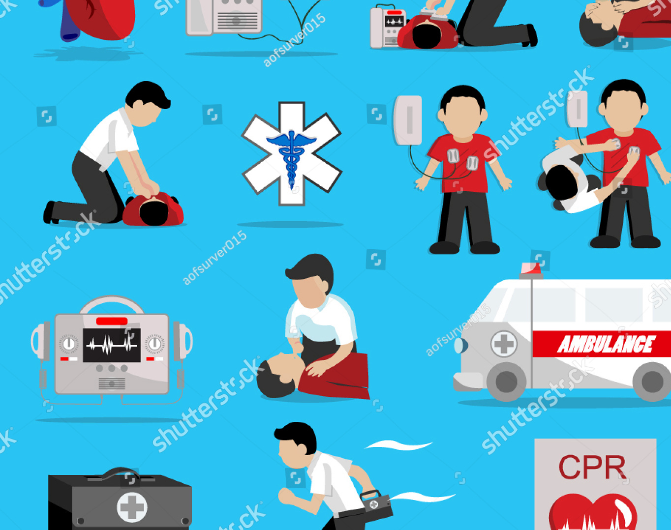
Cardiopulmonary arrest management, adult (Advanced practice)

Slide 36
Purpose of CPR
cardiopulmonary arrest management are to restore the patient's spontaneous heartbeat and respirations and prevent hypoxic damage to the brain and other vital organs.

Slide 37
Team approach
team approach is needed to manage the cardiopulmonary arrest effectively and increase the patient's chances of survival.
The team should consist mainly of health care workers trained in ACLS.
other health care workers can also be part of the team.
One ACLS-trained and experienced person functions as the team leader.
This procedure focuses on initiating a code for a cardiopulmonary arrest (ventricular fibrillation [VF], pulseless ventricular tachycardia [pVT], pulseless electrical activity [PEA], or asystole) and then acting as the team leader as the code progresses.

Slide 38
CARDIOPULMONARY ARREST MANAGEMENT TEAM ROLES
The team should ideally consist of six members to perform critical roles during cardiopulmonary arrest management. If a team has fewer members, the leader should prioritize tasks and assign team members to roles they're competent to perform. Team leader: Evaluates resources, assigns roles to team members, takes on roles not assigned, makes treatment decisions, monitors the patient's response to interventions, provides feedback to team members as needed, and models effective communication and professionalism Compressor: Assesses the patient, provides chest compressions, and alternates roles with the defibrillator (often the initial responder) Ventilator: Opens and manages the patient's airway and provides bag-mask ventilation Defibrillator: Operates the monitor and defibrillator and alternates roles with the compressor Medication administrator: Initiates and manages IV (or intraosseous) access and prepares and administers medications Recorder: Documents the time of interventions, medication administration, and interruptions in compressions and announces when medications and interventions are next due
Notes:
I

Slide 39
Determine whether the patient has a shockable or an unshockable rhythm
For a shockable rhythm, follow the advanced cardiac life support (ACLS) protocol for defibrillation. Then resume CPR immediately.
For an unshockable rhythm, resume CPR immediately. After five cycles of CPR, check the patient's rhythm. Perform a pulse check if you observe an organized rhythm on the monito

Slide 40
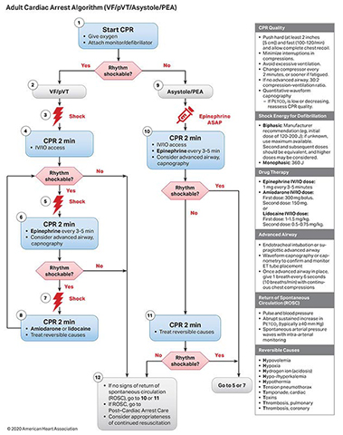

Slide 41
shockable
VT
VF

Slide 42
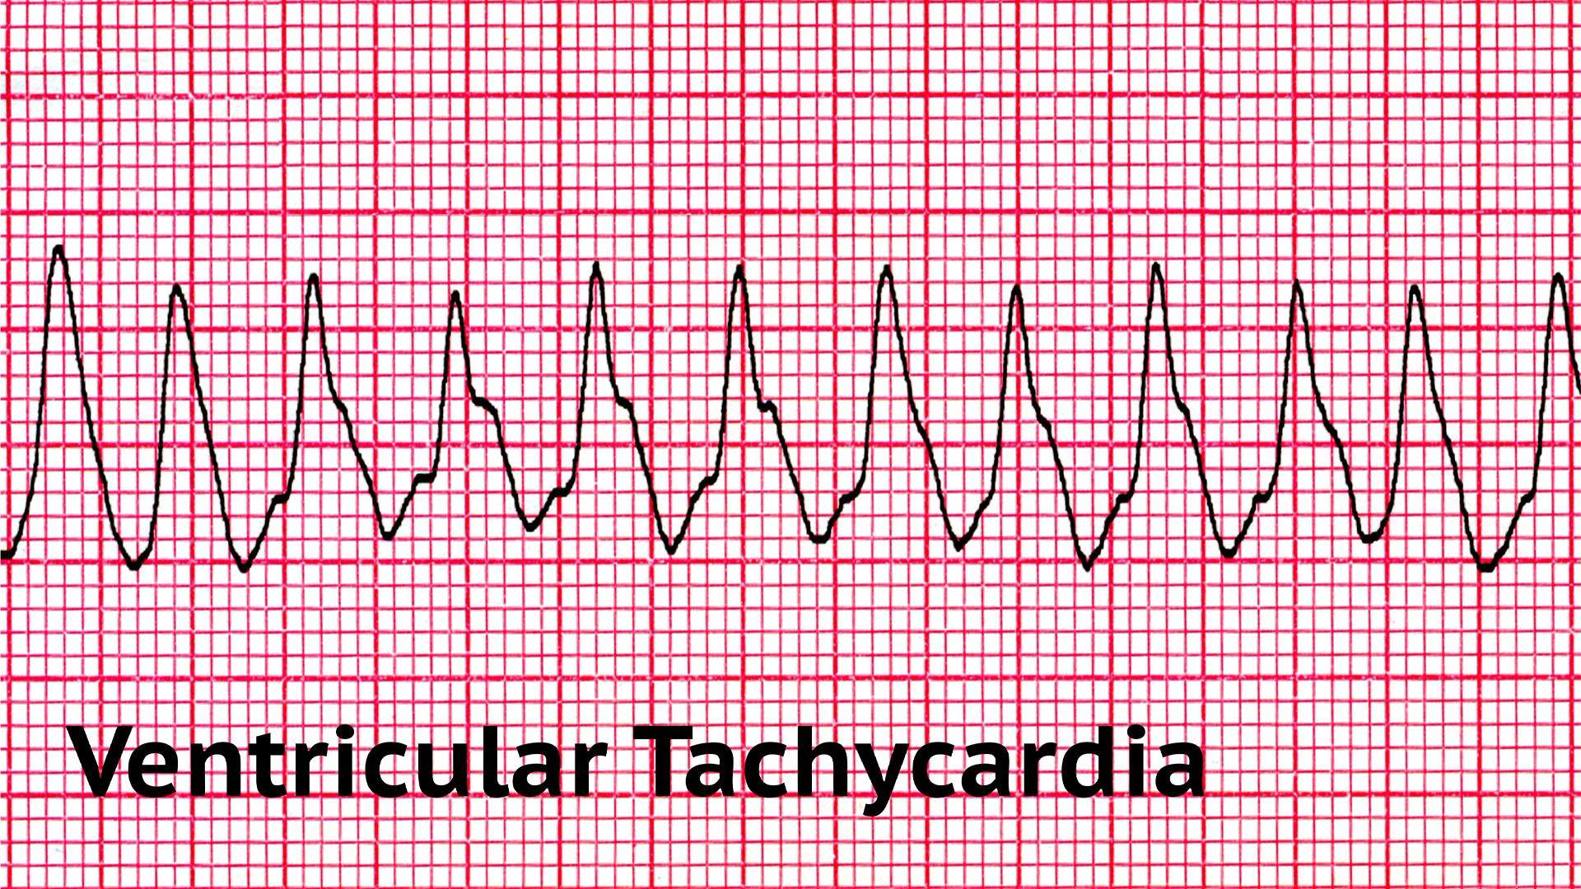

Slide 43
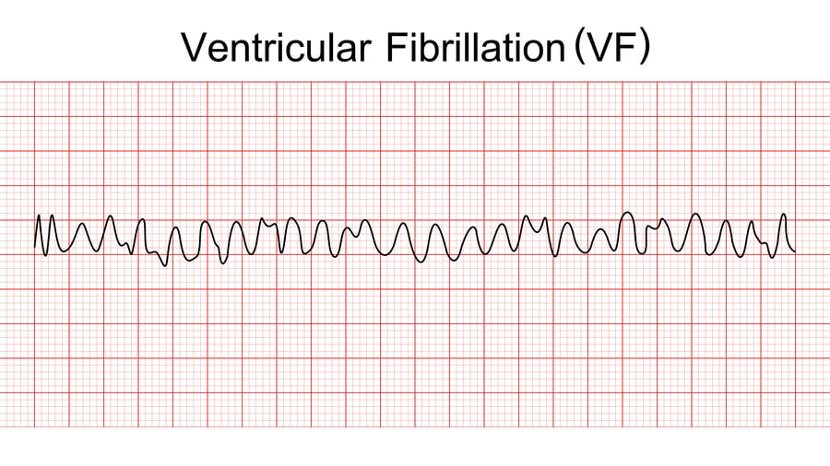

Slide 44
Unshockable
Asystole
Pulseless electrical activity PEA

Slide 45
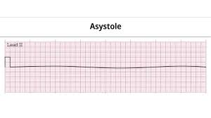

Slide 46
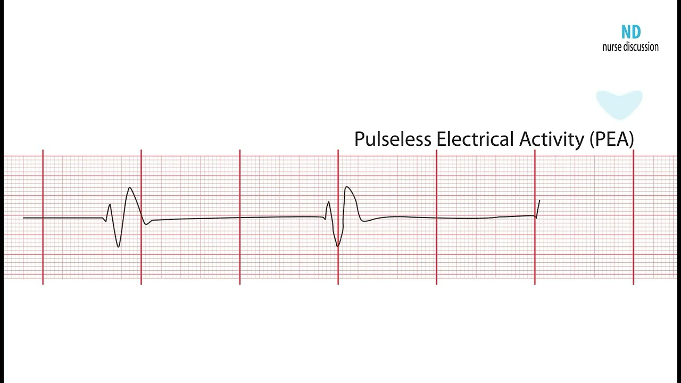

Slide 47
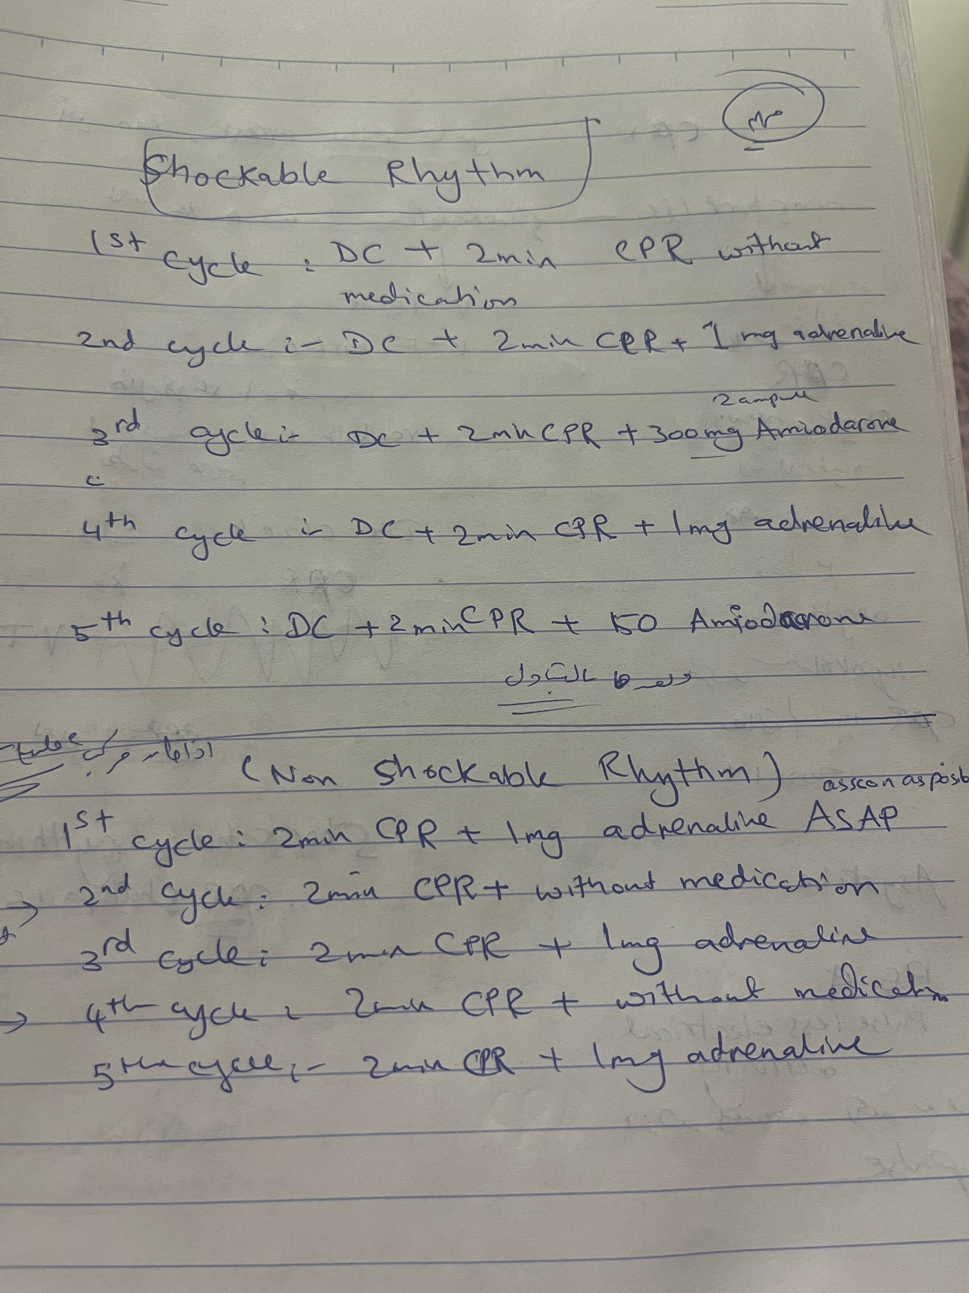

Slide 48


