Slide 1
Emergency Crash Cart

Slide 3
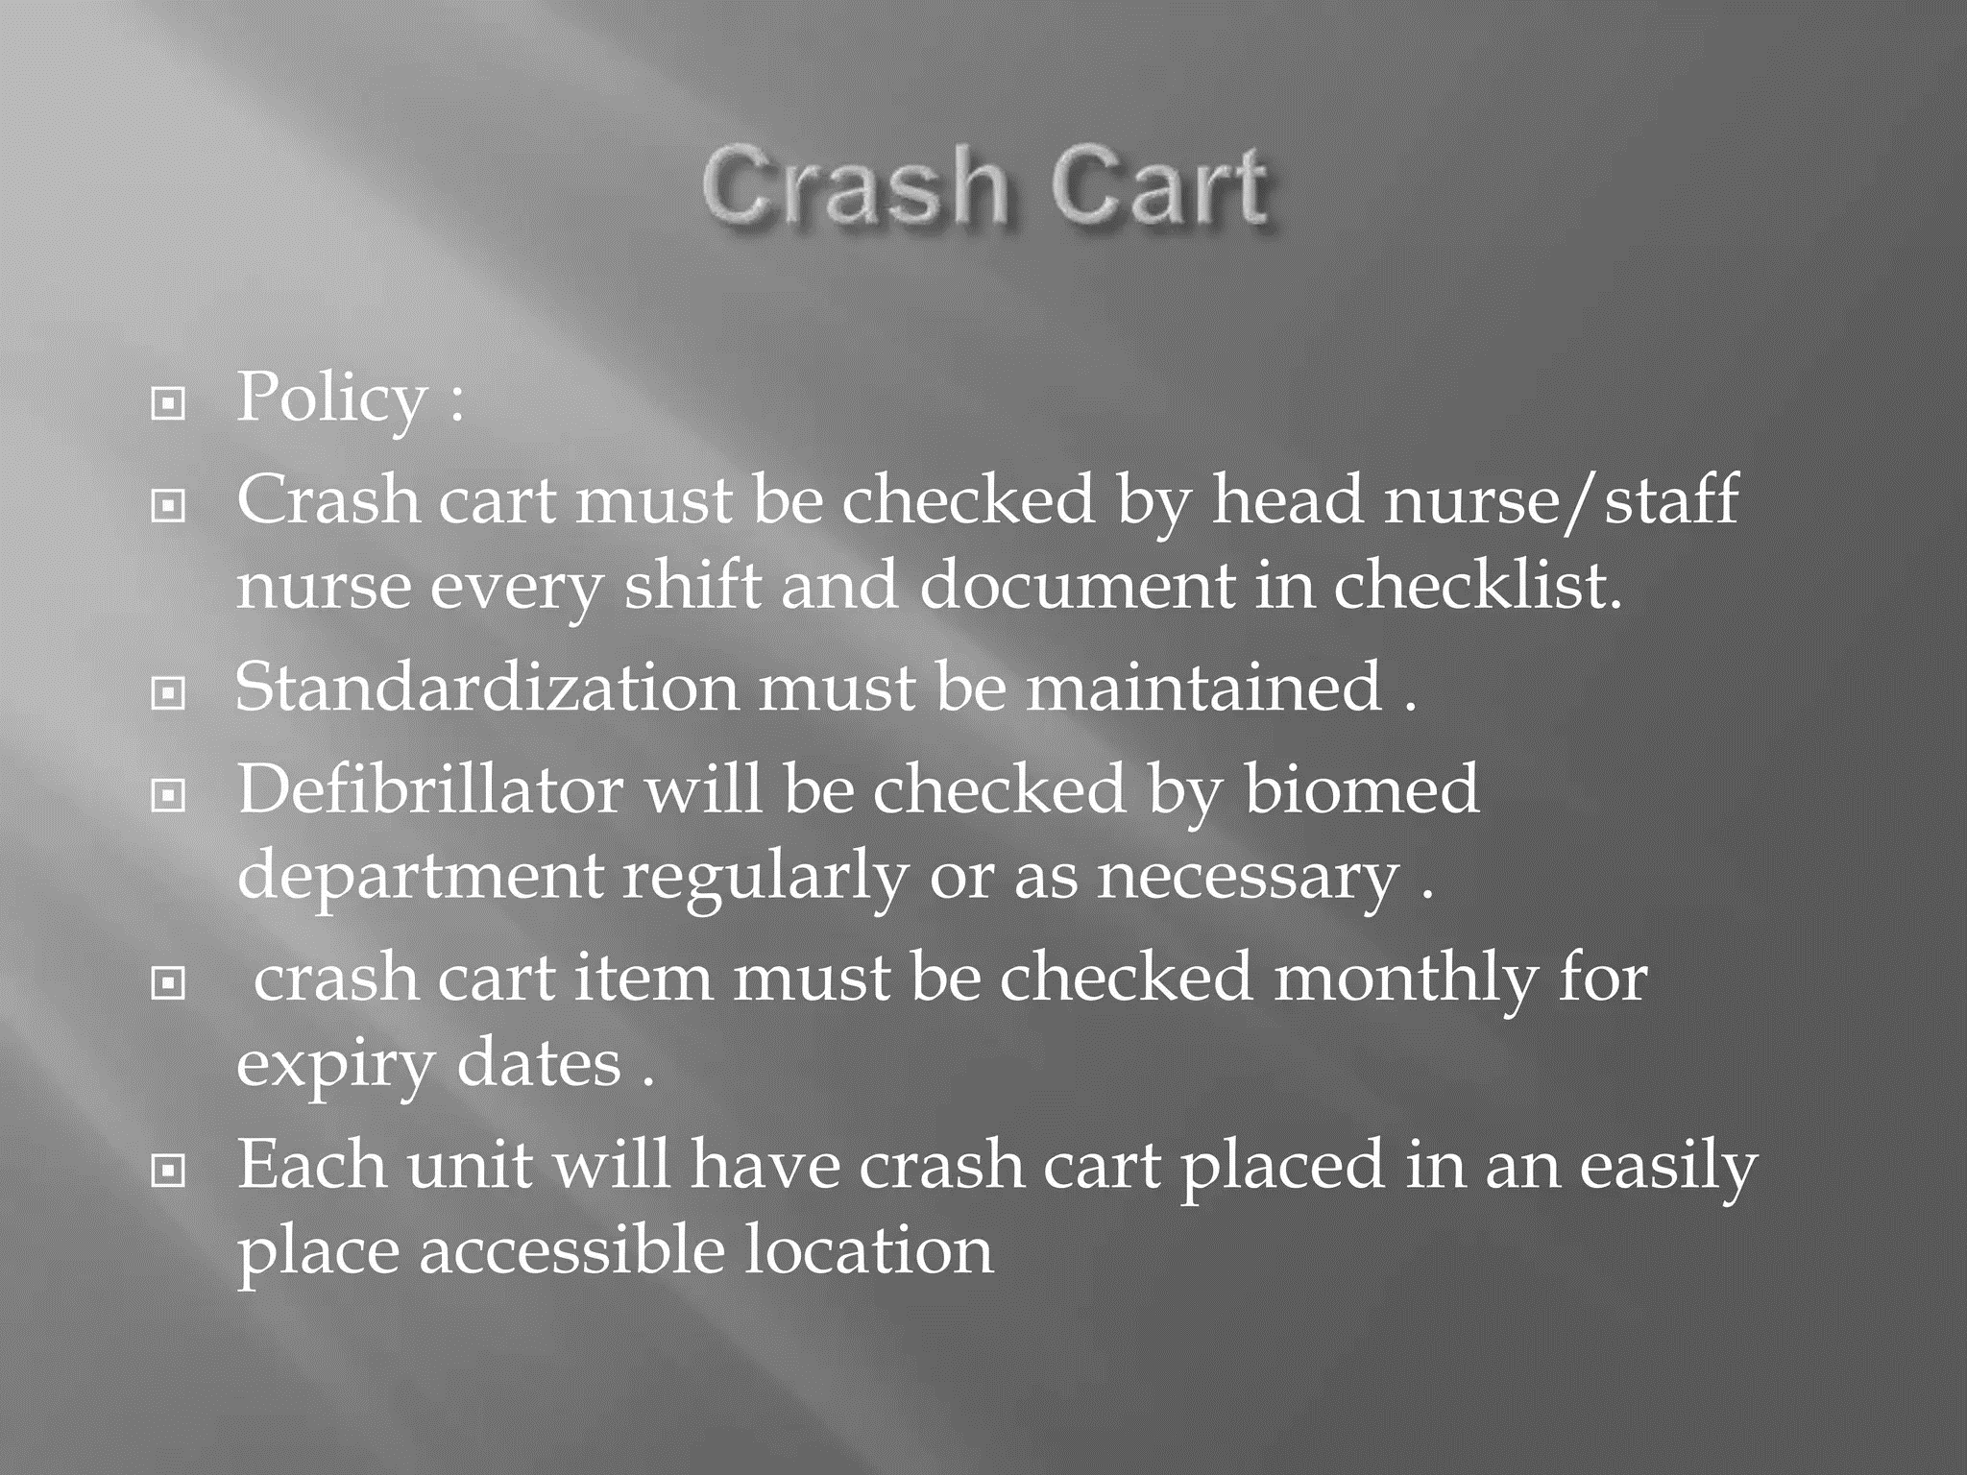

Slide 21
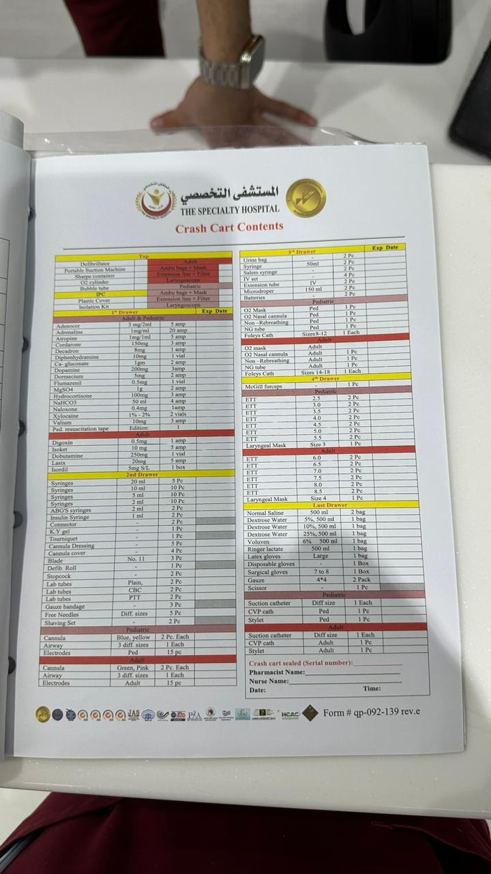
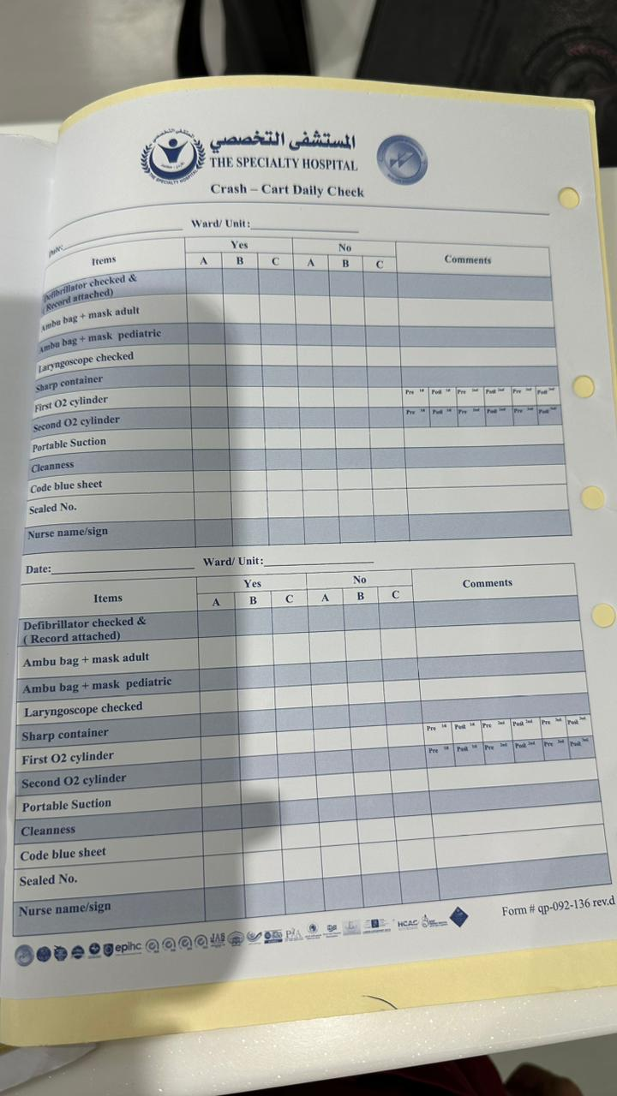

Example for E cart checklist
ped resuscitation tape( broselow)

Slide 22
THANK YOU

