Slide 1
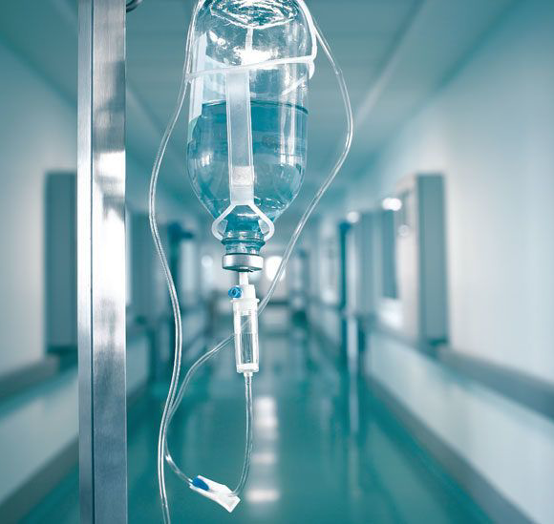
Intravenous fluids

Slide 2
Objectives:
Revision of fluid compartments (physiology part) (fluid & substance)
Identify types of intravenous fluids
Prescribing fluids
Electrolytes abnormalities

Slide 3

Intravenous fluids
IV fluid is the giving of fluid and substances directly into a vein.
Human Body has fluid and substances

Slide 4
Substances that may be infused intravenously
Fluid (crystalloids and colloids)
blood-based products (whole blood, fresh frozen plasma, cryoprecipitate)
blood substitutes,
medications.

Slide 5
We are approximately two-thirds water
Notes:
Water makes up around two thirds of our total body mass. To be exact, men are 60% water, whilst women are slightly less at 55%. A 70 kg. man will therefore contain about 42 litres, and a 70 kg. woman nearer 38 litres. The reason for this difference between the sexes is that women contain an extra 5% adipose tissue; the difference is only occasionally of clinical significance.

Slide 6
Body fluid compartments:
Intracellular volume
(40%) rich in water
Extra cellular volume
(20%) rich in water
15% constitute interstitial space and 5% the intravascular space.

Slide 7
Fluid shifts in disease
Fluid loss:
  GI: diarrhoea, vomiting, etc.
  renal: diuresis
  vascular: haemorrhage
  skin: burns
Fluid gain:
  Iatrogenic:
  Heart / liver / kidney failure:
Notes:
Numerous routes exist by which the body can lose or gain fluid. In theory, it is possible to gain or lose pure water, but in most cases, fluid moves along with electrolytes, and the result is determined by the balance of water gains and losses, versus solute gains and losses.
Do not underestimate the potential for fluid movement. Diarrhoeal illnesses, certain diureses, & fluid retaining states may result in gains or losses of tens of litres of fluid.

Slide 8
Iv fluids
IV fluid forms: ?????
Colloids
Crystalloids

Slide 9
Iv Fluids
Colloid solutions
Containing water and large proteins and molecules
tend to stay within the vascular space
Crystalloid solutions
containing water and electrolytes.

Slide 10
Colloid solutions
IV fluids containing large proteins and molecules
- tend to stay within the vascular space and increase intravascular pressure
-very expensive
- Examples: Dextran, hetastarch, albumin…

Slide 11
Crystalloid solutions
Contain electrolytes (e.g.,sodium, potassium, calcium, chloride)
Lack the large proteins and molecules
Come in many preparations and volume
Classified according to their “osmolslity”:
” 0.9% NaCl (normal saline), Lactated Ringer's solution isotonic,
2.5% dextrose hypotonic
D5 NaCl hypertonic

Slide 12
osmolality
Osmolality is the dissolution of a solute in whole blood measured in kilograms.
Normal = 280 - 300 mosm / kg
Notes:
Normal serum osmolality is 280 - 290 mosm / kg. Measured osmolality uses analysers that measure all active " osmoles ", but a calculated osmolality is often very close. As sodium is the major extracellular cation, the majority of extracellular anions will be equal to its concentration. Urea and glucose make up the remaining significant osmoles, and calculated osmolality is therefore ( 2 x [ Na+ ] ) + [ urea ] + [ glucose ]. It is easy to see that in conditions such as hypernatraemia, renal failure ( raised urea ) or hyperglycaemia, osmolality is raised.

Slide 13
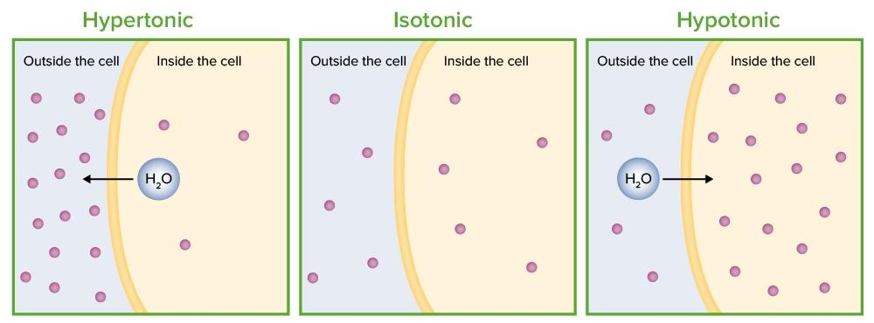

Slide 14
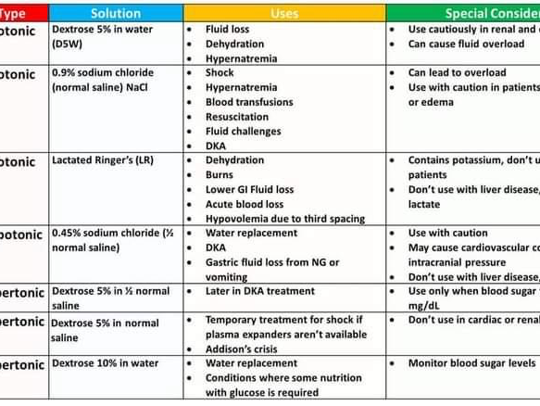

Slide 15
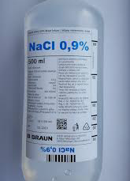
Normal saline fluid (NS 0.9%)
(NS) — is the commonly-used term for a solution of 0.90% w/v of NaCl, about 300 mOsm/L or 9.0 g per liter
Na is154 and only CL 154
No K, NO others

Slide 16
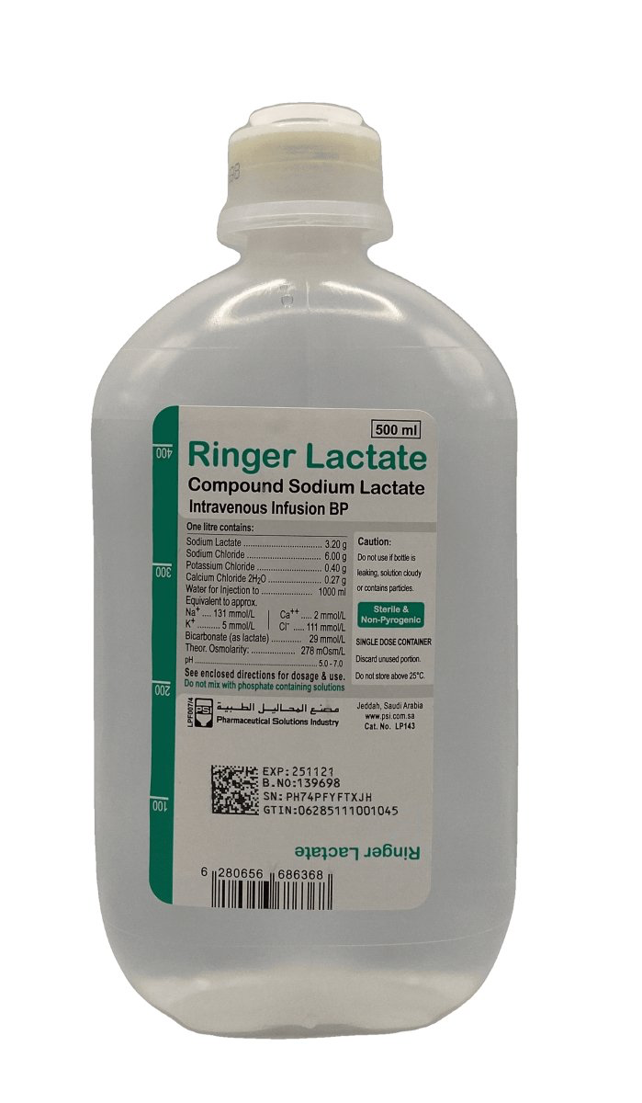
Ringer lactate fluid
One litre of lactated Ringer's solution contains:
130 mEq of sodium ion = 130 mmol/L
109 mEq of chloride ion = 109 mmol/L
28 mEq of lactate = 28 mmol/L
4 mEq of potassium ion = 4 mmol/L
3 mEq of calcium ion = 1.5 mmol/L

Slide 17
Labratory normal values
Item measured. Normal value in serum of blood
Electrolytes
Sodium 136-145mEq/L
Potassium K.3.5 - 5.0mEq/L
Chloride CL 98-106mEq/l
Total calcium Ca 8.4-10.5 mEq/l
Magnesium Mg 1.5-2.5mEq/l

Slide 18

Notes:
And that's it.
I hope that this gives you and idea of what IV fluids to use and why, and how much, along with some hints as to how to assess your patients in order to assess their fluid status.

