Slide 1
Intravenous access

Slide 2
Introduction
IV (Intravenous) access
Is a critical procedure in emergency and medical care, allowing for the rapid administration of medications, fluids, or blood products directly into the bloodstream. Here’s an overview of IV access and its use:

Slide 3

Types of IV Access:
^{1.Peripheral IV Access}
^{2.Central Venous Access}

Slide 4
1. Peripheral IV Access:
• Common Sites: Hands, arms, feet, or legs (e.g., cephalic vein, basilic vein).
• Use: Short-term use for administering fluids, medications, or blood products.

Slide 5
2. Central Venous Access
• Common Sites: Internal jugular vein, subclavian vein, femoral vein.
• Use: Long-term use, critical care, or when peripheral access is not feasible (e.g., In trauma or severe dehydration).

Slide 6
• Types of central venous access
• Central Venous Catheter (CVC): Inserted Into a large central vein, usually in the chest or neck.
• Peripherally Inserted Central Catheter (PICC): Inserted into a peripheral vein, but the tip extends Into a central vein

Slide 7
• Intraosseous (IO) Access:
For critical situations where IV access is not quickly available, medications and fluids can be administered through a needle placed into the bone marrow.

Slide 8
Steps to Perform Peripheral IV Access:
1. Preparation:
• Gather necessary supplie
) catheter, tourniquet, antiseptic, gloves, IV fluid, tape).
• Explain the procedure to the patient
• Apply a tourniquet above the InsertIon site to engorge the vein.
Clean the site with an antiseptic.

Slide 9
3. Insertion:
• Select an appropriate vein.
• Insert the catheter with the needle at a 15-30 degree angle.
• Once blood returns (flashback), advance the catheter while withdrawing the needle.

Slide 10
4. Secure and Confirm:
• Secure the catheter with adhesive tape or a dressing.
• Attach IV tubing and begin infusion.
• Ensure proper flow and monitor for any complications (e.g., swelling, infiltration).

Slide 11
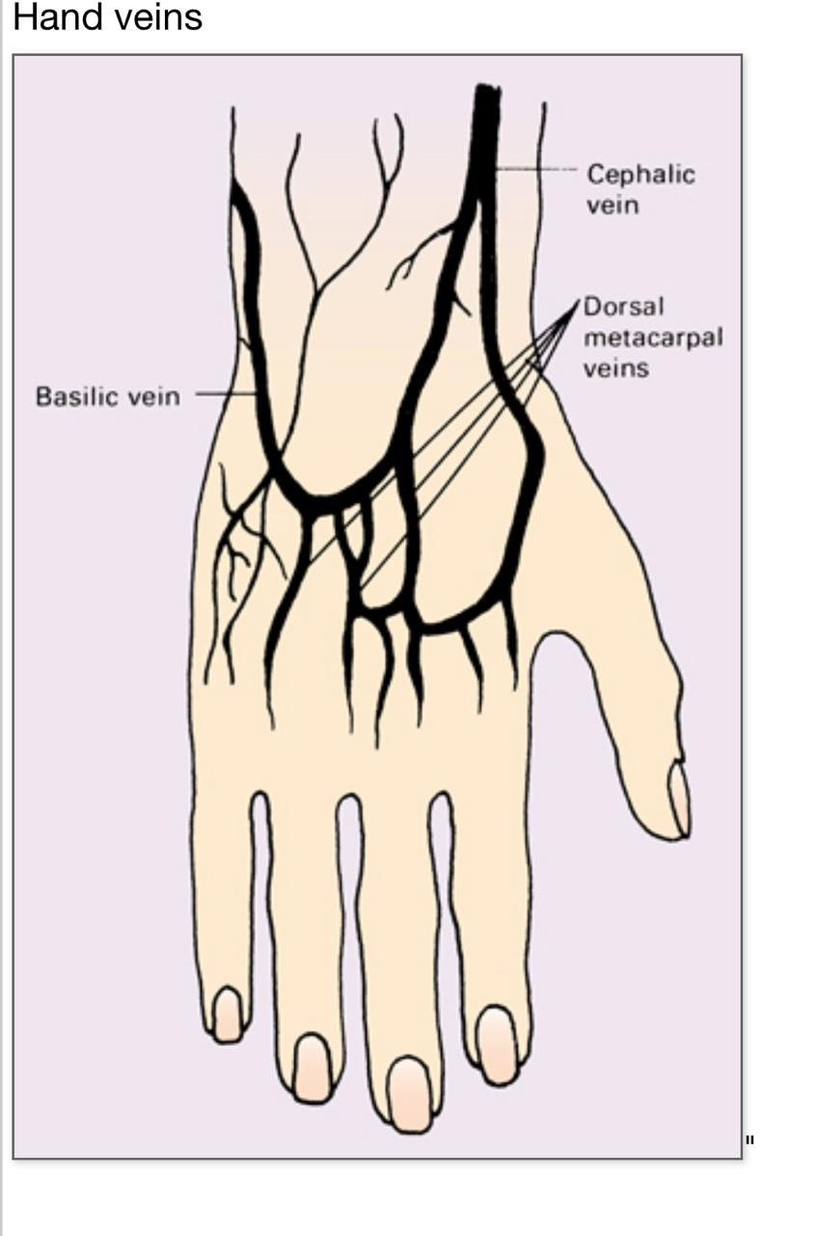

Slide 12
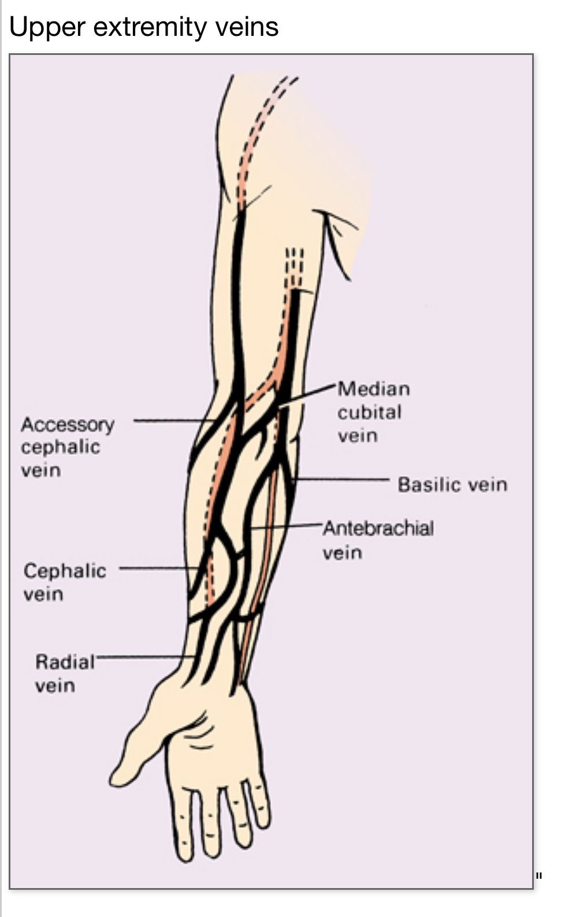

Slide 13
IV catheter insertion using a short peripheral IV catheter
Verify the practitioner’s order
Review the practitioner’s order to make sure that the prescribed infusion solution or medication, dose, rate, and route of administration is appropriate for the patient’s age, condition, and access device and that the infusion or medication is compatible with other solutions or medication. Address concerns about the order
Review the patient’s medical record for allergies and factors that may affect peripheral vasculature.
Gather and prepare the equipment and supplies.

Slide 14
Compare the medication label to the order In the patient’s medical record.
Check the expiration date on the medication. If expired, return it to the pharmacy and obtain new medication.
Visually inspect the solution for loss of Integrity. Don’t administer the medication if integrity is compromised.
If your facility uses bar-code technology, use it as directed.
Perform hand hygiene.
Confirm the patient’s Identity.
Provide privacy.
Explain the procedure

Slide 15
If required, confirm that the signed Informed consent form is in the patient’s medical record. Alternatively, obtain patient assent to perform the procedure.
Hang the IV solution or medication with attached primed administration set on an IV pole.
Raise the bed to waist level.
Place the patient In a comfortable sitting or reclining posItion, leaving the arm In a dependent position.
Applying the tourniquet

Slide 16
Apply a tourniquet on an upper extremity.
Assess the veins In the patient's upper extremity, and Identify potential sites that are easily seen or palpated. Choose an IV Insertion site.
Check for a pulse distal to the tourniquet location. Release the tourniquet and reapply it, if necessary.
Palpate the vein lightly with the Index and middle fingers of your nondominant hand. Stretch the patient's skin to anchor the vein. If it feels hard or ropelike, select another vein.
If the vein Is easily palpable but not sufficiently dilated, place the extremity In a dependent position for several seconds or stroke the vessel downward lightly. Apply dry heat, if necessary.

Slide 17
Release the tourniquet for IV insertion site preparation.
Preparing the IV Insertion site
If the intended IV insertion site is visIbly soiled, clean It with soap and water.
Clip hair around the IV insertion site, If needed.
Administer a local anesthetic, if indicated and prescribed.
Perform hand hygiene.
Put on gloves and, as needed, other personal protective equipment.

Slide 18
Prepare the insertion site using an antiseptic agent. Apply using a single-use sterile applicator. Allow the solution to dry completely.
Reapply the tourniquet.
Use visualization technology if needed and available.

Slide 19
Inserting the IV catheter
Stretch the patient’s skin taut below the puncture site using the thumb of your nondominant hand.
Tell the patient that you’re about to insert the device.
Puncture the patient’s skin and anterior vein wall, and advance the catheter according to the manufacturer’s instructions for use. Watch for blood to appear in the IV catheter, flashback chamber, or both.
Release the tourniquet.
Activate the device’s safety mechanism following the manufacturer’s instructions for use.

Slide 20
Assessing IV catheter patency
If the IV catheter doesn’t contain permanently attached extension set tubing and you need to attach tubing, compress the patient’s skin well above the catheter tip to stop blood flow. Then, attach the primed extension set to the IV catheter hub and tighten the luer lock, making sure the luer lock doesn’t come into contact with the patient’s skin.
Perform a vigorous mechanical scrub of the extension set tubing hub for at least 5 seconds using an antiseptic pad. Allow It to dry completely
While maintaining sterility of the syringe tip, attach a prefilled syringe containing preservative-free normal saline solution to the extension set hub. Aspirate slowly assess for a blood return that is the color and consistency of whole blood. If you don’t obtain a blood return, take steps to locate an external cause of obstruction.
If you obtain a blood return, Inject preservative-free normal saline solution slowly into the catheter. Use a minImum volume of twice the Internal volume of the catheter system. Don’t forcibly flush the device; further evaluate the device if you meet resistance.

Slide 21
Clamp the catheter.
Remove and discard the syringe in a puncture-resistant sharps disposal container.
Perform a vigorous mechanical scrub of the extension set tubing hub for at least 5 seconds using an antiseptic pad. Allow It to dry completely.
Attach the primed IV administration set to the hub. Trace the IV tubing from the patient to the point of origin.
Unclamp the catheter, and begin the Infusion as prescribed. Monitor the IV insertion site for swelling. Remove the catheter if swelling occurs or the patient complains of discomfort or pain.

Slide 22
Dressing the IV Insertion site
Secure the IV catheter with an Integrated securement device, subcutaneous anchor securement system, tissue adhesive, or adhesive securement device, if available. If a securement device is unavailable, secure the IV catheter with sterile tape.
Apply a transparent semipermeable dressing over the insertion site following the manufacturer’s instructions.
Route the tubing In a standardized direction If the patient has other tubing and catheters having different purposes. Label the tubing at both the distal and proximal ends.
Curl the extension set to the side and tape It to the patient’s arm, if needed.
Label the IV dressing.
Use a joint stabilization device, If necessary.

Slide 23
Completing the procedure
Instruct the patient and family (If appropriate) to obtain assistance from nursing staff whenever there Is a need to connect or disconnect devices or Infusions.
Advise the patient to avoid gettingg the IV dressing and Insertion site wet during bathing and handwashing.
Return the bed to the lowest position.
Discard used supplies appropriately.
Remove and discard your gloves and, if worn, other personal protective equipment.
Perform hand hygiene.
If reusable equipment was used, clean and disinfect it.
Document the procedure.

Slide 24
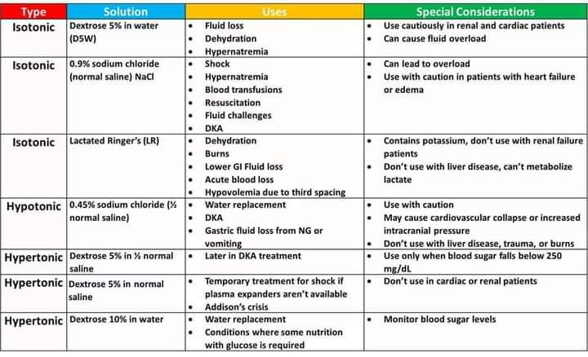
Intravenous fluid

