Slide 1
Wound assessment
Prepared by:
Razan Alsokhon

Slide 2
Introduction
A thorough wound assessment should consist of objective criteria and measurements that promote accurate, consistent comparisons to determine the extent of the wound and the effectiveness of wound healing.
Comprehensive wound assessment is necessary during every dressing change. Comparing the assessment results to the previous findings helps monitor, communicate, treat, and document wound healing progression or complications.

Slide 3
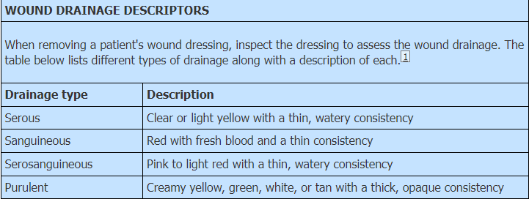

Slide 4
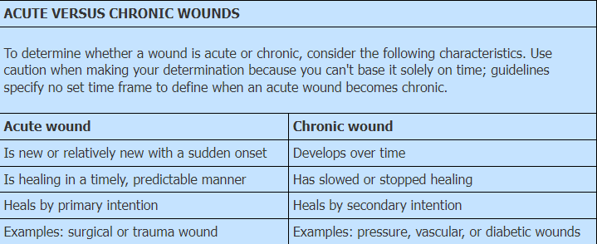

Slide 5
WOUND COLOR
The red-yellow-black classification system is a common approach to wound assessment that can help determine the progress of wound healing.

Slide 6
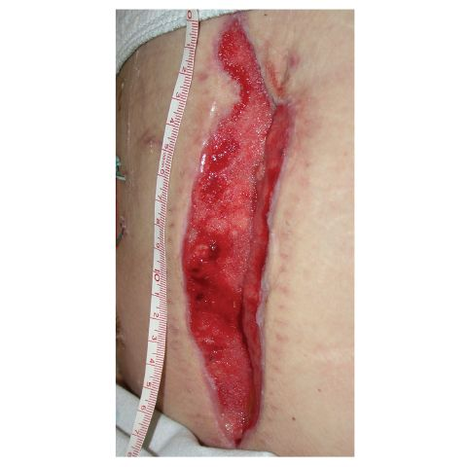
WOUND COLOR ASSESSMENT
Red, the color of healthy granulation tissue, indicates normal healing.

Slide 7
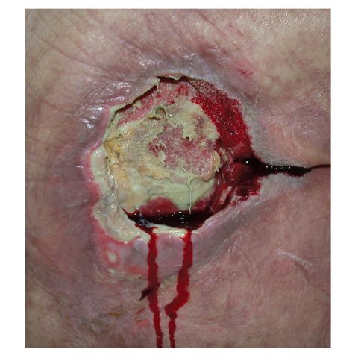
WOUND COLOR ASSESSMENT
Yellow is the color of exudate produced by microorganisms in an open wound.
When a wound heals without complications, the immune system removes microorganisms.

Slide 8
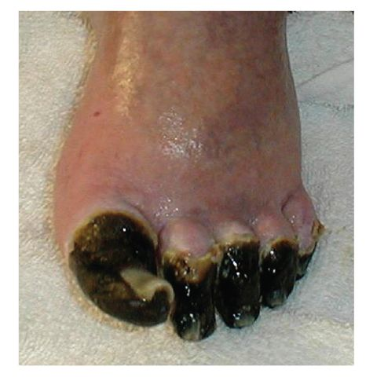
WOUND COLOR ASSESSMENT
Black, the least healthy wound color, signals necrosis. Dead, avascular tissue slows healing and provides a site for proliferation of microorganisms.

Slide 9
Special Considerations
If two or three colors are present, classify the wound by the least healthy color.

Slide 10
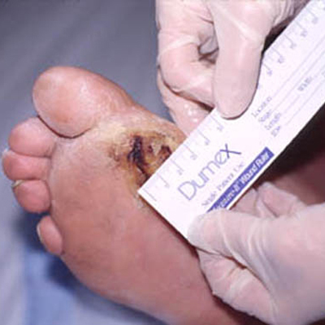
MEASURING A WOUND
The easiest, most common method for measuring a wound is the linear method, using a paper or plastic ruler marked in centimeters or millimeters. To use this method, measure the longest area of the wound using head-to-toe orientation. Then measure the widest width, perpendicular to the length.

Slide 11
Patient Teaching
Teach the patient and family (if appropriate) about the normal wound healing process.
Keep them informed about the progress (or lack of progress) toward healing, including signs and symptoms that they should report.
Explain the importance of adequate nutrition and fluid intake to promote wound healing.

Slide 12
Complications
Complications associated with wound assessment may include:
wound infection from improper infection control practices.

Slide 13
Documentation
general appearance of the patient's skin and bony prominences
location, size, and appearance of the wound site
presence of drains or tubes
presence or absence of drainage
color, type, amount, and odor of any drainage
date and time of the assessment
tolerance of the procedure
pain assessments
  interventions performed
  response to those interventions
teaching provided to the patient and family (if applicable)
  understanding of that teaching
  follow-up teaching needed.

Slide 14


