Slide 1
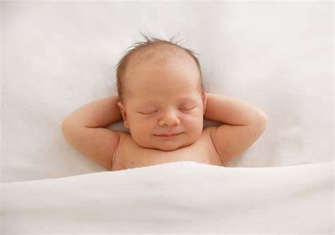
Pediatric Clinical
Shefa’a Al-fraheed: PhD candidate, MSN, RN pediatric Nursing

Slide 2
Physical Assessment Upon Delivery
1: The initial assessment using the
Apgar scoring system.
2: Assessment of gestational age, Ballard Score

Slide 3
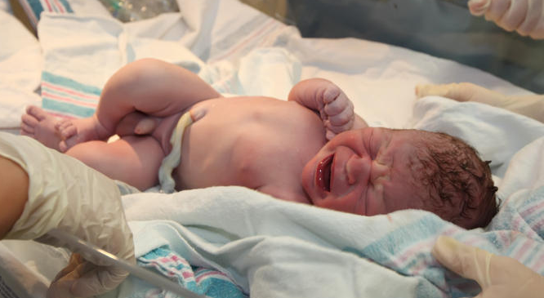
APGAR Score
Apgar score: at the first minute and 5 minute to re-evaluate physical condition, and is based on five signs (heart rate, respiratory effort, muscle tone, reflex irritability, and color).

Slide 4
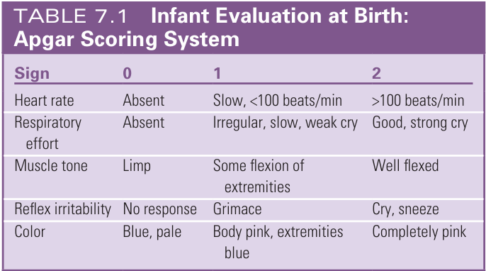

Slide 5
APGAR Score
Apgar score is 10 that state of cardiopulmonary function , If child score is 4 or less i.e child cyanosed , heart rate below 100 beats/ min & inadequate or difficulty respiration , he will needed oxygen . If he has score 7-10 he usually needs no treatment, that is indicated for gestational age for the neonate

Slide 6
You are assisting in the delivery of a full-term baby. At 1 minute of life, the newborn has the following signs:
Heart rate: 110 bpm
Respiratory effort: Slow, irregular breathing
Muscle tone: Some flexion of extremities
Reflex irritability: Grimace when suctioned
Color: Body pink, hands and feet blue
What is SPGAR score ?
Answer:
Heart rate: 2
Respiratory effort: 1
Muscle tone: 1
Reflex irritability: 1
Color: 1
✅ Total = 6

Slide 7
At 5 minutes after birth, a baby presents with:
Heart rate: Absent
Respiratory effort: Absent
Muscle tone: Limp
Reflex irritability: No response to stimulation
Color: Pale
APGAR score is:
Answer : Zero (0)

Slide 8
BALLARD SCORE

Slide 9
2- Assessment Of Gestational Age: Ballard Score
Ballard score defined as :
- is set of procedure developed by Dr. Jeanne Ballard to determine gestational age through neuromuscular & physical assessment of newborn fetus
-Ballard exam :
1- Focuses on physical & neuromuscular characteristic
2- Best done between 12 – 20 hours of life
3- Accurate within 2 weeks

Slide 10
Takes in to account 2 things:
1. Neuromuscular maturity
2.Physical maturity
Posture 4. Popliteal angle
Square Window Test 5. Scarf Sign
Arm recoil 6. Heal to ear test
Skin 4. Breast
Lanugo 5. Eye/Ears
Plantar surface 6. Genitals
Neurological signs are more reliable than physical
Robert Kennedy College - University of Cumbria Online Master Programmes 100% Online in just 1 Year

Slide 11
Tests To Assess Gestational Age
Posture: With infant quiet and in a supine position, observe degree of flexion in arms and legs. Muscle tone and degree of flexion increase with maturity. Full flexion of the arms and legs.
Square window: With thumb supporting back of arm below wrist, apply gentle pressure with index and third fingers on dorsum of hand without rotating infant's wrist. Measure angle between base of thumb and forearm. Full flexion (hand lies flat on ventral surface of forearm)

Slide 12
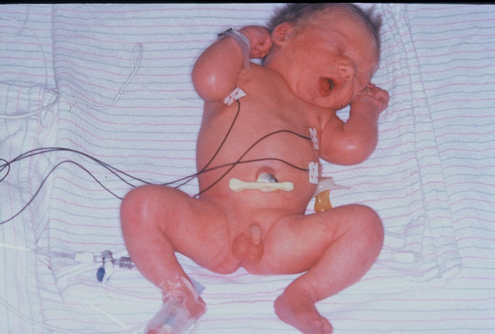
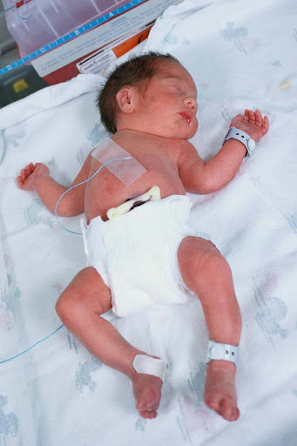
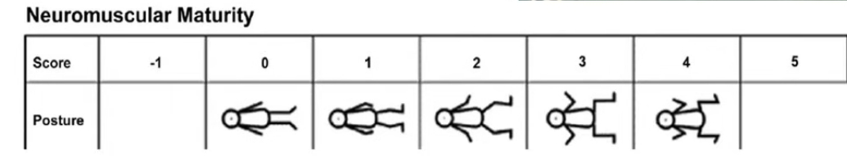
1. POSTURE:

Slide 13
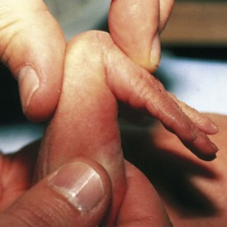
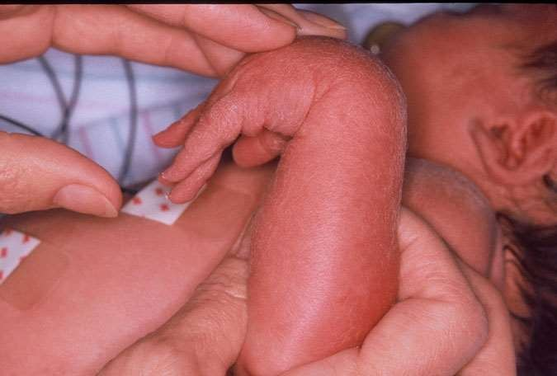
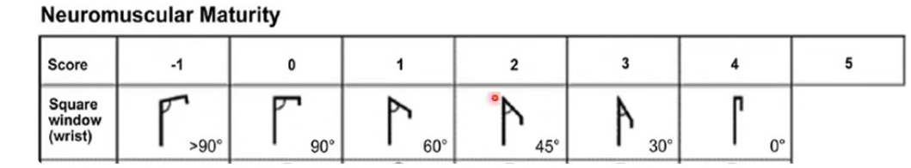
2. Square Window:

Slide 14
Tests To Assess Gestational Age cont.
Arm recoil: With infant supine, fully flex both forearms on upper arms, hold for 5 seconds; pull down on hands to fully extend and rapidly release arms. Observe rapidity and intensity of recoil to a state of flexion. A brisk return to full flexion.
Popliteal angle: With infant supine and pelvis flat on a firm surface, flex lower leg on thigh and then flex thigh on abdomen. While holding knee with thumb and index finger, extend lower leg with index finger of other hand. Measure degree of angle behind knee (popliteal angle). An angle of less than 90 degrees.

Slide 15
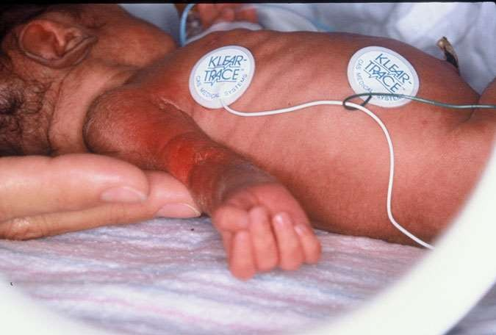
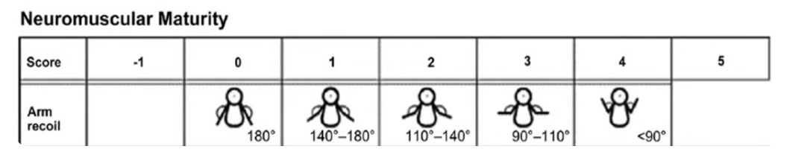
3. Arm Recoil:

Slide 16
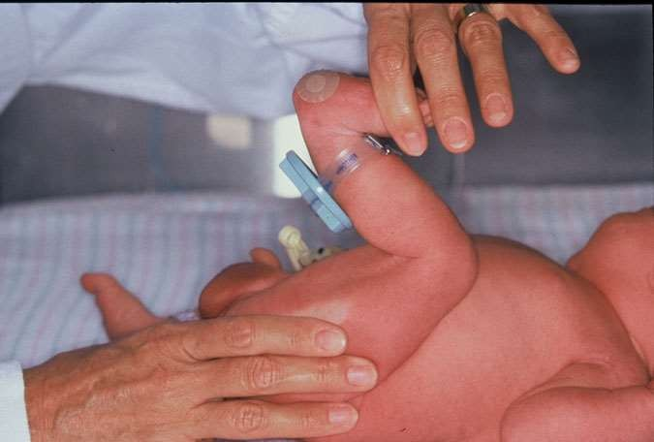
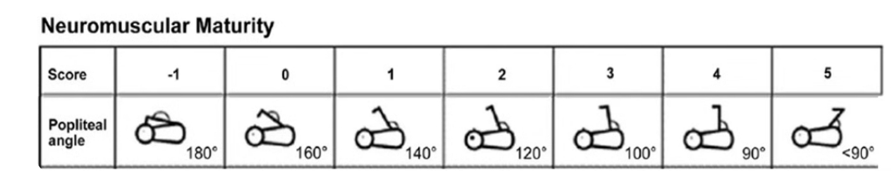
4. Popliteal Angle:

Slide 17
Tests To Assess Gestational Age cont.
Scarf sign: With infant supine, support head in midline with one hand; use other hand to pull infant’s arm across the shoulder so that infant’s hand touches shoulder. Determine location of elbow in relation to midline. Elbow does not reach midline.
Heel to Ear: With infant supine and pelvis flat on a firm surface, pull foot as far as possible up toward ear on same side. Measure degree of knee flexion (same as popliteal angle). Knees flexed with a popliteal angle of less than 90 degrees
physical exam -Newborn Normal: Tone - Heel to Ear

Slide 18
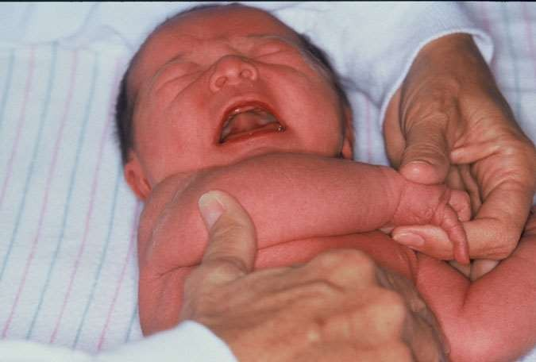
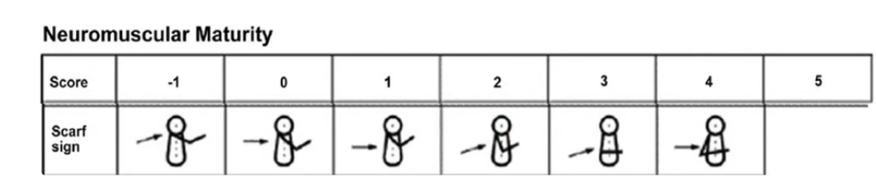
5. Scarf Sign:

Slide 19
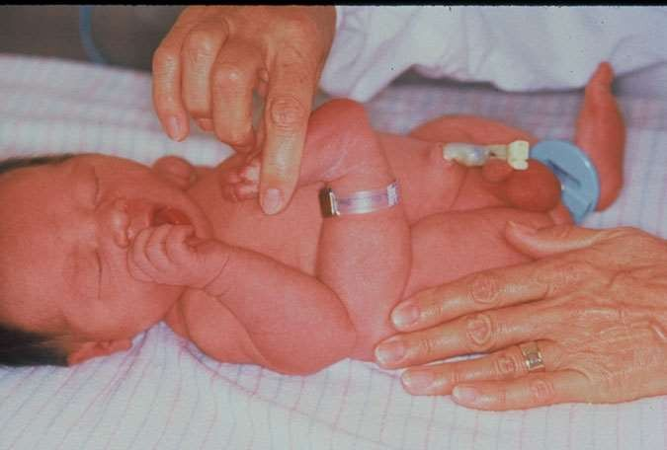
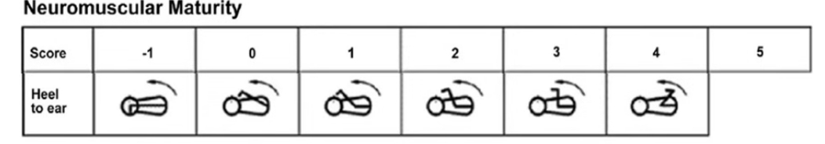
6. Heel to Ear:

Slide 20
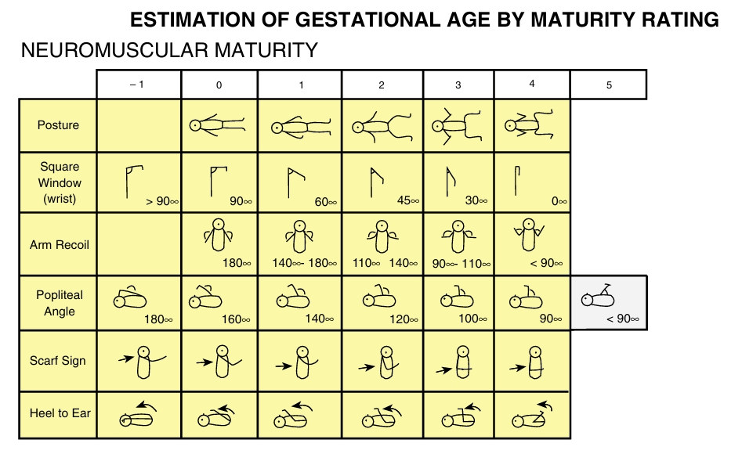

Slide 21
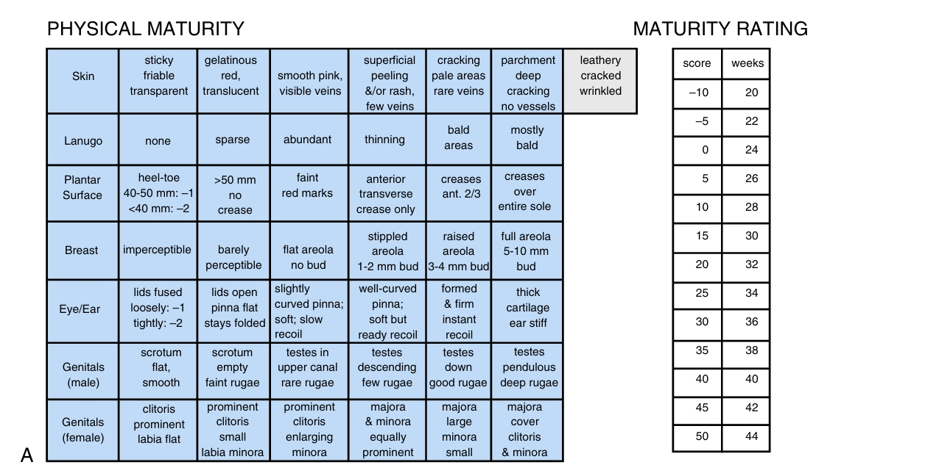
Ballerd Scale Con.

Slide 22
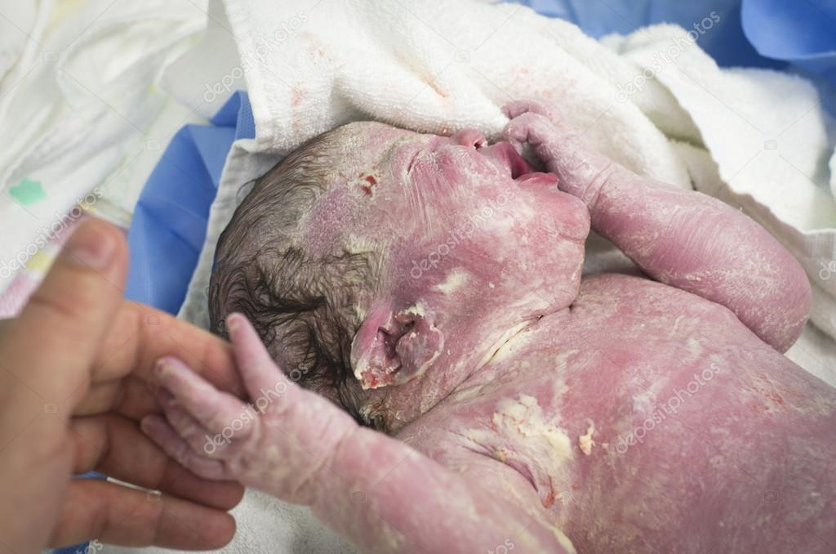
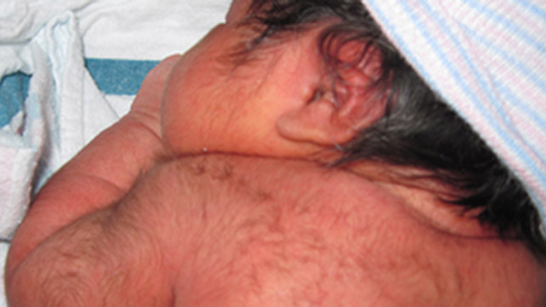
General Appearance
1-Vernix caseosa:
It is soft yellowish cream; which covers the neonates at birth to protect the skin from infection. It is formed of sebaceous gland mixed with old epithelial cell.
2 - Lanugo hair:
It is along soft growth of fine hair observed on the shoulders, back, extremities and forehead. The more premature baby is, the heavier the presence of lanugo is. It disappears during the first weeks of life.

Slide 23
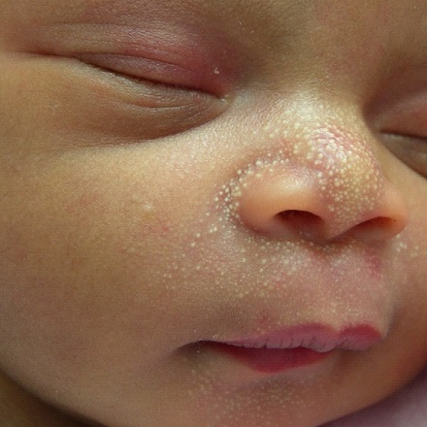
General Appearance cont.
3- Mila:
`These are small pinpoint white or yellow spots due to increased fat secretion.
Common on the nose, forehead, cheeks, and chin of the newborn infants. They will disappear within a few weeks (one to two weeks). They should not be expressed.

Slide 24
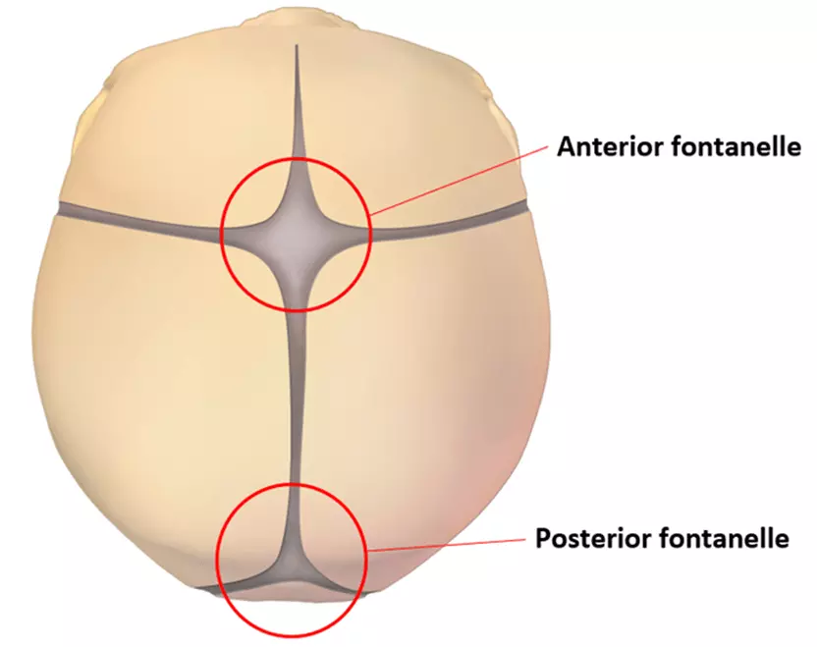
The anterior fontanel:
Is diamond in shape and located at the junction of two parietal and fontal bones. It closes between 12 -18 month of age.
The posterior fontanel:
Is triangular and located between the occipital and parietal bones.
It is closes by two month of age.

Slide 25
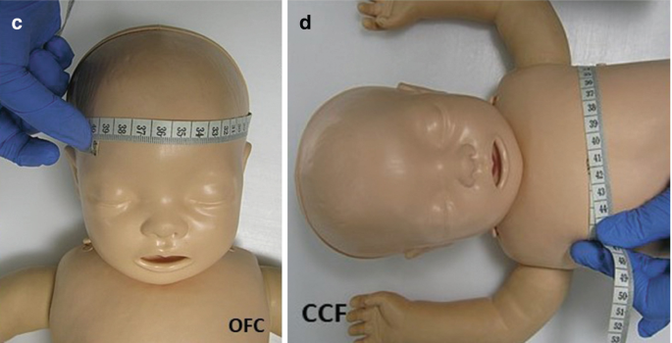
Chest Circumference : Nipple Line
Head Circumference: Above ear, above eyebrow, occipital prominence.

Slide 26
REFLEXES

Slide 27
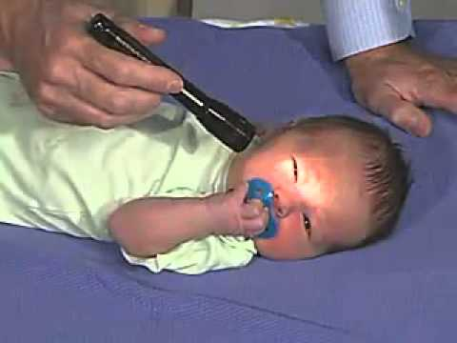
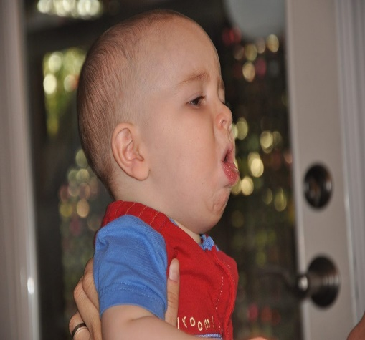
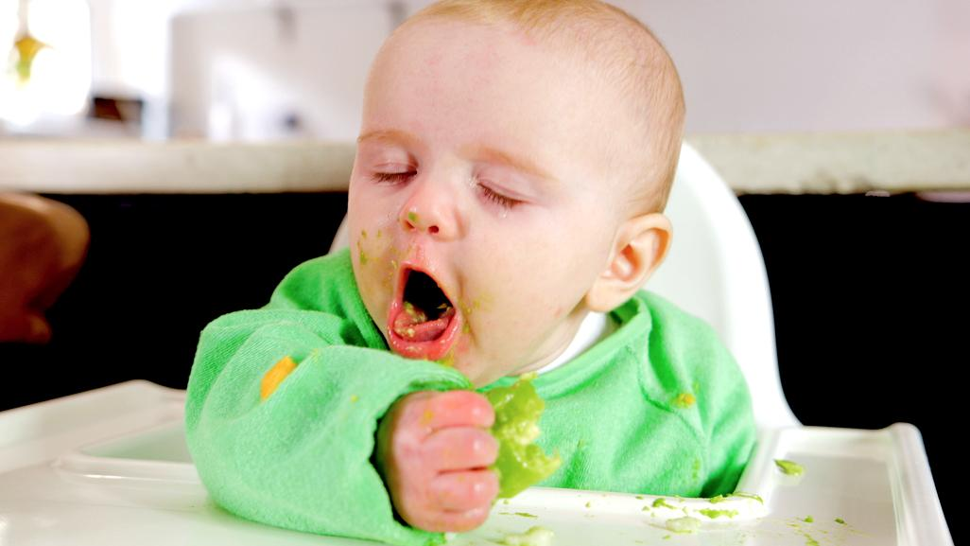
Neonatal Reflexes
Protective reflexes:
Blinking reflex- it is aroused when the infant is subjected to light
Coughing and sneezing –to clear the respiratory tract.
Gagging to prevent choking.

Slide 28
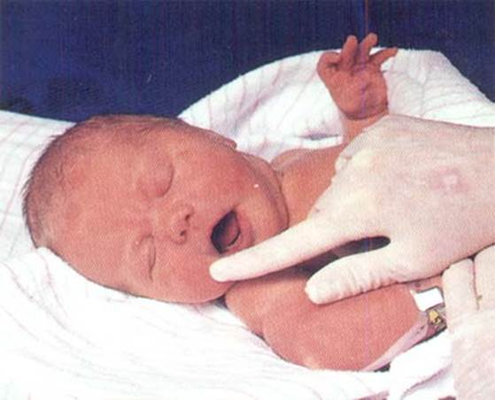
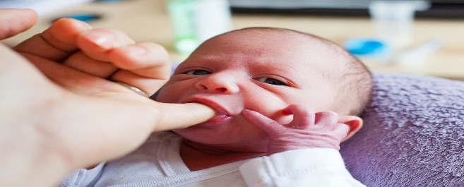
Neonatal Reflexes cont.
Feeding reflexes:
- Rooting reflex:
starts when the corner of the baby's mouth is stroked or touched.
The baby will turn his or her head and open his or her mouth to
follow and root in the direction of the stroking.
This reflex lasts about 4 months. Rooting helps the baby get ready to suck
Sucking reflex.
When the roof of the baby's mouth is touched, the baby will start to suck.
- Swallowing reflex: it follows sucking reflex

Slide 29
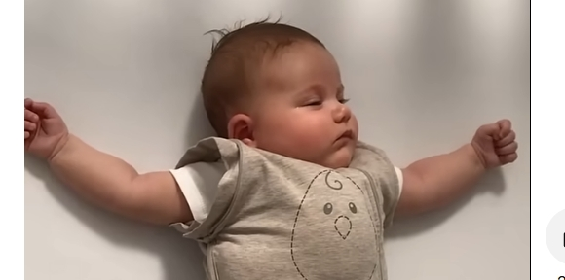
Neonatal Reflexes cont.
- Startle reflex :
A sudden loud noise causes abduction of the arms with flexion of elbows; hands remain clenched; disappears by 4 months old.

Slide 30
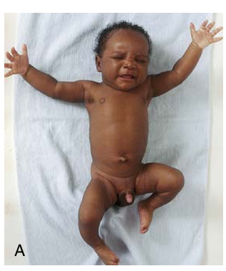
Moro reflex
Sudden jarring or change in equilibrium causes sudden extension and abduction of extremities and fanning of fingers, with index finger and thumb forming a C shape followed by flexion and adduction of extremities.

Slide 31
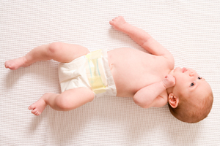
Neonatal Reflexes cont.
- Tonic neck reflex.
When a baby's head is turned to one side, the arm on that side stretches out and the opposite arm bends up at the elbow. This is often called the fencing position. This reflex lasts until the baby is about 5 to 7 months old.

Slide 32
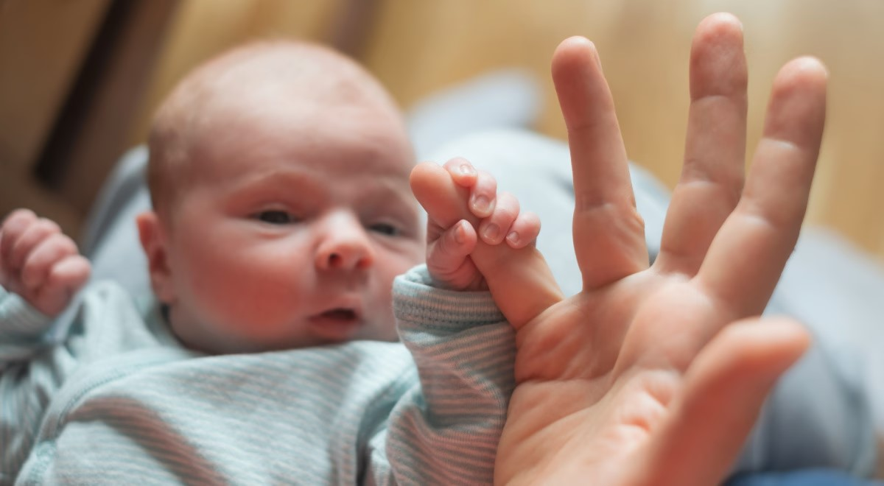
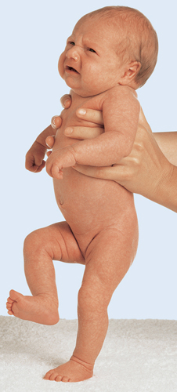
Neonatal Reflexes cont.
- Grasp reflex
Stroking the palm of a baby's hand causes the baby to close his or her fingers in a grasp. The grasp reflex lasts until the baby is about 5 to 6 months old. A similar reflex in the toes lasts until 9 to 12 months.
- Stepping reflex
This reflex is also called the walking or dance reflex because a baby appears to take steps or dance when held upright with his or her feet touching a solid surface. This reflex lasts about 2 months.

Slide 33
HEAT LOSS

Slide 34
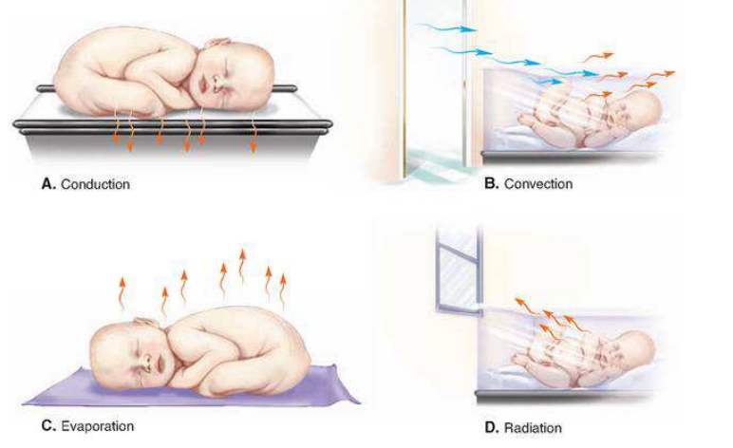
Heat loss mechanism in newborn

Slide 35
Heat loss mechanism in newborn cont.
1- Convection
When cooler air passes over a warm newborn.
Minimize heat loss by: Placing newborn away from direct fans or opens windows.
2- Conduction
Occurs when the transfer of body heat to a cooler solid object in contact with the newborn.
Minimize heat loss by: Cover surfaces with a pre-warm blanket or towel.

Slide 36
Heat loss mechanism in newborn cont.
3- Radiation
Occurs when the transfer of heat to a cooler object not in contact with the newborn.
Minimize heat loss by: Placing newborn care areas away from windows, doorways and outside walls.
4- Evaporation
When the wet newborn’s skin is exposed to room air of any temperature.
Minimize heat loss by: Dry newborn immediately and replace wet blankets with warm blankets.

Slide 37
VITAL SIGNS

Slide 38
Body Temperature

Slide 39
Routes For Measuring The Body Temperature
- ORAL
best site for measuring in the clinical settings
triangle shaped thermometer
axillo – oral difference 0,3 °C
- AXILLARY
more likely to be affected by the environmental temperature,
used in children/adults
- RECTAL
fast thermometer, used in infants/confused patients/receiving O2
axillo – rectal difference 0,5 °C

Slide 40





















Respiration
Description | Respiration
Normal breathing | Eupnea
Increase rate | Tachypnea
Decrease rate | Bradypnea
Distress during breathing | Dyspnea
Cessation of breathing | Apnea
Increased depth | Hyperpnea
Decreased rate and depth (shallow) | Hypoventilation
Increased rate and depth | Hyperventilation
Last grasping breaths before death | Agonal
Hyperventilation, grasping labored respiration; usually seen in diabetic ketoacidosis (DKA) or respiratory acidosis | Kussmaul respiration
Gradually increase rate and depth with periods of apnea | Chyene-Stokes respiration
Chest falls on inspiration and rises on expiration | Seesaw respiration

Slide 41
Average respiratory rate
Age group | Respiratory rate breaths / min
Newborn | 30-60
Infant | 20-40
Toddler | 20-30
Preschool | 16-22
School | 16-20

Slide 42
Average of blood pressure
Age group | Blood pressure (mmHG)
Systolic
Newborn | 65-70
2-5 years | 100
6-12 years | 104-116
12-18 years | 120-126
Diastolic
Newborn | 45
2-5 years | 55
12-6 years | 67-75
12-18 years | 76-83

Slide 43
PULSE
PULSE RHYTHM
Regular
Irregular – arrythmia
PULSE QUALITY
Strong (fever)
Weak (shock/heart failure)
PULSE RATE
Normal
Bradycardia
Tachycardia
Asystole

Slide 44
Average Of Heart Rate
Age group | Heart rate breaths / min
Newborn | 120-140
Infant | 80-150
Toddler | 80-130
Preschool | 70-115
School | 70-115

Slide 45
PAIN ASSESSMENT

Slide 46
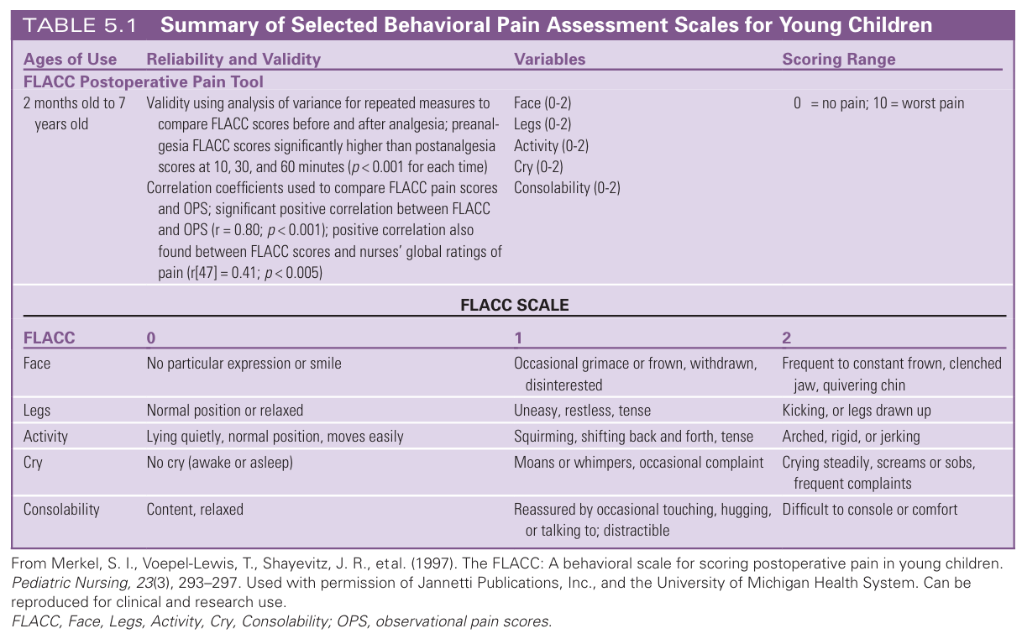

Slide 47
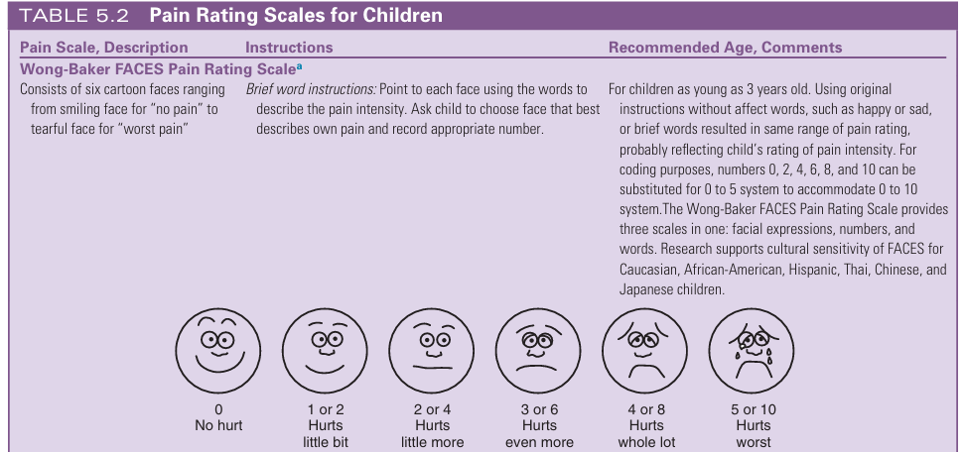

Slide 48
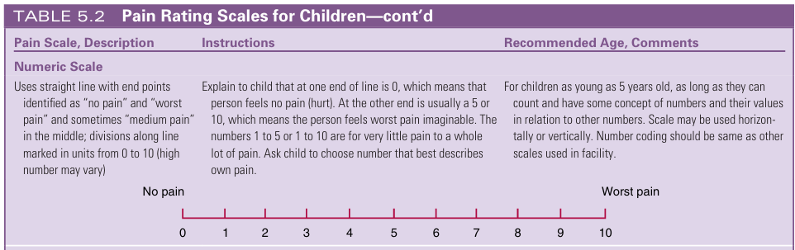

Slide 49
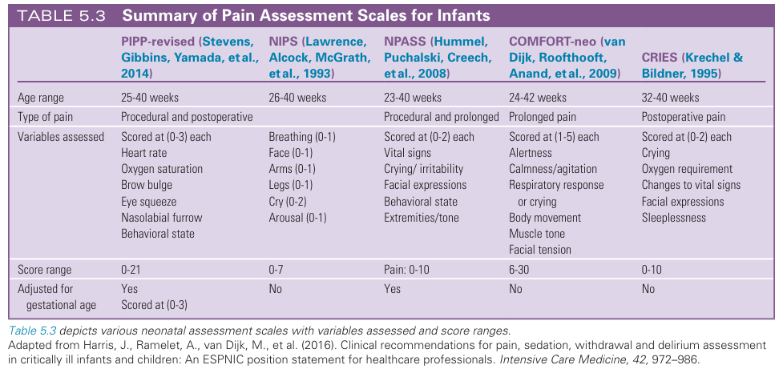

Slide 50
IMMUNIZATION

Slide 51
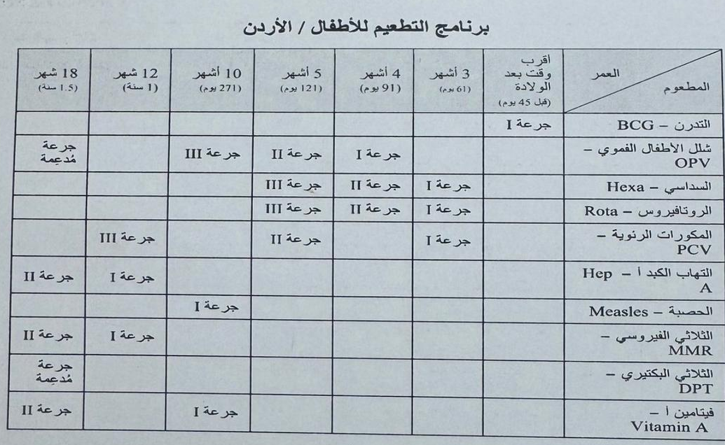
Immunization

Slide 52
Age | Vaccine
After birth | BCG
61 days | (DPT1+ Hib1+ HepB1+ IPV1)+ Rota virus 1 + PCV1
91 days | (DPT2+ Hib2+ HepB2+ IPV2)+ Rota virus2 +OPV1
121 days | (DPT3+ Hib3+ HepB3+ IPV3)+ Rota virus3 +OPV2+ PCV2
10th month | Measles + OPV3 + Vit A1 (100000 IU )
12th month | MMR1 + PCV3 + Hep A1
18th month | DPT boster+ MMR2 + OPV boster + Hep A2 + Vit A2 ( 200000 IU)

Slide 53
At 61 days, which of the following vaccines is administered according to Jordanian vaccination schedule?
A. OPV, PCV, Rotavirus
B. OPV, Hexavalent, Rotavirus
C. IPV, PCV, MMR
D. OPV, MMR, Hexavalent
🟩 Answer: B. OPV, Hexavalent, Rotavirus
How many doses of the Hexavalent vaccine are given in Jordanian vaccination schedule?
A. 1
B. 2
C. 3
D. 4
🟩 Answer: C. 3 (at 61, 91, and 121 days)

Slide 54
At what age does the child receive the first dose of Hepatitis A vaccine according to Jordanian vaccination schedule?
A. At birth
B. 10th month
C. 12th month
D. 18th month
🟩 Answer: C. 12th month

Slide 55
Holliday-Segar
"a method used in pediatrics to calculate maintenance fluid requirements based on pediatric body weight.
daily maintenance fluid needs as follows:
Weight of Child | Daily Fluid Requirement
First 10 kg | 100 mL/kg
Next 10 kg (10–20 kg) | 50 mL/kg
Any weight above 20 kg | 20 mL/kg

Slide 56
Child’s weight = 25 kg
Break it down:
First 10 kg → 10 kg × 100 mL = 1000 mL
Next 10 kg → 10 kg × 50 mL = 500 mL
Remaining 5 kg → 5 kg × 20 mL = 100 mL
Total Daily Requirement = 1000 + 500 + 100 = 1600 mL/day

Slide 57
Hourly maintenance fluid needs as follows:
Weight of Child | Daily Fluid Requirement
First 10 kg | 4 mL/kg
Next 10 kg (10–20 kg) | 2 mL/kg
Any weight above 20 kg | 1 mL/kg

Slide 58
Child weighs 27 kg
Break it down by segment:
First 10 kg → 10 × 4 = 40 mL/hr
Next 10 kg → 10 × 2 = 20 mL/hr
Remaining 7 kg → 7 × 1 = 7 mL/hr
Total = 40 + 20 + 7 = 67 mL/hr

Slide 59
Medication Calculation

Slide 60
Volume Calculation (for liquid meds)
If you know the dose and the concentration, use:
Formula:
Prescribed Dose (mg) x Dilution (ml)
Volume to be given (ml) =
Stock (mg)
Example:
Order: 250 mg Amoxicillin
Stock: 500 mg/10 mL
Volume to be given = 250 x 10 / 500 = 5 ml

Slide 61
Example:
Order: 115 mg Ampicillin
Stock: 500 mg/5 mL
Volume to be given = 115 x 5 / 500 = 1.15 ml
If in 10 ml ?
115 x 10 / 500 = 2.3 ml

Slide 62
Thank you

