Slide 1

Injections
Done by:Safaa hammad

Slide 2
Intramuscular (IM) injection
Introduction
Intramuscular (IM) injection deposits medication deep into muscle tissue. This route of administration provides rapid systemic action and absorption of relatively large doses (up to 5 mL in appropriate sites). Guidelines recommend IM injection for a patient who can't take medication orally, when IV administration is inappropriate or inaccessible, and for medications that are altered by digestive juices. Because muscle tissue has few sensory nerves, an IM injection allows less painful administration of irritating medications.

Slide 3
You must choose the site for an IM injection carefully, taking into account the patient's general physical status and the purpose of the injection. IM injections are contraindicated if the site is inflamed, edematous, or irritated or contains moles, birthmarks, scar tissue, or other lesions
The prescribed medication must be sterile. The needle may be packaged separately or already attached to the syringe

Slide 4
Equipment
Alcohol pads
Gauze pads
Patient's medication administration record
Prescribed medication
The following guidelines can help in your choice:
vastus lateralis muscle
deltoid muscle
ventrogluteal site
Single-use sterile syringe and needle of appropriate size and gauge (self-sheathing needle recommended)

Slide 5
Implementation
Gather and prepare the necessary equipment and supplies.
Compare the medication label to the order in the patient's medical record.
Review the patient's medical record for an allergy or contraindication
Visually inspect the solution for particles, discoloration, or other loss of integrity. Don't administer the medication if its integrity is compromised
Perform hand hygiene
Provide privacy. Explain the procedure to the patient and family (if appropriate)

Slide 6
Select an appropriate injection site. The ventrogluteal site is the safest for a large-volume IM injection in an adult, although you may use the deltoid muscle for a small-volume injection (2 mL or less)

Slide 7
LOCATING IM INJECTION SITES
For deltoid muscle injection, have the patient sit or stand Insert the needle 1" to 2" (2.5 to 5 cm) below the acromion process, usually two or three fingerbreadths, at a 90-degree
The maximum injection volume for this area is 2 mL.

Slide 8
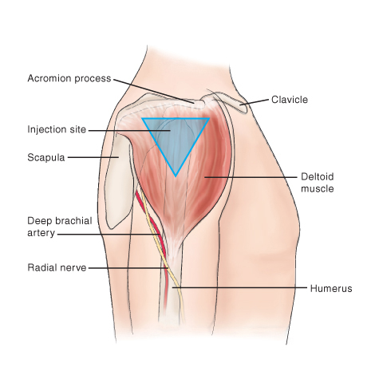

Slide 9
Ventrogluteal site
For ventrogluteal site injection, have the patient sit, stand, lie laterally, or lie supine.
Give at a 90-degree angle to the muscle

Slide 10
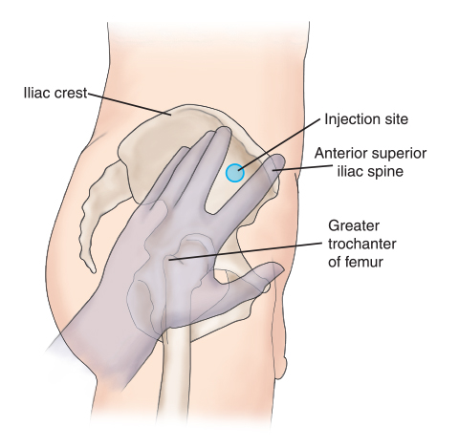

Slide 11
Vastus lateralis muscle
Insert the needle into the outer middle third of the muscle
The maximum injection volume for this area is 5 mL

Slide 12
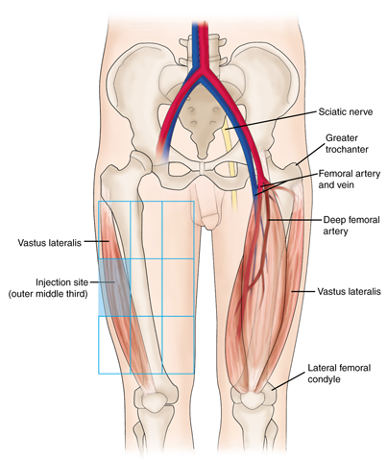

Slide 13

Position and drape the patient appropriately using the bed linens (as shown below), making sure that the injection site is well exposed and that lighting is adequate.

Slide 14
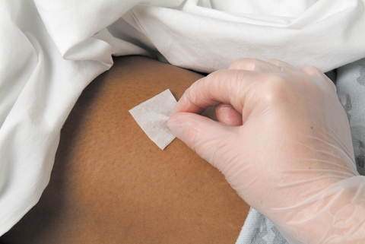
After selecting the injection site, clean the skin with an alcohol pad (as shown below). Move the pad outward in a circular motion

Slide 15
Remove the needle sheath
With the thumb and index finger of your nondominant hand, displace the skin and subcutaneous tissue of the injection site gently by pulling the skin
Position the syringe at a 90-degree angle to the patient's skin surface, with the needle a couple of inches from the skin
With your dominant hand, insert the needle quickly and smoothly through the patient's skin and subcutaneous tissue, deep into the muscle, at a 90-degree angle
inject the medication slowly into the patient's muscle
withdraw the needle slowly at a 90-degree angle

Slide 16

Release the patient's displaced skin and subcutaneous tissue
Cover the injection site immediately with a gauze pad, and apply gentle pressure (as shown below).

Slide 17
Remove the gauze pad, and inspect the injection site for signs of active bleeding or bruising. If bleeding continues, apply pressure to the injection site. If bruising occurs, consider applying ice or a cold compress.
Apply an adhesive bandage, if necessary.

Slide 18

Subcutaneous injection

Slide 19
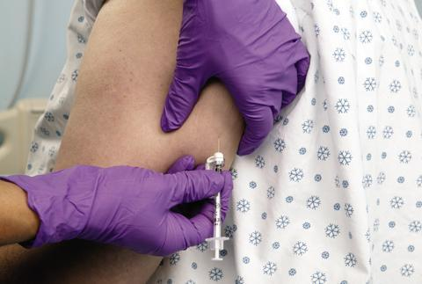
Subcutaneous injection delivers a drug into the adipose (fatty) tissue beneath the skin
TECHNIQUE FOR SUBCUTANEOUS INJECTION
Select an appropriate injection site
Before giving the injection, elevate the subcutaneous tissue at the site by grasping it firmly (as shown below)

Slide 20
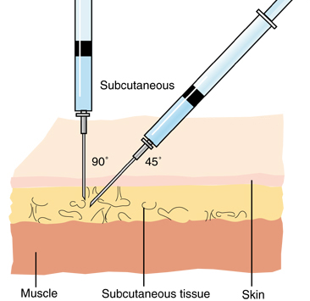
Insert the needle at a 45- or 90-degree angle to the skin's surface, depending on needle length and the amount of subcutaneous tissue at the site (as shown below)

Slide 21
Intravenous injection
Intravenous means "within a vein." Most often it refers to giving
medicines or fluids through a needle or tube inserted into a vein
A healthcare professional may administer an IV injection in the following situations:
when a person needs a potentially life saving medication very quickly
when a person needs a very accurate dose of a medication
when a person needs a large dose of a medication over an extended period of time
when taking a medication by mouth would be impractical or ineffective

Slide 22
Extra necessary equipment may include the following:
a tourniquet to help the healthcare professional identify a suitable vein
IV bags and lines for delivering infusions

Slide 23
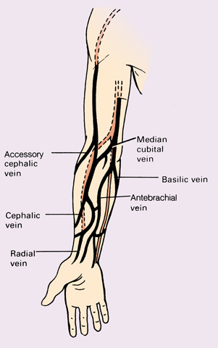
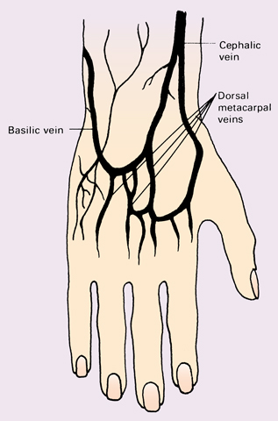
Sites
Some common sites for short-term IV lines include forearm locations, such as the wrist or elbow, or the back of the hand.

Slide 24
TECHNIQUE FOR IV INJECTION
Assess IV insertion site for complications
Apply a tourniquet on an upper extremity to dilate the veins and assess for an appropriate IV insertion site
Palpate the vein lightly with the index and middle fingers of your nondominant hand to assess vein condition
Prepare the insertion site using an antiseptic agent, Allow the solution to dry completely
Preparing the syringes:
1- Remove the syringe cap
2- Gently tap the syringe to move air to the tip.
3 -Push the plunger to remove air and extra solution.
4 -Replace the syringe cap until you are ready to use it.

Slide 25
Stretch the patient's skin taut below the puncture site using the thumb of your nondominant hand to stabilize the vein
Tell the patient that you're about to insert the device.
Puncture the patient's skin and anterior vein wall, and advance the needle
Aspirate and Watch for blood to appear in the needle
Release the tourniquet.
Administer the medication, injecting medication slowly

