Slide 1
Infection control
Done by: MRS. SAFAA HAMMAD

Slide 2
WHAT IS INFECTION
An invasion of body tissue by microorganisms and their growth there
Type of microorganisms causing infection
Bacteria
Viruses
Fungi
Parasites

Slide 3
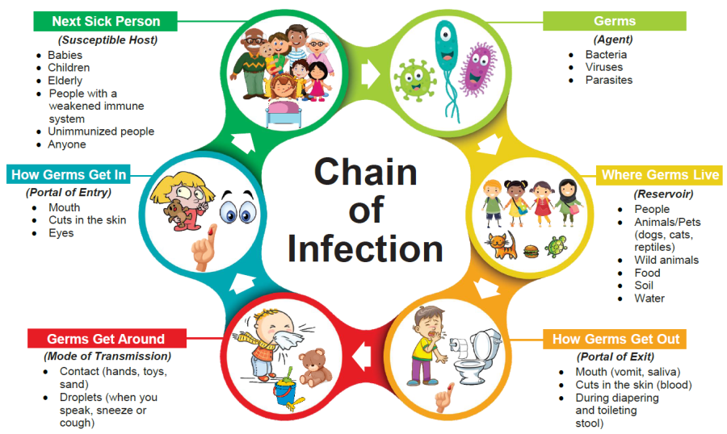

Slide 4
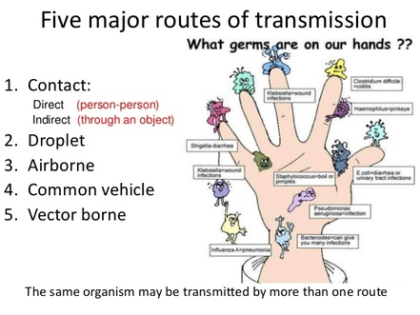

Slide 5
What is Infection Control:
All of the practices used to prevent the spread of microorganisms that could cause disease in a person.
Infection control practices help to protect clients and healthcare providers from disease by reducing and/or eliminating sources of infection

Slide 6
Most nosocomial infections are transmitted by health care workers and clients as a result of direct contact.
We must pay particular attention to washing hands after contact with clients or equipment.

Slide 7
Why do we need to control nosocomial infection?
Nosocomial infections lead to
Increased healthcare costs,
Extended hospital stays.
Prolonged recovery time.
Cause disability and discomfort.
Loss of life.

Slide 8
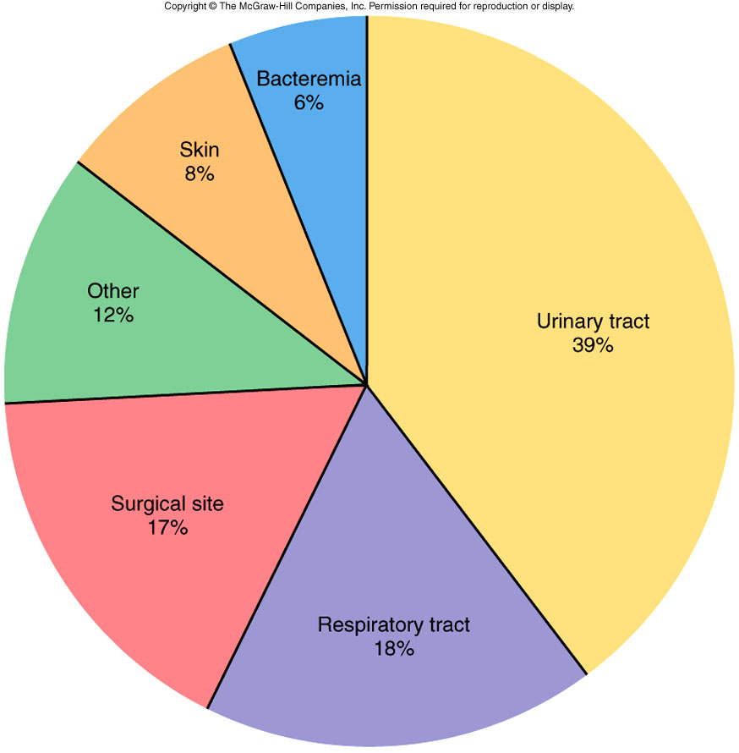
Frequency of different Nosocomial Infections

Slide 9
How to prevent of nosocomial infection?
Hand hygiene
Break the chain of infection
provide adequate nutrition & rest.
promote body defenses against infection & provide immunization.
Follow the principles of aseptic technique.

Slide 10


Slide 11
HANDWASHING…
is the most important measure you can use to prevent the spread of infection
• Hands are the main pathways of
germ transmission during health care.
• Hand hygiene is therefore the most
important measure to avoid the
transmission of harmful germs
prevent health care-associated
infections.

Slide 12
Key Times to Wash Hands
You can help yourself and your loved ones stay healthy by washing your hands often, especially during these key times when you are likely to get and spread germs:
Before, during, and after preparing food
Before eating food
Before and after caring for someone at home who is sick with vomiting or diarrhea
Before and after treating a cut or wound
After using the toilet
After changing diapers or cleaning up a child who has used the toilet
After blowing your nose, coughing, or sneezing
After touching an animal, animal feed, or animal waste

Slide 13
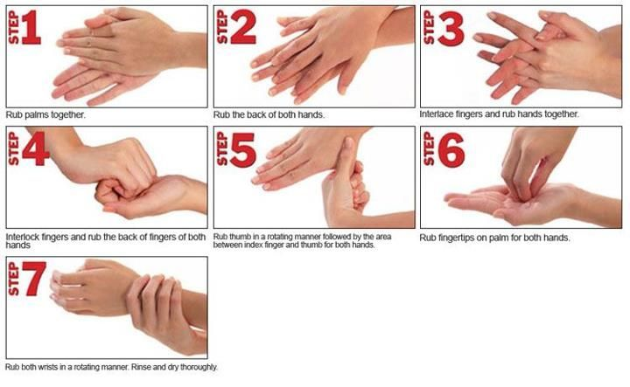

Slide 14
Part of routine infection control practices, standard precautions include wearing gloves for situations involving known or anticipated contact with blood, body fluids, tissue, mucous membranes, or nonintact skin.¹ If the task or procedure you're performing may result in splashing or splattering of blood or body fluids to the face, you should also wear a mask and goggles or a mask with a face shield. If the task or procedure you're performing may result in splashing or splattering of blood or body fluids to the body, you should also wear a fluid-resistant gown or apron.¹² Additional protective clothing, such as shoe covers, may be appropriate to protect your feet in situations that may expose you to large amounts of blood or body fluids (or both), such as when caring for a trauma patient in an operating room or emergency department.

Slide 15
Part of routine infection control practices, standard precautions include wearing gloves for situations involving known or anticipated contact with blood, body fluids, tissue, mucous membranes, or nonintact skin. If the task or procedure you're performing may result in splashing or splattering of blood or body fluids to the face, you should also wear a mask and goggles or a mask with a face shield. If the task or procedure you're performing may result in splashing or splattering of blood or body fluids to the body, you should also wear a fluid-resistant gown or apron. Additional protective clothing, such as shoe covers, may be appropriate to protect your feet in situations that may expose you to large amounts of blood or body fluids (or both), such as when caring for a trauma patient in an operating room or emergency department.

Slide 16
Precaution type | Indications | Nursing actions
Airborne | To prevent the spread of infection when a patient is suspected or known to have an infection that's spread by the airborne route | Place the patient in an airborne infection isolation room with monitored negative pressure, if available. Caution all people entering the room to wear a respirator mask Staff members who aren't immune to vaccine-preventable airborne diseases shouldn't care for the patient.
Contact | To prevent the spread of epidemiologically important infectious organisms through direct patient contact or indirect contact with the patient's environment | Place the patient in a single-patient room, if possible. Wear a gown and gloves for all interactions with the patient or the patient's environment. Follow your facility's infection control plan to determine when to initiate contact precautions Dedicate patient care equipment to a single patient, if possible.

Slide 17
Droplet | To prevent the spread of infectious organisms through close respiratory or mucous membrane contact with respiratory secretions from an infected patient | Place the patient in a single-patient room, if possible. Put on a mask before entering the patient's room, Dedicate patient care equipment to a single patient, if possible. Have the patient wear a mask, if transported outside of the room.

Slide 18
Airborne precautions
Condition | Precautionary period | Special considerations (as applicable)
Avian influenza | For 14 days after onset of symptoms or until an alternative diagnosis is confirmed | N/A
Chickenpox (varicella) | Until lesions are crusted and no new lesions appear | Susceptible health care workers shouldn't enter the room if immune health care workers are available. Contact precautions should be instituted.
Measles (rubeola) | For 4 days after onset of rash For duration of illness in immunocompromised patients | Susceptible health care workers shouldn't enter the room if immune health care workers are available.
Severe acute respiratory syndrome | Duration of illness plus 10 days after resolution of fever | Eye protection (goggles or face shield) should be worn. Contact precautions should be instituted. Vigilant environmental disinfection should be performed.

Slide 19
Tuberculosis, extrapulmonary, draining lesion | Until the patient improves clinically and drainage has ceased or until three consecutive negative cultures of continued drainage are obtained1 | Contact precautions should be instituted.

Slide 20
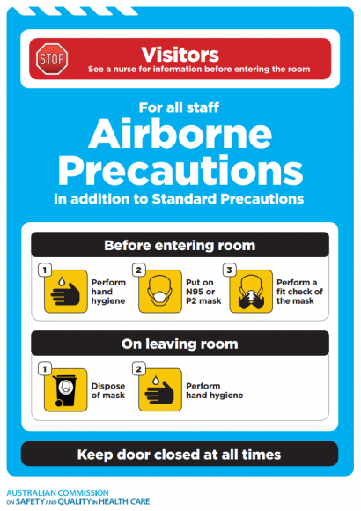

Slide 21
Contact precautions
Condition | Precautionary period | Special considerations (if applicable)
Abscess, major draining | Duration of illness or until drainage stops or can be contained by a dressing | Add droplet precautions for the first 24 hours of appropriate antibiotic therapy if you suspect invasive group A streptococcal disease.
Bronchiolitis | Duration of illness | Wear a mask according to standard precautions.
Diphtheria, cutaneous | Until two cultures (obtained 24 hours apart) are negative and the patient is off antibiotics
scherichia coli gastroenteritis diapered or incontinent patient | Duration of illness or a duration that's appropriate to control a facility outbreak
Hepatitis type A | Duration of hospitalization in infants and children younger than age 3 For 2 weeks after the onset of symptoms in children ages 3 to 14 For 1 week after the onset of symptoms in children older than age 14

Slide 22
gastroenteritis, diapered or incontinent patient | Duration of illness and a period following recovery while the patient is still shedding the virus at high levels (usually 24 to 72 hours)12 | Wear a mask when cleaning areas that are heavily contaminated with feces or vomitus.12 Note that in some situations in health care facilities, isolation of exposed and potentially incubating patients may also be necessary.12 Conduct environmental cleaning and disinfection consistently; consider using an EPA-registered disinfectant that has a sporicidal claim or sodium hypochlorite solution.
Rotavirus gastroenteritis | Duration of illness | Conduct environmental cleaning and disinfection consistently. Change and dispose of soiled diapers frequently. Note that viral shedding may be prolonged in immunocompromised pediatric and elderly patients.

Slide 23
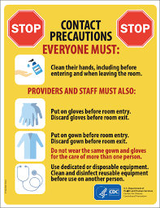

Slide 24
Droplet precautions
Pediatric alert: When handling infants or young children who require droplet precautions, you may also need to institute contact precautions and wear gloves and a gown to prevent soiling of clothing from nasal and oral secretions.

Slide 25
Condition | Precautionary period | Special considerations (as applicable)
Diphtheria (pharyngeal) | Until the patient is no longer taking antibiotics and two cultures taken at least 24 hours apart are negative
Influenza (seasonal) | For 7 days after onset of signs and symptoms or until 24 hours after fever and respiratory symptoms have resolved, whichever is longer3 For the duration of illness in immunocompromised patients | Viral shedding is prolonged in immunocompromised patients.
Mumps | For 5 days after the onset of swelling4 | Susceptible health care workers shouldn't provide care if immune caregivers are available.
Rubella (German measles) | Until 7 days after onset of rash | Susceptible health care workers shouldn't enter the room if immune caregivers are available. Administer vaccine to nonpregnant susceptible individuals within 3 days of exposure.

Slide 26
