Slide 1
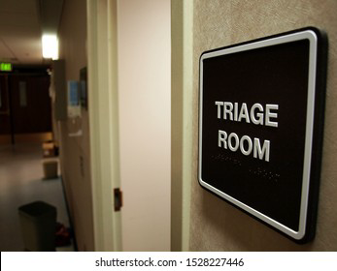
Triage and rapid assessment done by eman lafi

Slide 2


Slide 3

Triage
a method of classifying all incoming emergency department patients, uses the patient's primary concern and the results of primary and secondary assessments to set priorities for care.

Slide 4
Triage Principles
Triage is a process which places the right patient in the right place at the right time to receive the right level of care.
A basic concept of triage is to do the greatest good for the greatest number of casualties.

Slide 5
Good Triage Providers
Clinically experienced.
Good judgment and leadership.
Calm and cool under stress.
Decisive.
Knowledgeable of available resources.
Sense of humor.
Creative problem solver.
Available.
Experienced and knowledgeable regarding anticipated casualties.

Slide 6
Categories of triage
Daily triage:
On a routine basis every day in the emergency department.
Mass casualty incident triage:
When the emergency department is stressed by large number of patients but remains functional.
Disaster triage:
When local emergency services are overwhelmed to the point that immediate care cannot be provided to everyone who need it.

Slide 7
Categories of triage
Tactical-military triage:
Is similar to disaster triage, only military mission objectives rather than traditional nursing guidelines drive the triage and transport decision.
Special conditions triage:
Used when patients present from incident involving weapons of mass construction, such as radiation, biologic, or chemical contamination.

Slide 8
General Types of Triage
In-hospital triage ) Conventional ( :
The most fragile patients are identified and treated first.
Military triage )Reverse Triage ( :
Fragile patient who have a good likelihood of survival and do not require an extraordinary number of resources are treated first.
Those who have a low probability of survival or require a large number of resources are not treated.

Slide 9
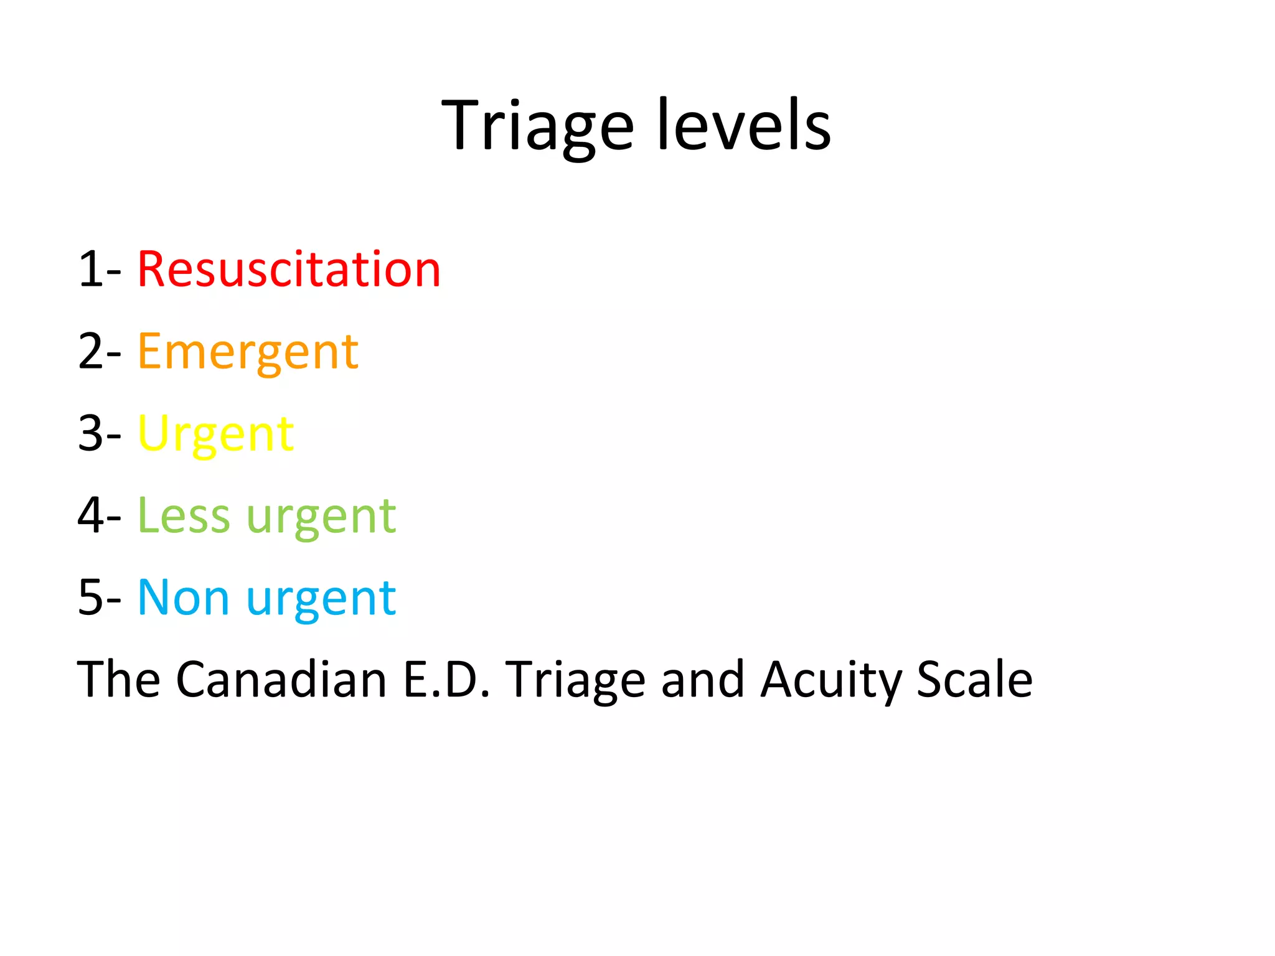

Slide 10
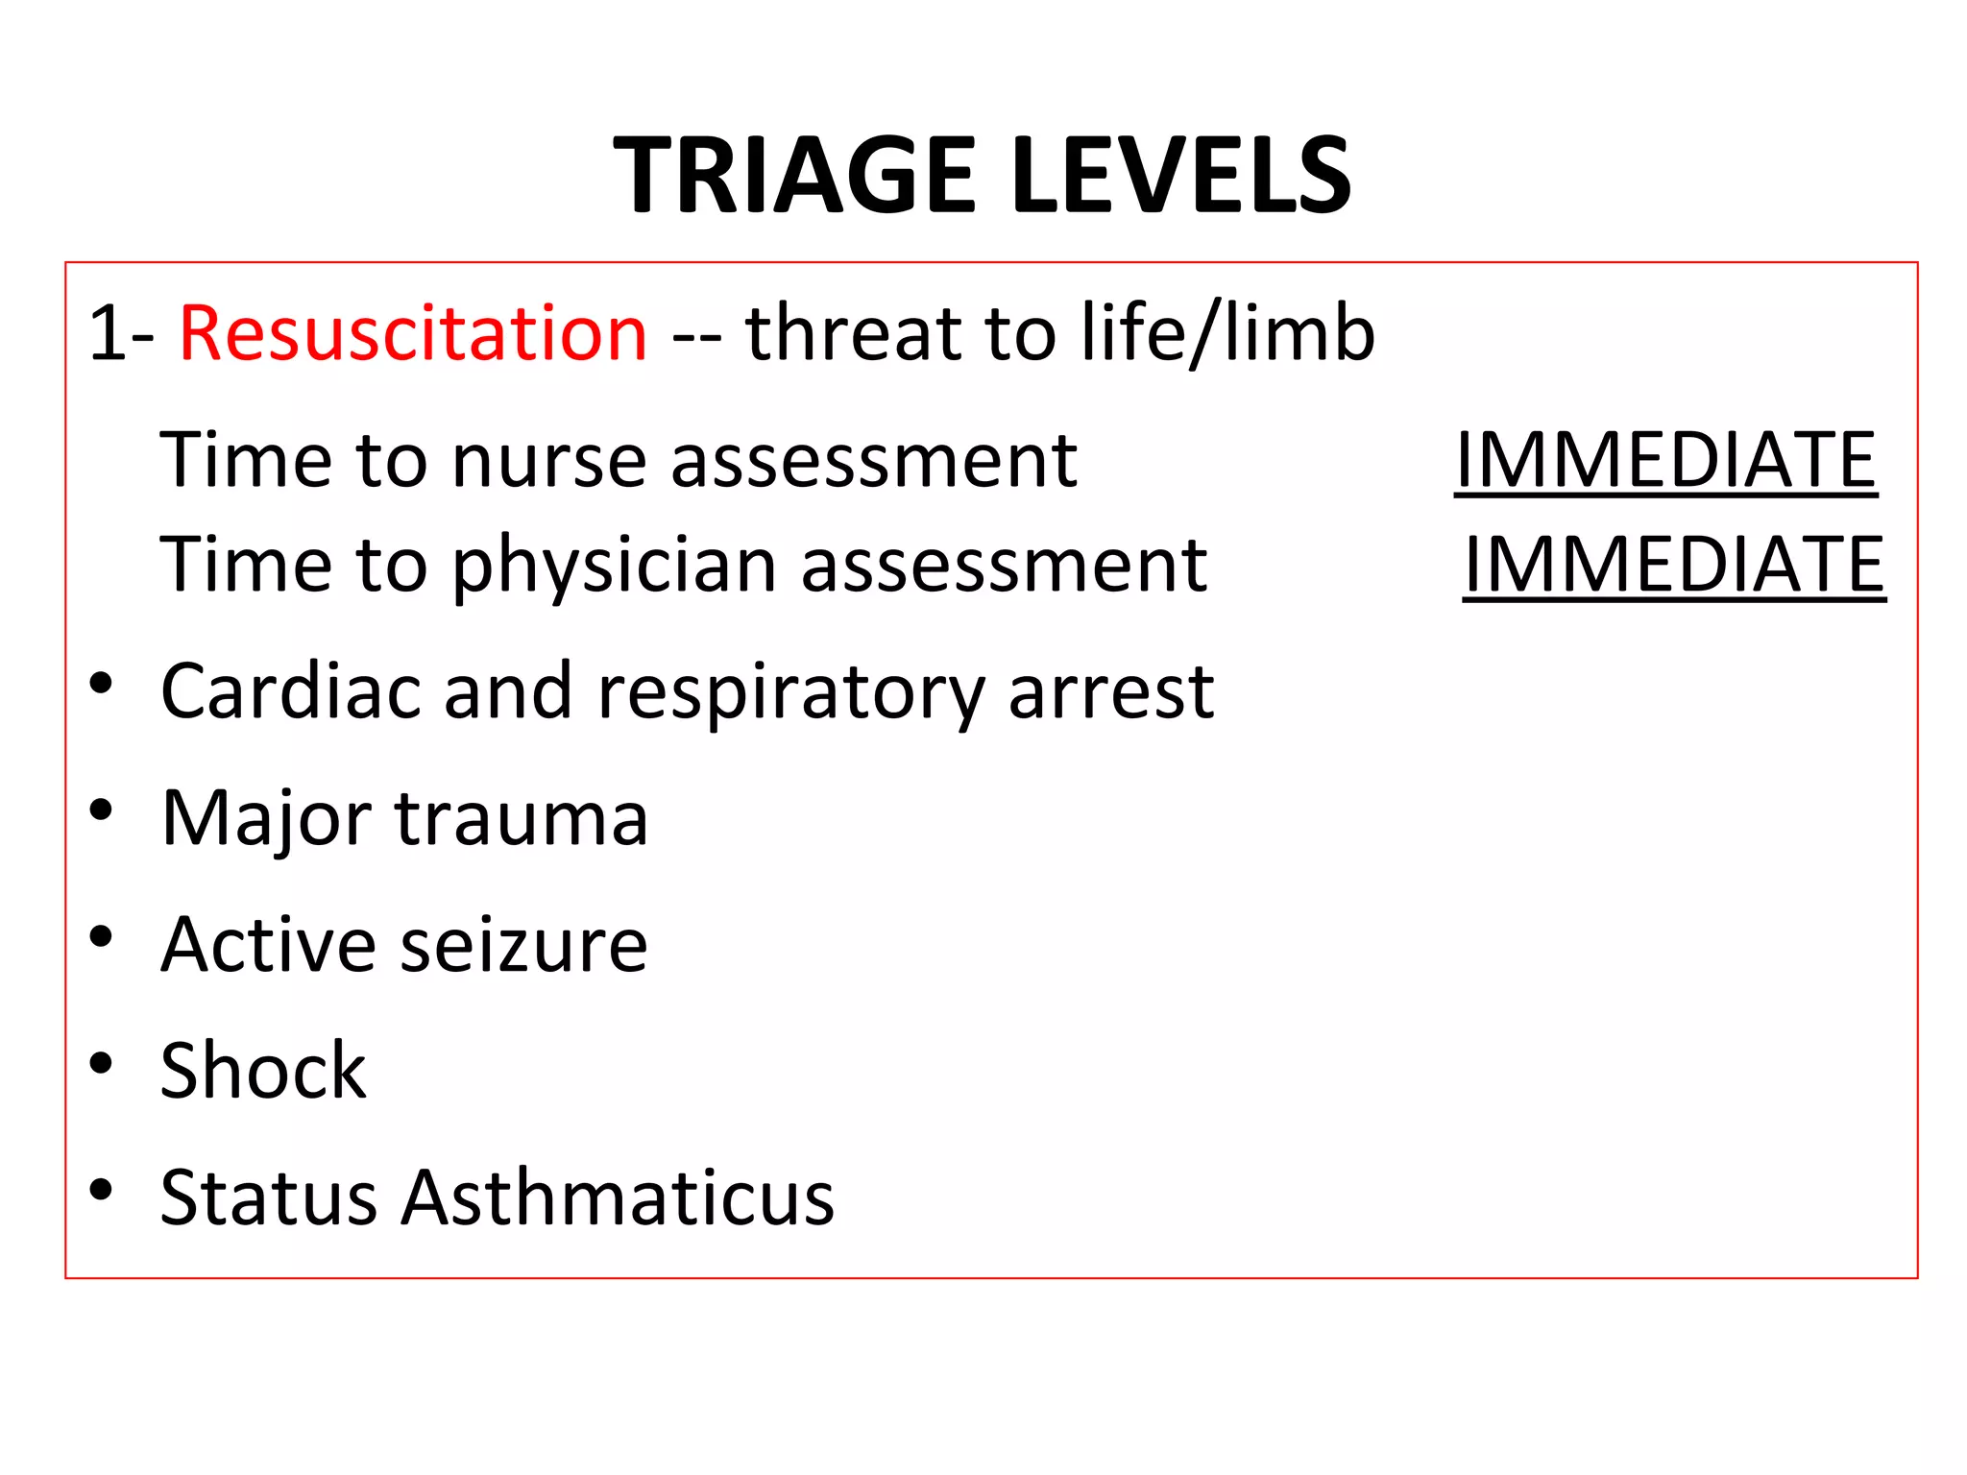

Slide 11
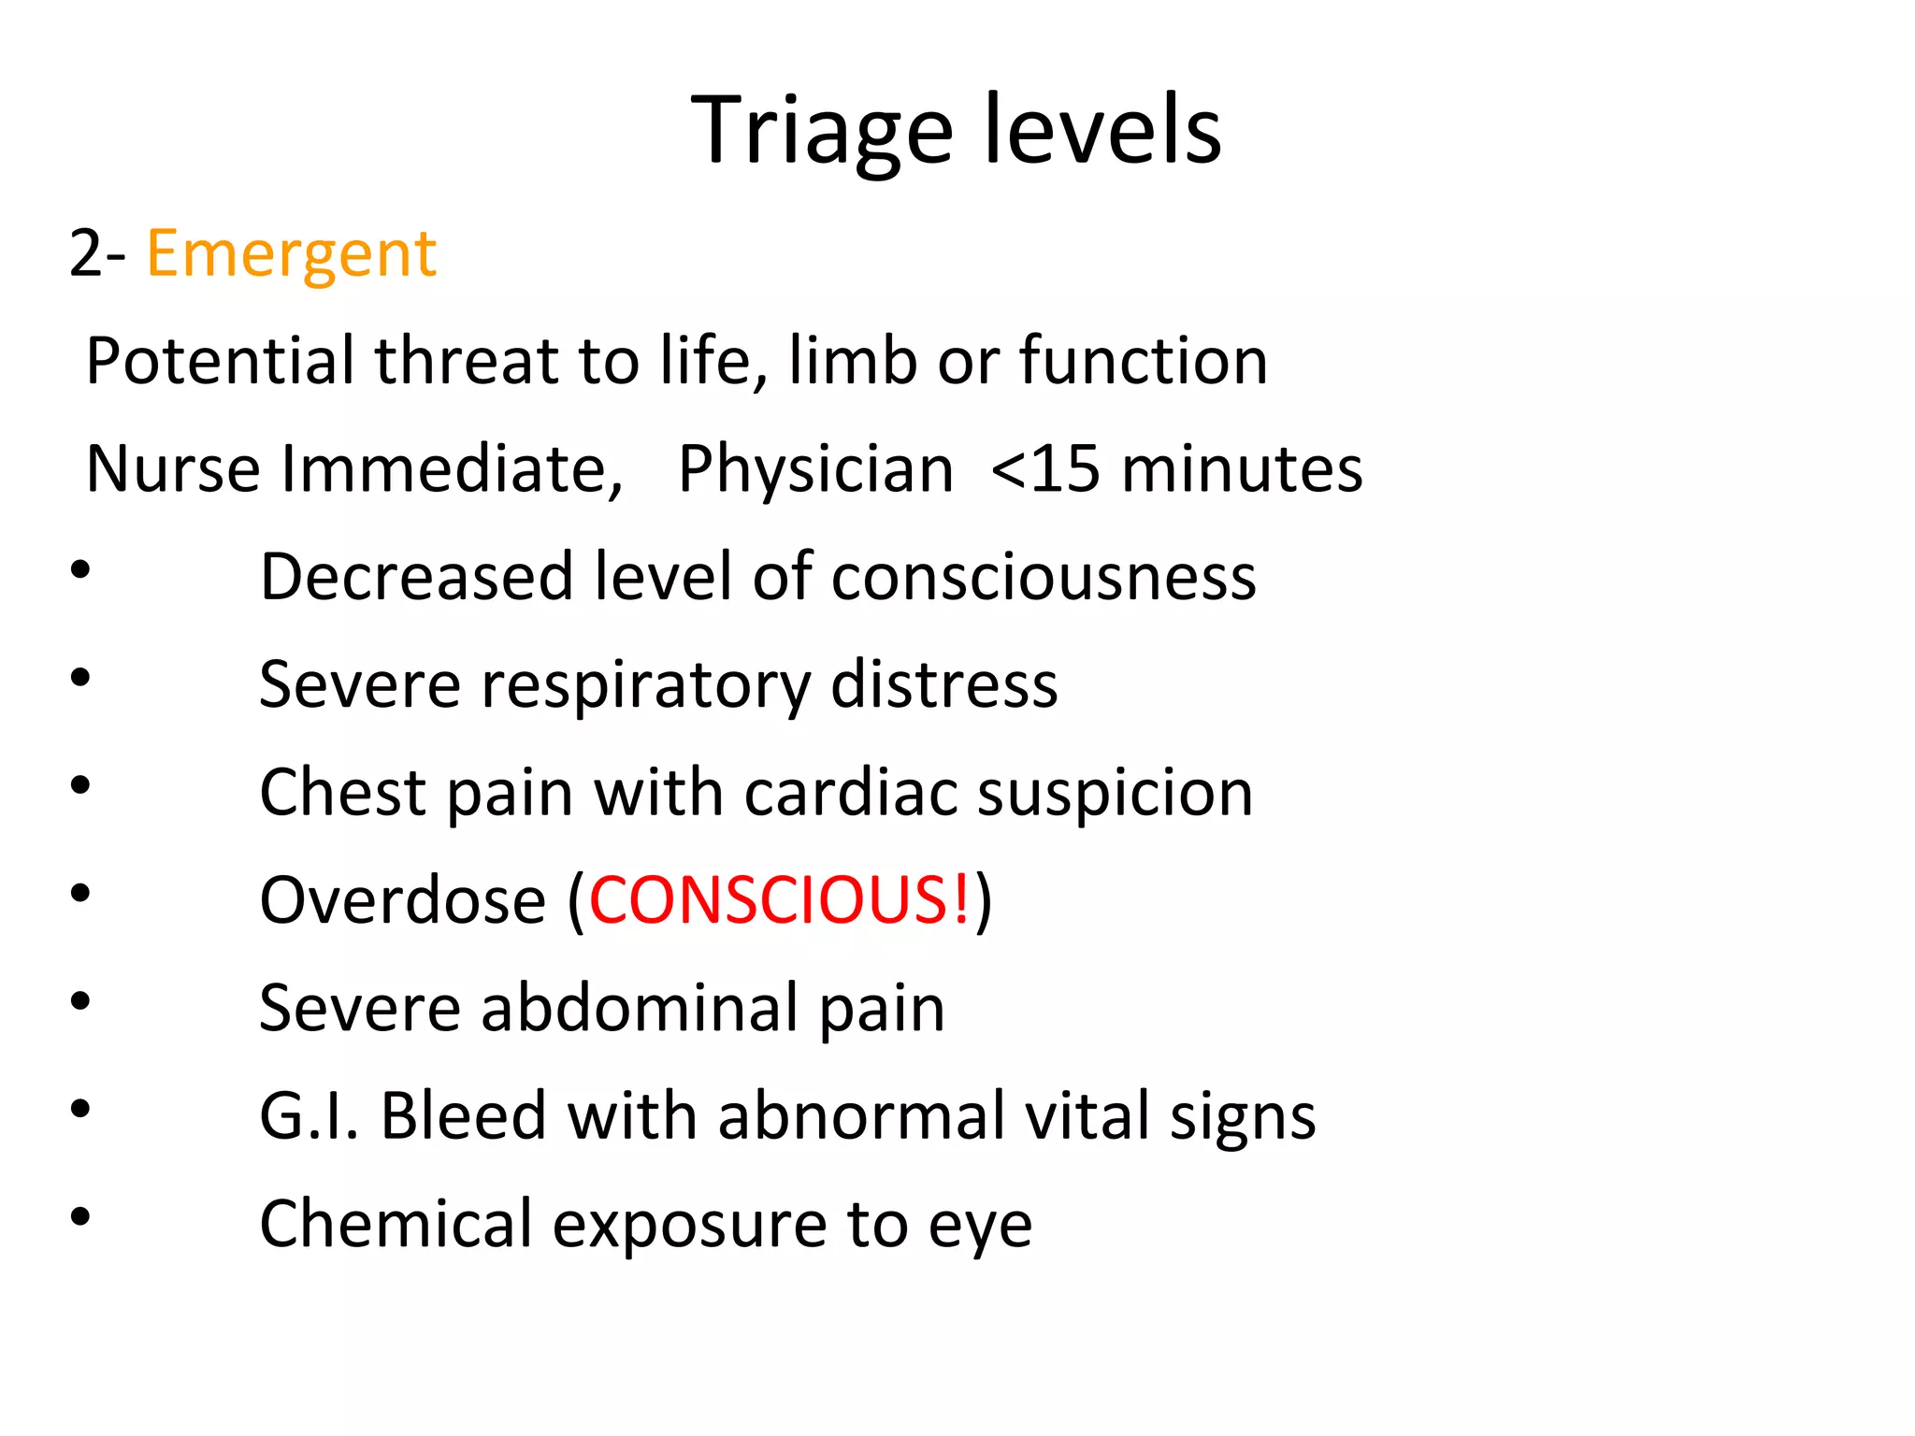

Slide 12
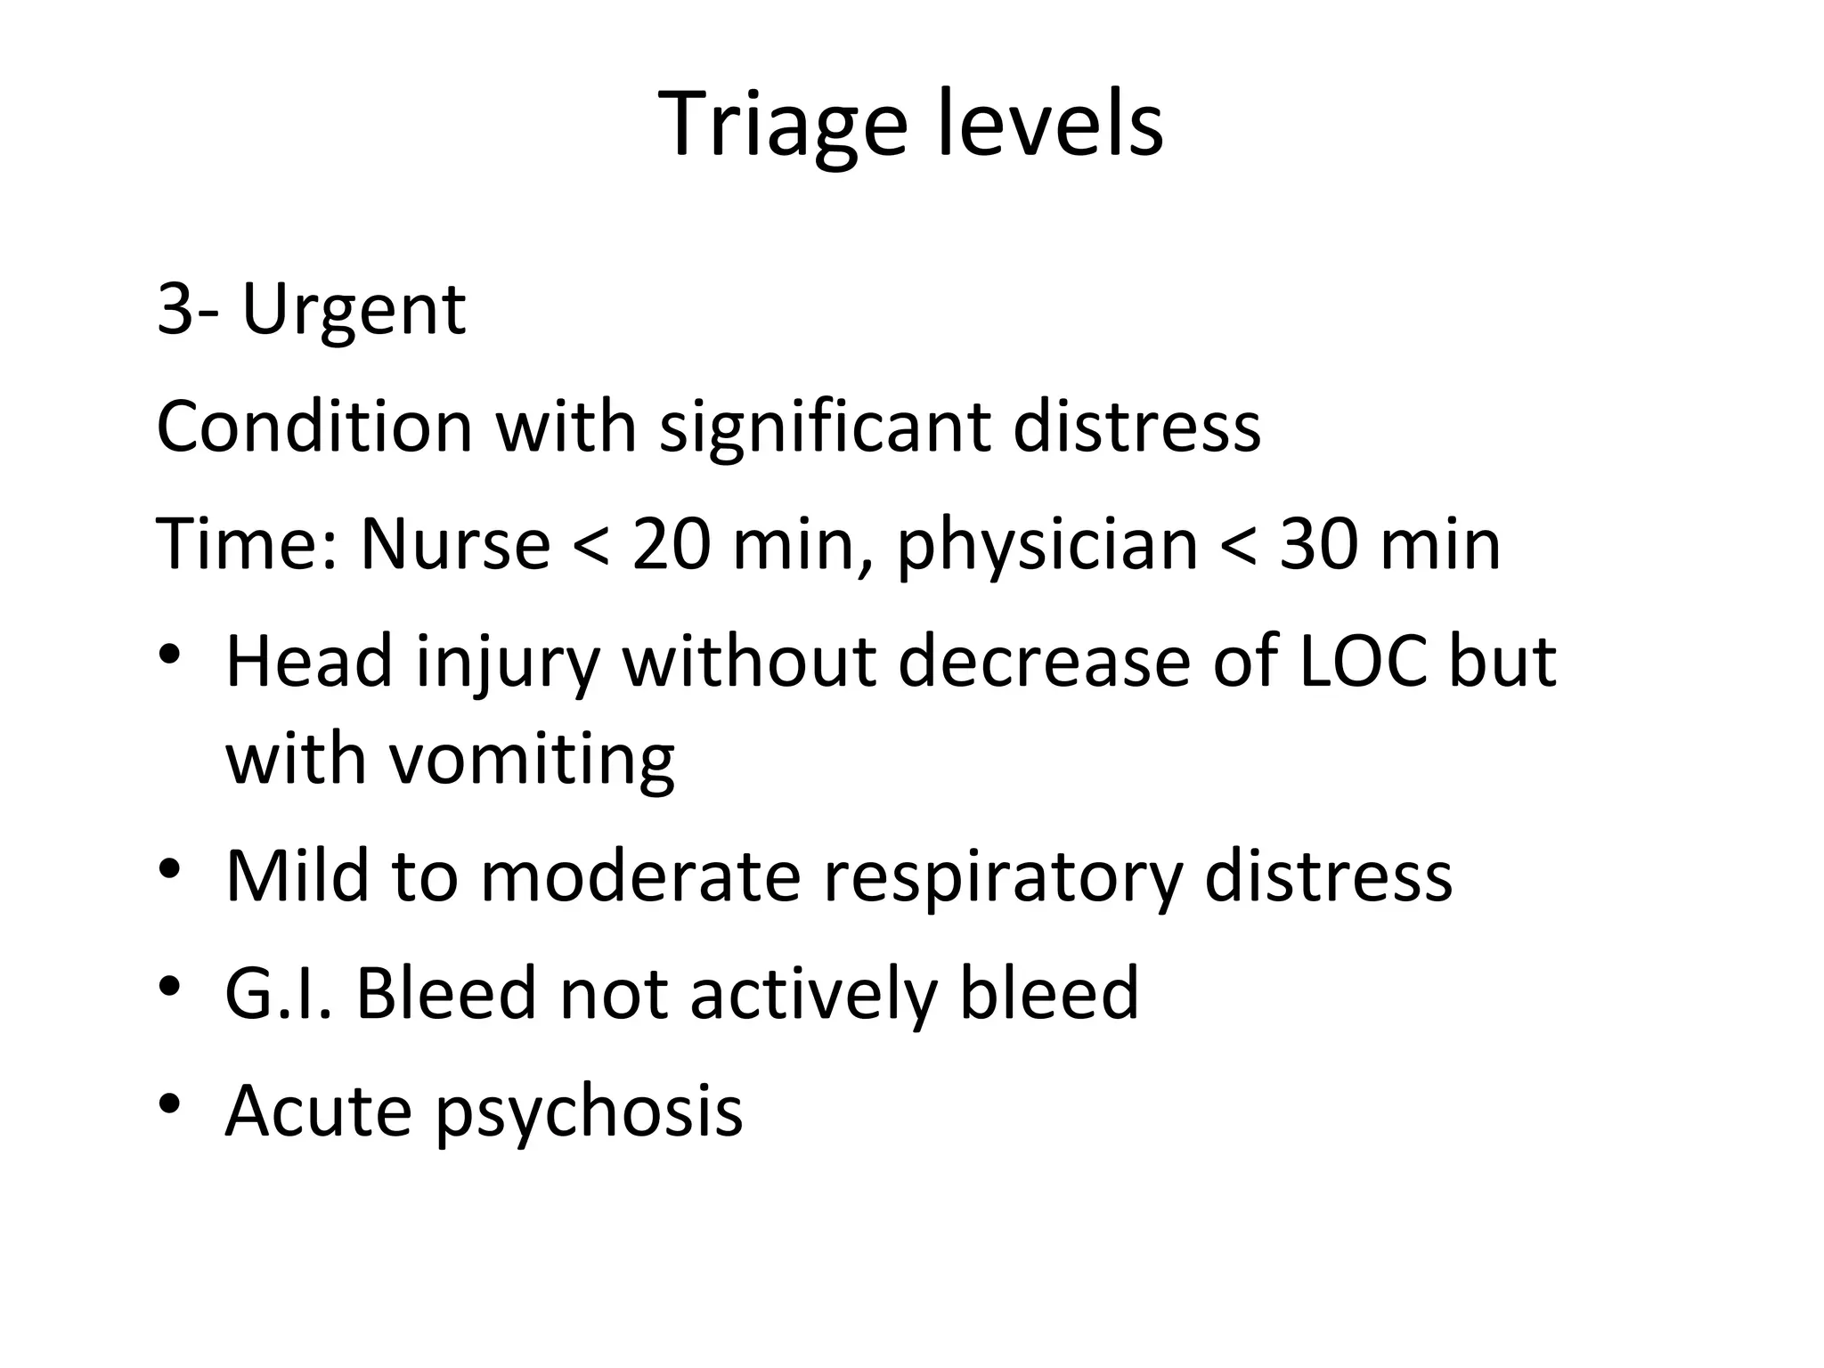

Slide 13
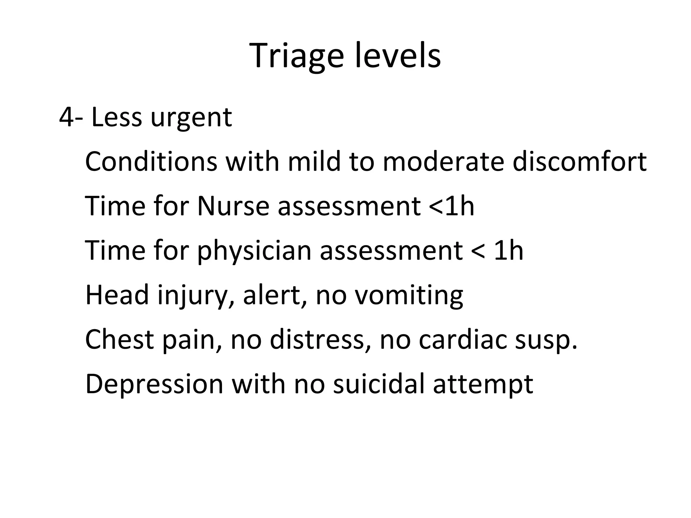

Slide 14
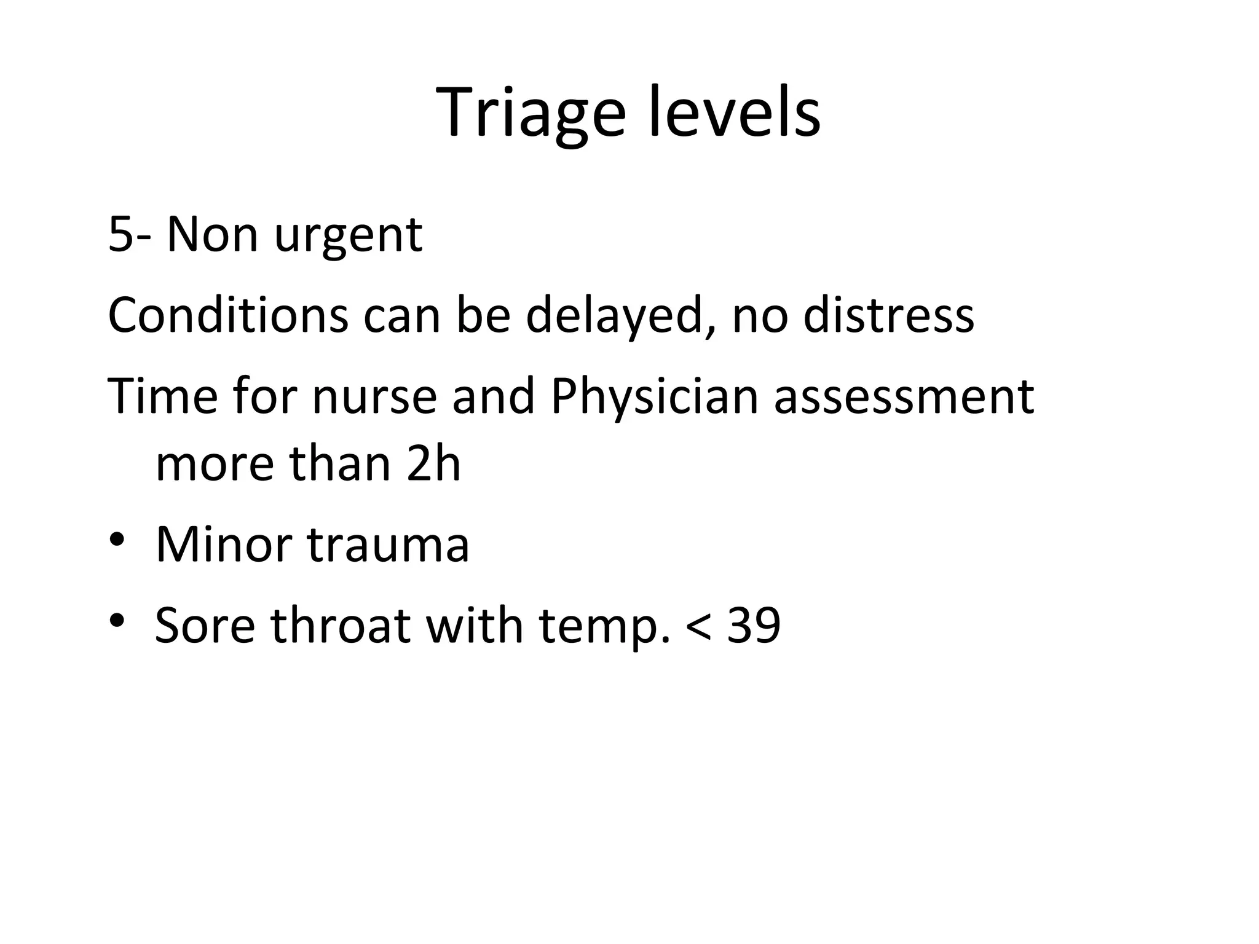

Slide 15
Basic component of triage :
Across the room assessment
Primary assessment
Secondary assessment
The triage decision

Slide 16
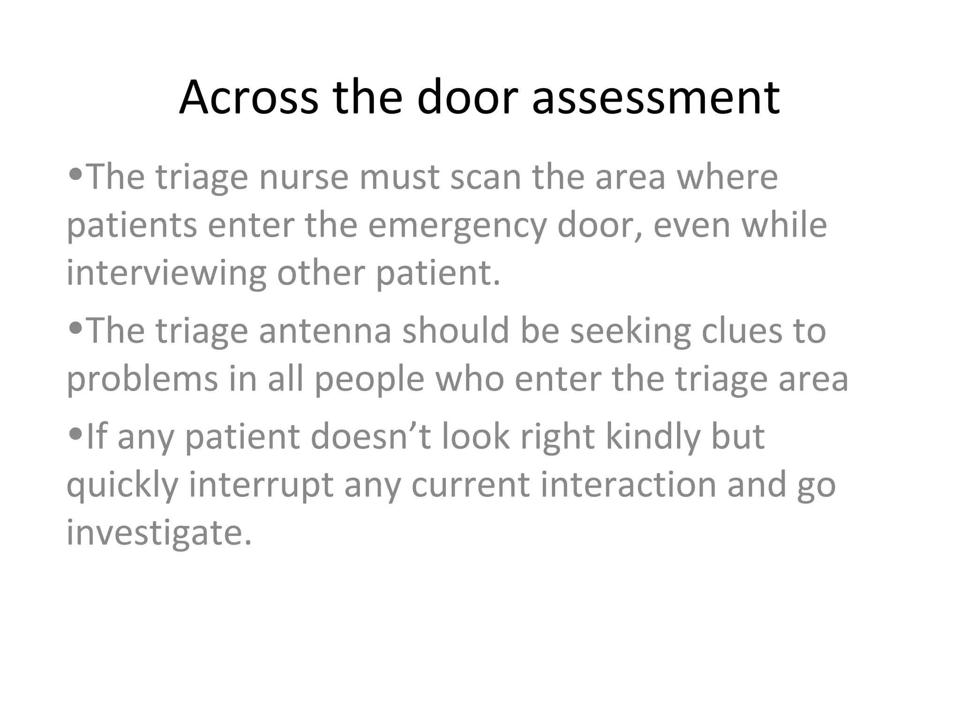

Slide 17
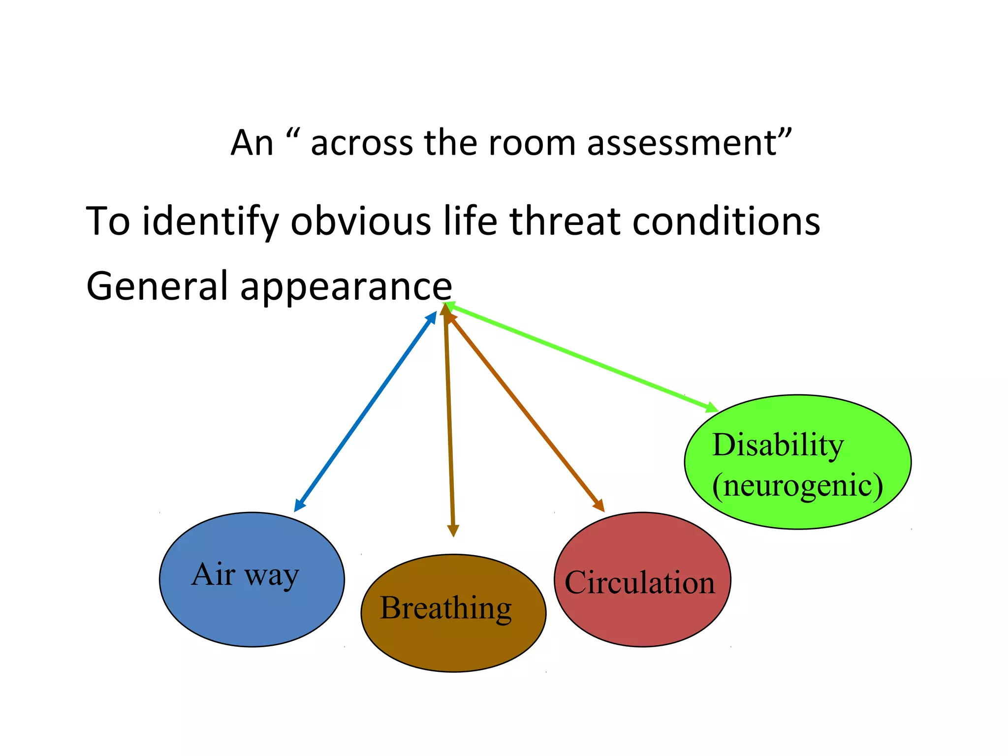

Slide 18
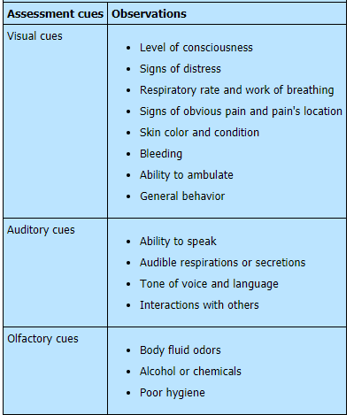
ACROSS-THE-ROOM ASSESSMENT

Slide 19
Primary assesses
A. B. C. D. E
A : air way
B :breathing
C:circulation
D:disability
E:exposure

Slide 20
PRIMARY ASSESSMENT
Parameter | Assessment | Interventions
Circulation | Pulse and blood pressure Bleeding or hemorrhage Capillary refill time, color of skin and mucous membranes Cardiac rhythm | Administer cardiopulmonary resuscitation, medications, and defibrillation or synchronized cardioversion. Control hemorrhaging by applying direct pressure. Establish IV access and administer IV fluids (isotonic fluids and blood products), as ordered. Treat life-threatening conditions.
Airway | Airway patency | To open the patient's airway, stabilize the patient's neck and maintain it in a midline position, then perform the head-tilt chin-lift maneuver or, if you suspect a cervical spine injury, the jaw-thrust maneuver.
Breathing | Respirations (rate, depth, and effort) Breath sounds Chest wall movement and chest injury Position of trachea (midline or deviation) | Administer 100% oxygen with an appropriate device (such as a bag-valve mask). Use airway adjuncts (oral or nasal airway, endotracheal tube, esophageal-tracheal Combitube, cricothyrotomy, or supraglottic airway), as indicated. Provide suction, as needed. Remove foreign bodies that may obstruct breathing. Treat life-threatening conditions.
Disability | Neurologic assessment, including level of consciousness, pupil reactivity to light, and motor and sensory function | Immobilize the patient's cervical spine until X-rays confirm the absence of cervical spine injury.
Exposure and environment | Injuries and environmental exposure (extreme cold or heat) | Institute warming therapy for hypothermia or cooling therapy for hyperthermia.

Slide 21
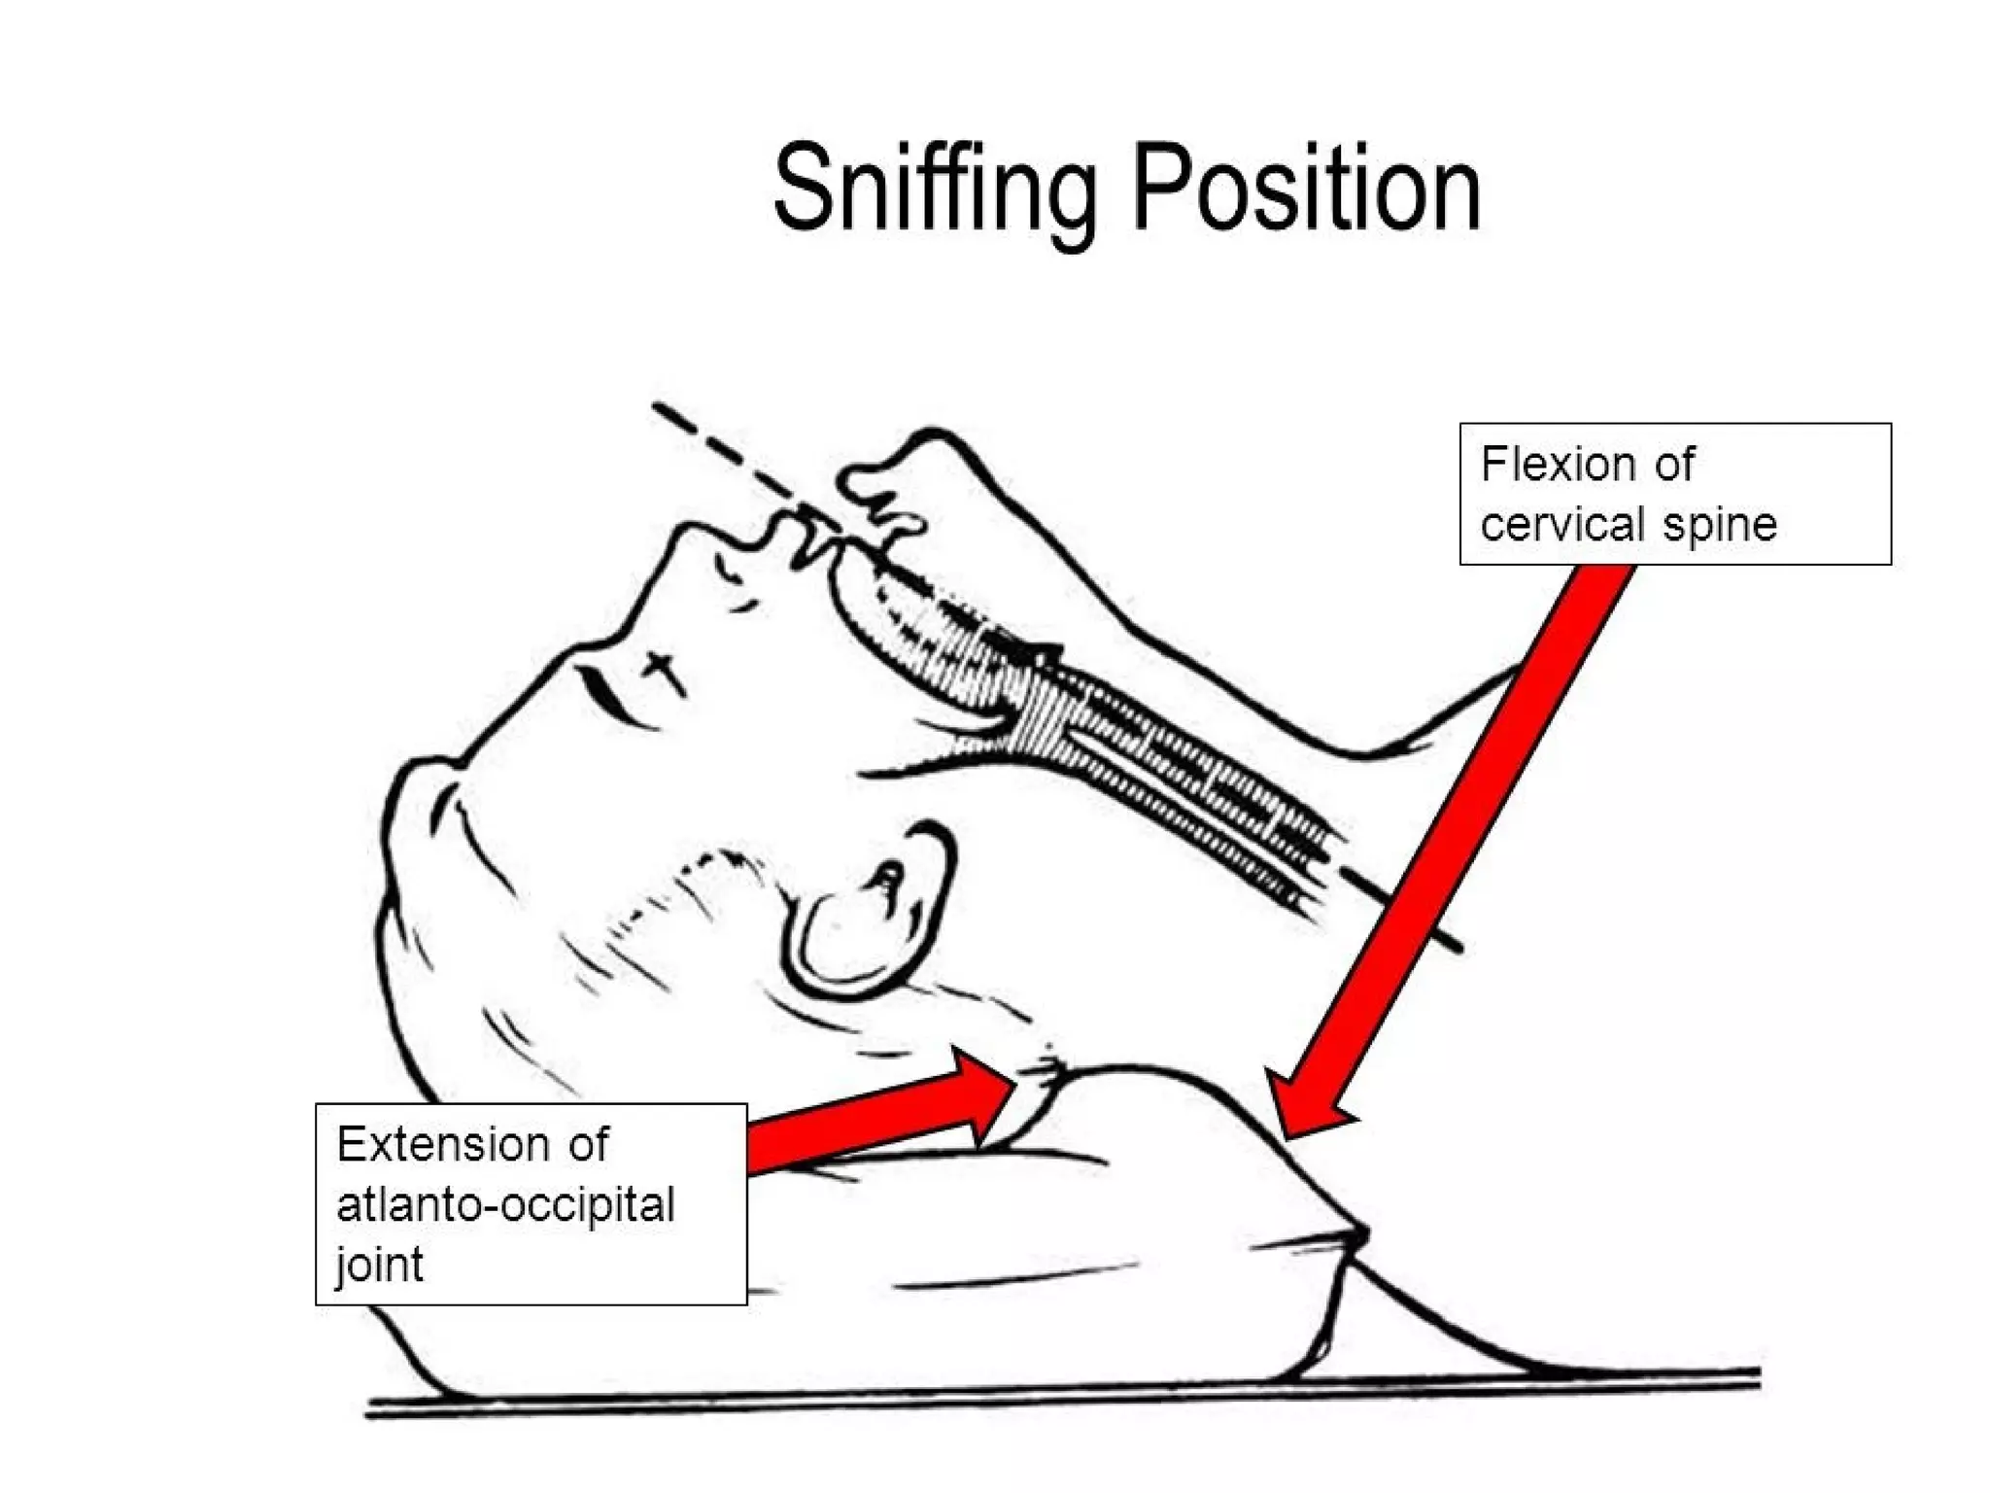

Slide 22
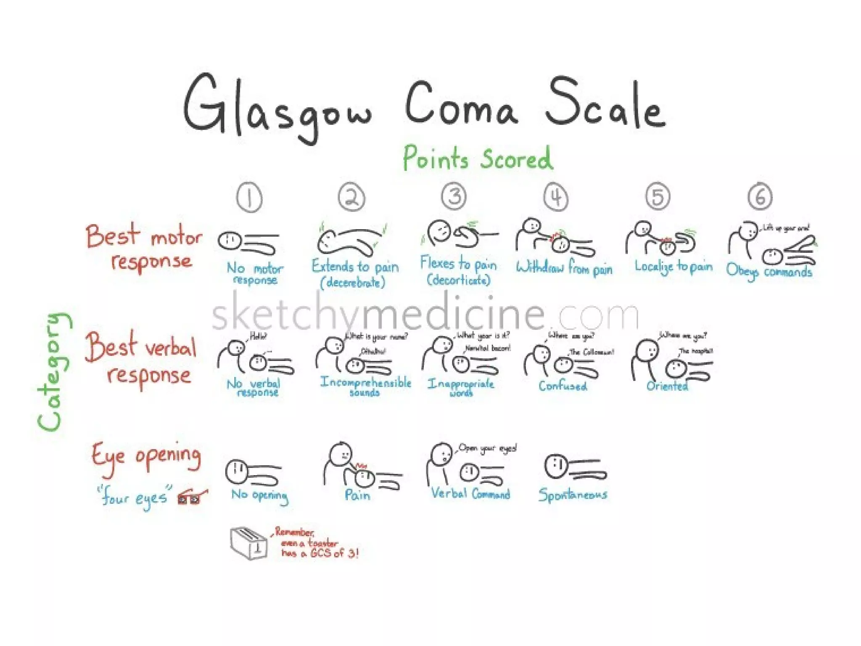

Slide 23
Secondary assessment

Slide 24
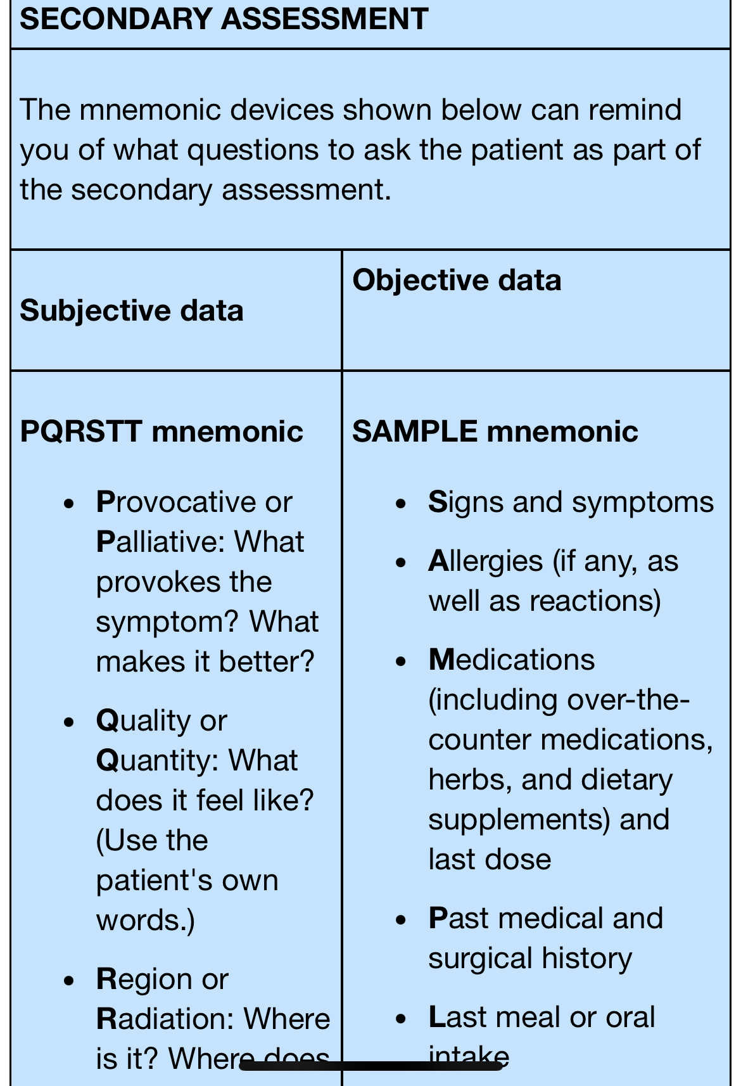
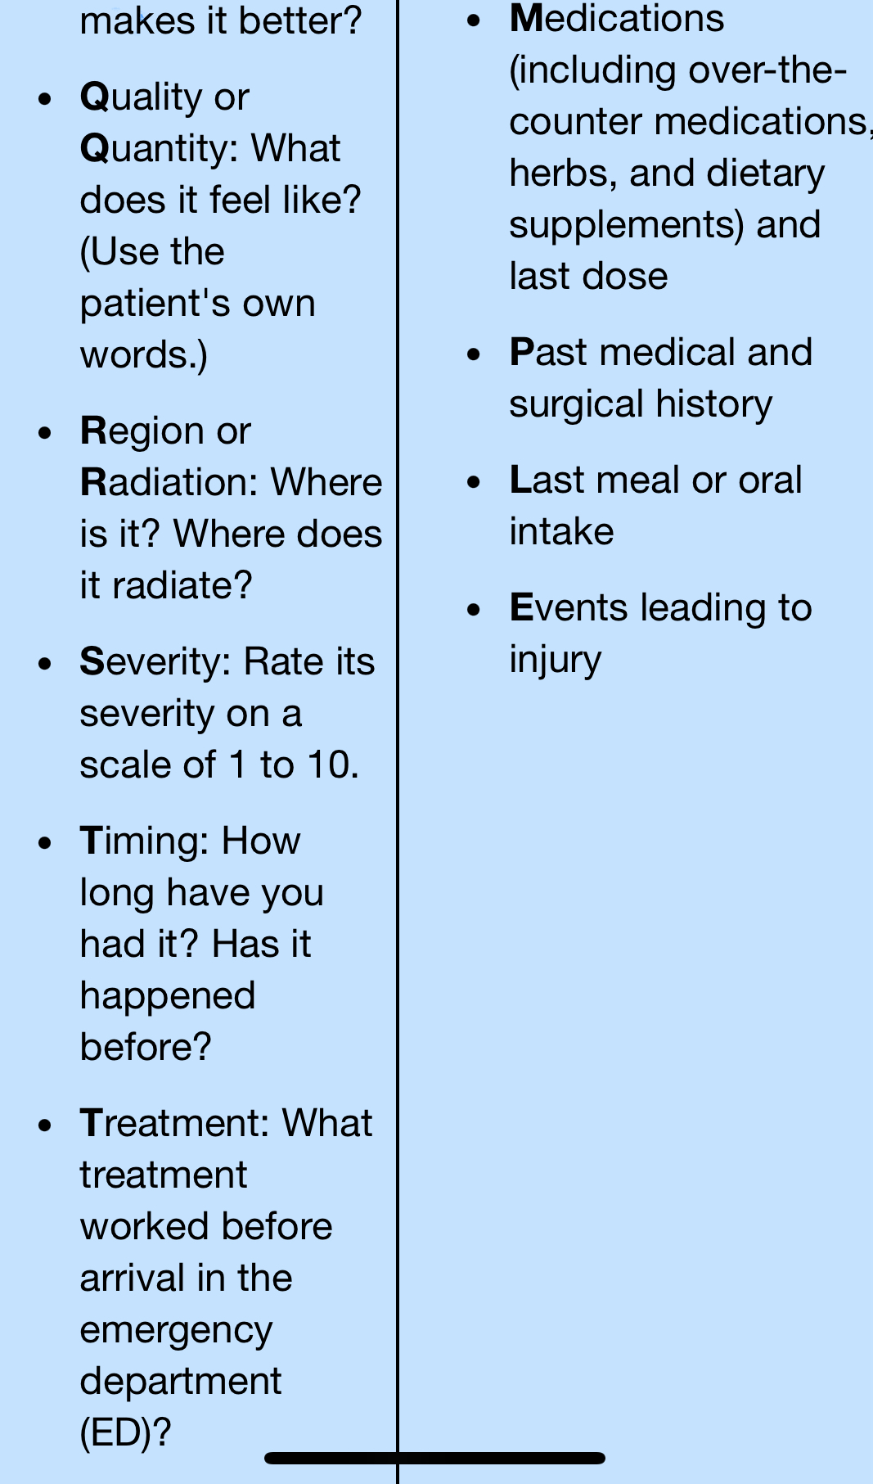

Slide 25
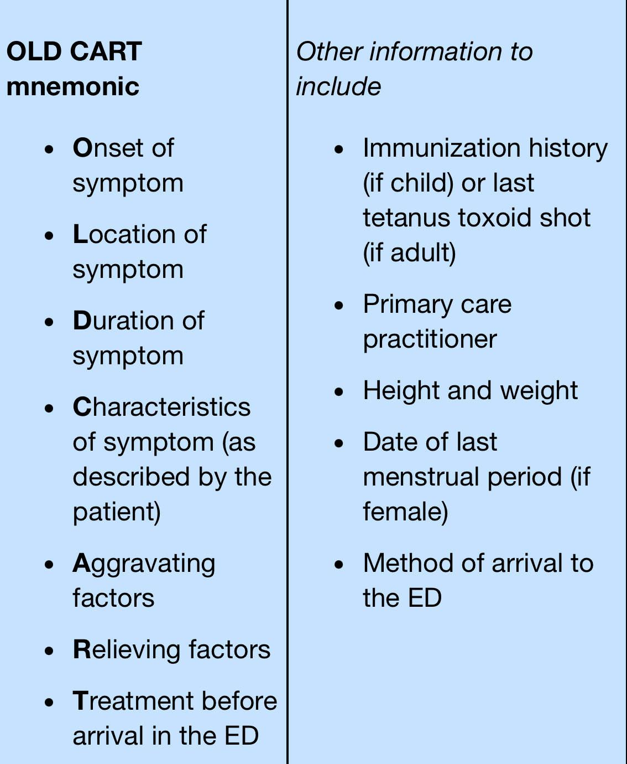

Slide 26

Typical Information Elements Gathered at the Point of Triage
Name.
Age.
Gender.
Chief complain.
History of present illness.
Mechanism of injury.
Past medical and surgical history.
Allergy.
Medication.
Tetanus.
Last menstrual period.
Level of consciousness.
Skin and vital signs.

Slide 27
Documentation associated with ED triage includes:
sufficient (but brief and clear) information
timelines relating to care
patient's primary concern
relevant subjective and objective data relating to the primary concern
medications (prescription and over-the-counter)
allergies
vital signs
pain evaluation
care initiated
reevaluation performed

Slide 28
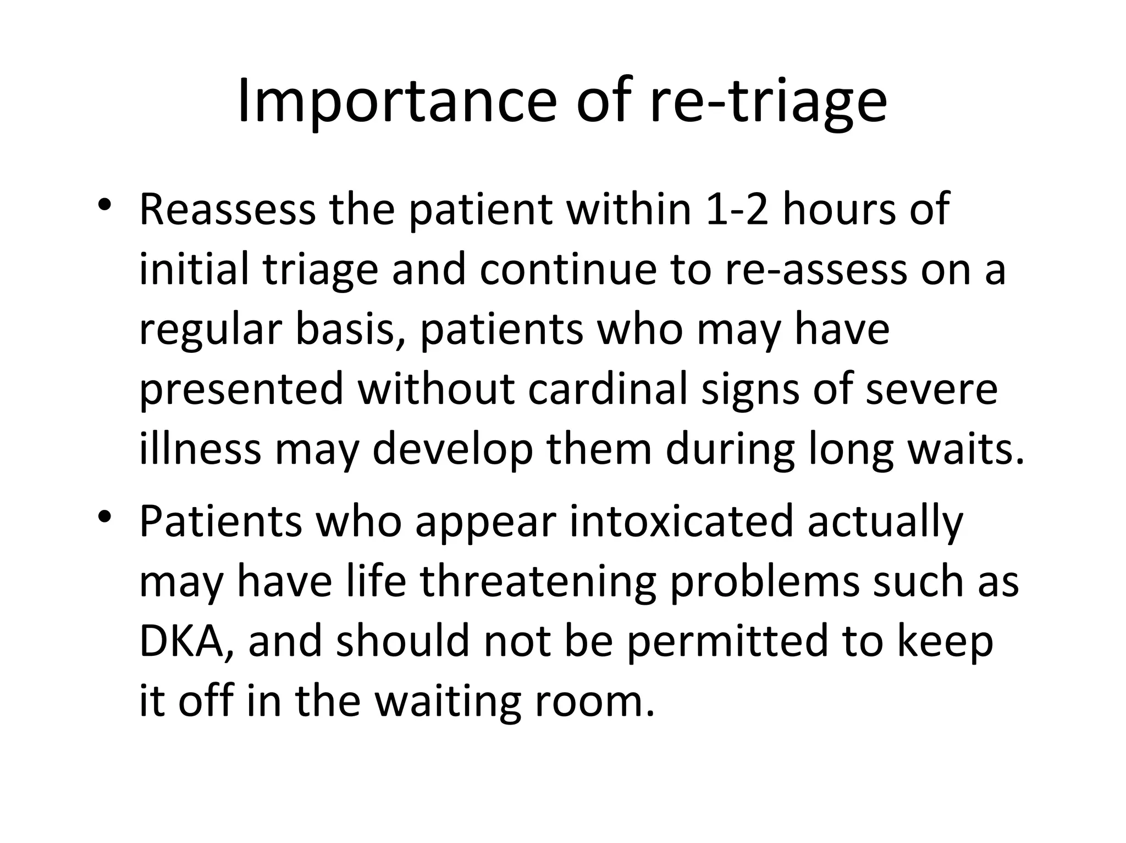

Slide 29


